Slide 1
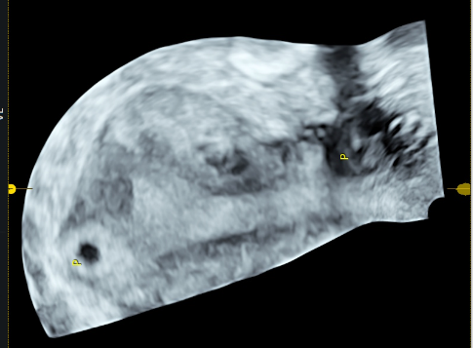
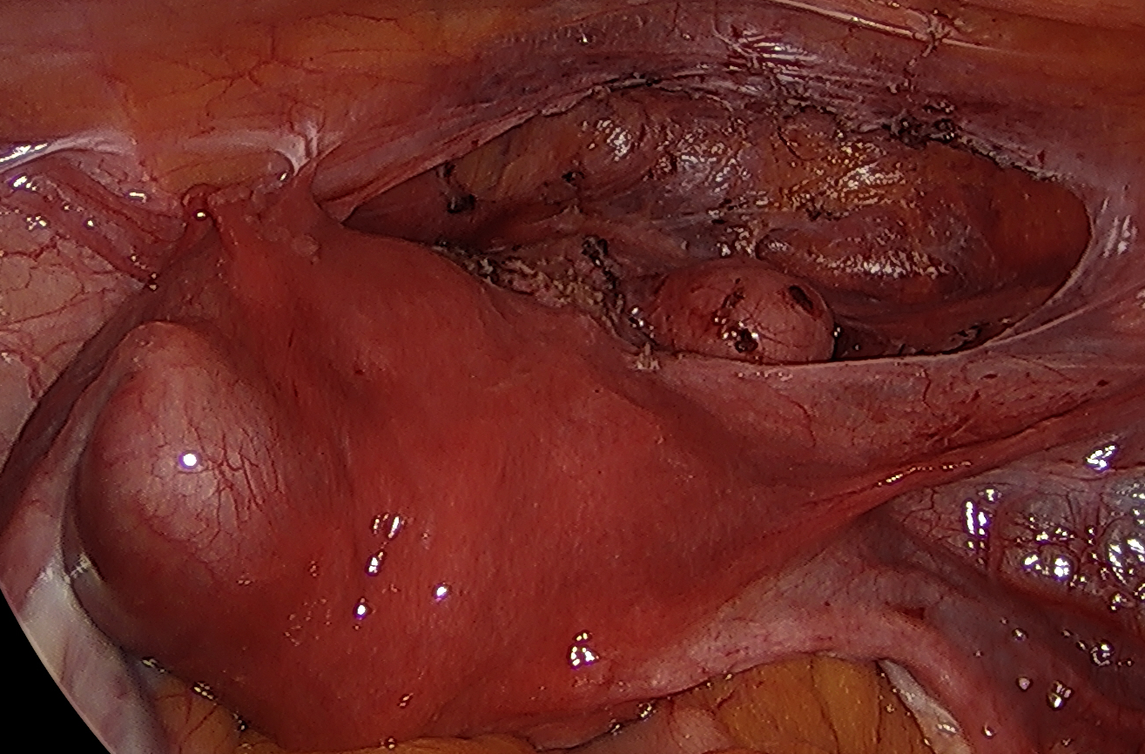
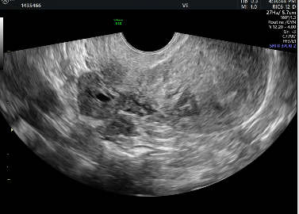
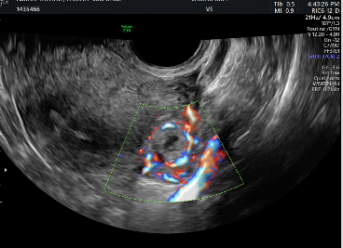
Double Trouble: Two Site Pregnancy Pathology – A Laparoscopic Double Take
Dr. Brendon Jones¹, Dr. Christine Thuy Trang Tran¹, Dr. Elisabeth Smet¹, Dr. Alexander Chen^{1,2}
Department of Obstetrics and Gynaecology,, Westmead Hospital, Westmead, NSW 2145
Department of Obstetrics and Gynaecology, Auburn Hospital, Auburn, NSW 2144
Case
A 40-year-old G3P1+1-1 presented at 7+5 days gestation following a double embryo transplant overseas with highly suspicious ultrasound imaging of a suspected left interstitial ectopic pregnancy with an overlying myometrium thinned to 1.5mm and concurrent right sided Caesarean Scar Pregnancy (CSP) protruding through the myometrium, with no overlying visible myometrium. The b-HCG level was 7626. Obstetric history included a previous 28-week Caesarean Section delivery of twins due to severe preterm preeclampsia and loss of one twin at 23 weeks. Following this she had a miscarriage overseas at an early gestation. All her pregnancies were conceived via IVF. A diagnostic laparoscopy to assess endometriosis prior to her first pregnancy was her only other previous surgical procedure. She was otherwise well.
Figure 2: On the left is a Laparoscopic view of the pelvis after opening the bladder peritoneum. In the lower left the left interstitial ectopic pregnancy can be seen. Within the exposed lower segment the suspected CSP can be seen. On the right is the corresponding composite Ultrasound image oriented to align with the laparoscopic view. The two suspected pathologies are labelled "P".
Management
The patient’s main concern in this case was ongoing fertility and she declined the recommended management of hysterectomy. The high risk of rupture with medical management was deemed too high risk due to the thin myometrium overlying both suspected products of conception. In recent literature, CSP management leans towards early surgical treatment and intralesional methotrexate compared with systemic methotrexate which is not recommended.¹ Recent literature regarding Interstitial pregnancies does not advocate strongly for either surgical or medical management but also reports increased success rates for surgical and local methotrexate compared to systemic methotrexate.² With two concurrent pathologies a tailored laparoscopic approach was developed. The suspected CSP was first exposed to separate the adherent bladder, and the bladder was reflected. The CSP was excised with Harmonic following the identification of a trophoblastic tail growing into the uterus and the uterine niche was repaired concurrently. This was followed by a left cornuectomy and salpingectomy. Prior to the excision of both suspected products of conception, vasopressin was infiltrated circumferentially. Both suspected pregnancies were successfully removed and both myometrial defects were closed in two layers. A cystoscopy was performed post repair to confirm no bladder injury and to identify bilateral ureteric jets.
Results/Findings
Histopathology of the excised specimens showed products of conception in the interstitial pregnancy and surprisingly the suspected CSP histopathology was reported as endometriosis infiltrating the scar.
Discussion
In the history of this presentation, the double embryo transfer led to concerns of a complex management dilemma with the potential for concurrent non-viable pregnancies. Fertility being the main worry for the patient also impacted the management decisions made. The interstitial pregnancy returned as expected, but the surprise finding was the endometriosis of the caesarean scar.
Caesarean scar endometriosis (CSE) is an uncommon disease, thought to arise via the iatrogenic cell implantation theory, which most commonly localises to the corners of the hysterotomy scar, as was the case in this presentation.³ The incidence of CSE is rising with increasing CS rates. The majority of CS Endometriomas arise in previous Pfannenstiel incisions. Our patient had a previous history of endometriosis, but had been treated for this surgically, and showed no evidence of other sites of endometriosis.
Figure 3: Laparoscopic view of the pelvis following Harmonic excision of the suspected CSP, uterine niche repair, left cornuectomy, and salpingectomy
A
Conclusions
This presentation outlines the unique fertility sparing surgical approach in conjunction with uterine niche repair to manage concurrent pathologies while aligning with the patient’s concerns for potential future childbearing.
References
1. Petersen, K.B., Hoffmann, E., Larsen, C.F. and Nielsen, H.S. (2016). Cesarean Scar Pregnancy: A Systematic Review of Treatment Studies. Fertility and Sterility 105(4): p. 958-967
2. Brincat, M., Bryant-Smith, A. and Holland, T.K. (2019). The Diagnosis and Management of Interstitial Ectopic Pregnancies: A Review. Gynaecological Surgery 16:2
3. Zhang, P., Sun, Y., Zhang, C., Yang, Y., Zhang, L., Wang, N. and Xu, H. (2019). Caesarean scar endometriosis: presentation of 198 cases and literature review. BMC Women’s Health 19: Article 14
B
Figure 1: Ultrasound images on presentation. The image labelled A shows the suspicious caesarean scar pathology in the lower segment. Image B shows the doppler image of the caesarean scar pathology.

