Slide 1
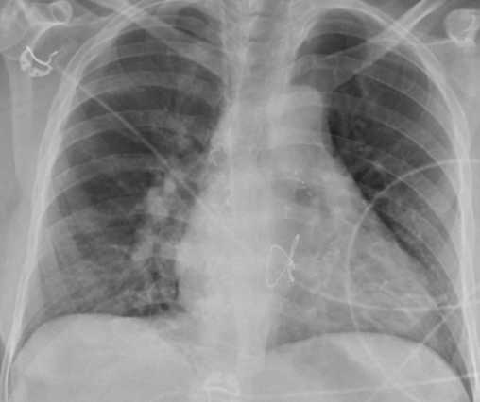
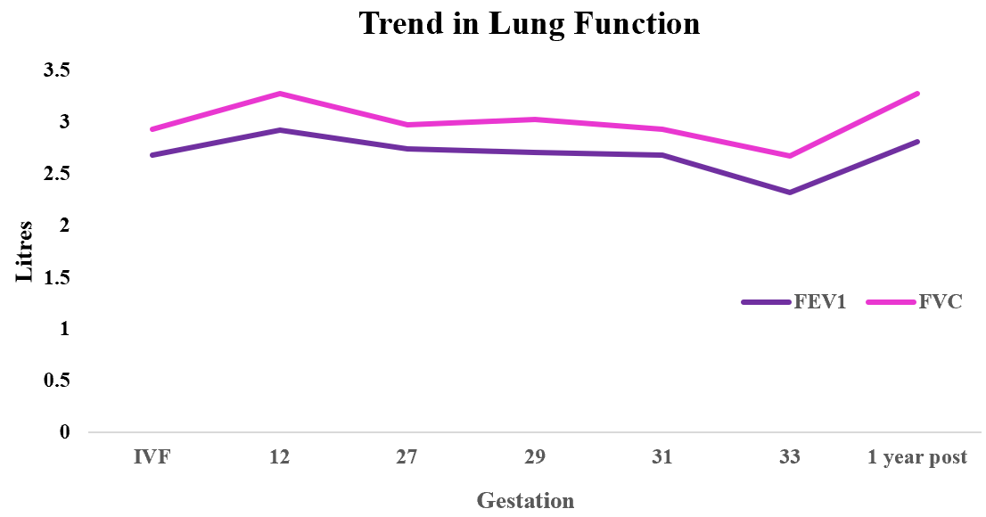
Successful Pregnancy in a patient with Cystic Fibrosis after double lung transplant complicated by pre-eclampsia
Dr K. Warwick.¹, A/Prof I. Alahakoon.¹ Prof P.Middleton ²
¹ Institute of Maternal Fetal Medicine, Department of Obstetrics and Gynaecology, Westmead Hospital, ² Department of Respiratory and Sleep Medicine, Westmead Hospital
Introduction
Cystic Fibrosis (CF) is an autosomal recessive condition due to mutations in the cystic fibrosis transmembrane conductance regulator (CFTR) gene. As a result of improved therapies and interventions, particularly with the introduction of CFTR modulators, the life expectancy of people diagnosed with CF is now estimated >50 years (1-2) . Lung transplantation still forms an important aspect of disease treatment for severe and end stage CF, and as of 2023 in Australia, of the 3798 people living with CF, 118 had received lung transplants (3). Although CFTR modulators are improving CF disease severity, CF remains the most common indication for lung transplantation under the age of 50 accounting for 17% of all lung transplants (4- 6). As the life expectancy continues to increase, more individuals with CF are pursuing pregnancy with 88 recorded in 2023 in Australia (with 52% live birth rate) (3). Adverse outcomes from CF pregnancies with lung transplants remain higher due to higher rates of graft rejection and lower successful birth rates (2).
Patient Presentation
A 30-year-old female G0P0 with Phe508del homozygous CF and bilateral lung transplant presented for IVF after two years of infertility and eight years post transplantation. Prior to commencing IVF, Mycophenolate was changed to Azathioprine and Tacrolimus for immunosuppression, and the patient was continued on regular prednisolone, Bactrim, and CF medications.
Lung function was normal (FEV1 2.92L / FVC 3.28L) with stable graft function and no signs of graft rejection prior to IVF and pregnancy. The patients BMI was 22.
Co-morbidities: CF related Diabetes (CFRD) (HbA1c 10.2%), managed with insulin. Hypertension (HTN) managed with Irbesartan. Osteoporosis, transplant-related neuropathy, and multi-resistant pseudomonas colonisation.
The patient achieved a successful pregnancy after the third embryo transfer, and at time of conception had a HbA1c 6.0%.
Clinical Course
The patient was commenced on Aspirin and Labetalol at 13 weeks gestation. Investigations demonstrated low risk aneuploidy screening and a normal morphology ultrasound. Tacrolimus levels were monitored weekly and titrated by the transplant team. Regular growth ultrasounds demonstrated good growth intervals, and regular respiratory function testing demonstrated stable lung function (figure 2).
The patient was admitted at 32 weeks gestation with pre-eclampsia (PET).
At 33 weeks and 2 days gestation, the patient developed new onset dyspnoea with new oxygen requirements. Examination revealed increased peripheral oedema, a mildly raised JVP, and bilateral chest crepitations. Chest X-ray (figure 1) demonstrated an enlarged cardiac silhouette (when compared with previous imaging) and a transthoracic echocardiogram demonstrated normal right ventricular function with left ventricular ejection fraction 61%.
At 33 weeks and 3 days, an uncomplicated emergency caesarean section with neuraxial analgesia was completed due to concerns for maternal wellbeing with progressing pre-eclampsia and concern for declining respiratory function (figure 2) and possible graft dysfunction. Neonate birth weight 2320g, APGAR 9/9.
The patient had a 2-day admission to ICU post caesarean for close monitoring of blood pressure and respiratory function, and was discharged day 6 with an uncomplicated post-operative recovery. Lung function returned to normal in the post-partum period
Discussion
Normal pregnancy respiratory changes include reduced functional residual capacity (FRC), expiratory reserve volume (ERV), and residual volume (RV), FEV1 and FVC remain unchanged. Patients with lung transplants demonstrate similarly predictable changes (7), whereas CF patients have a decline in FEV1 & FVC in the third trimester (8). Changes in these values in patients with CF & lung transplants require further investigation.
In patients with CF, evidence suggests pregnancy does not result in significant deterioration in lung function, progression of disease, or immediate increase in mortality. (9, 10, 11) However, for pregnant patients with lung transplants, pregnancy is a period of higher rates of acute rejection, post-partum graft loss, and increased risk of mortality after pregnancy (40% survival rate at 10 years) (5, 12).
Patients with CF and lung transplants have higher rates of pre-term births, gestational diabetes, low birth weights, HTN, and PET. (5, 7, 12, 13) Overall, rates of PET are higher in patients with lung transplants (6-13%) than the general population (2-10%). (12)
Recommended mode of delivery in patients with CF and lung transplants is vaginal delivery due to reduced risks of blood loss and infection rates. (12) The decision for a caesarean section should be indication for obstetric indications or severe deterioration in maternal condition (13).
All immunosuppressant medications cross the placenta. Mycophenolate may be associated with increased risks of congenital malformations and is recommended to be ceased prior to pregnancy. No pattern of congenital malformations have been associated with Tacrolimus, steroids, or Azathioprine (14, 15).
Conclusion
This case demonstrates a high-risk medically complex pregnancy illustrating multiple challenges in management across the pre-natal, antenatal, intra-partum and postpartum period. It demonstrates the importance of pre-pregnancy counselling and multi-disciplinary involvement. Clear and open discussions of the risks of such pregnancies are integral to informed decision making by these patients.
Figure 1
.
Figure 2
7 Thakrar MV, Morley K, Lordan JL et al., Pregnancy after lung and heart-lung transplantation. The Journal of Heart and Lung Transplantation. 2014: 33(6); 593-598. doi.org/10/1016/j.healun.2014.02.008.
8 Wu, C., Wu, G., Fukushima, L., Rao, A.P. and Baydur, A. Spirometric Changes during Pregnancy in Cystic Fibrosis Patients. Open Journal of Respiratory Diseases. 2021; 11: 19-25. doi.org/10.4236/ojrd.2021.111002
9 Lau EM, Barnes DJ, Moriarty C, etal.. Australian and New Zealand Journal of Obstetrics and Gynaecology. 2011; 51 (3): 220-224. doi: 10.1111/j.1479-828X.2010.01287.x.
10 John R. McArdle, Pregnancy in Cystic Fibrosis. Clinics in Chest Medicine. 2011; 32(1): 111-120. doi.org.acs.hcn.com.au/10.1016/j.ccm.2010.10.005.
11 Cohen-Cymberknoh M, Reiss BG, Reiter J. et al.. Baseline Cystic fibrosis disease severity has an adverse impact on pregnancy and infant outcomes, but does not impact disease progression. Journal of Cystic Fibrosis. 2021; 20 (3), 388-394. doi.org/10.1016/j.jcf.2020.09.002
12 Divithotawela C, Chambers D, Hopkins P. Pregnancy after lung transplant. Breathe. 2015; 11(4): 291-295. doi.org/10.1183/20734735.008915
13 Robin Vos, David Ruttens, Stijn E. Verleden, Elly Vandermeulen, Hannelore Bellon, Bart M. Vanaudenaerde, Geert M. Verleden, Pregnancy after heart and lung transplantation, Best Practice & Research Clinical Obstetrics & Gynaecology. 2014: 28 (8); 1146-1162. doi.org/10.1016/j.bpobgyn.2014.07.019.
14 F.P. Edenborough, G. Borgo, C. Knoop, L. Lannefors, et al. Guidelines for the management of pregnancy in women with cystic fibrosis. Journal of Cystic Fibrosis. 2008: 7(1); S2-S32. doi.org/10.1016/j.jcf.2007.10.001.
15 Hughan KS, Daley T, Rayas MS, Kelly A, Roe A. Female reproductive health in cystic fibrosis, Journal of Cystic Fibrosis. 2019: 18(2); S95-S104. doi.org/10.1016/j.jcf.2019.08.024.
References
1 Ruseckaite R, Salimi F, Earnest A, et al. Survival of people with cystic fibrosis in Australia. Sci Rep. 2022;12(1):19748. Published 2022 Nov 17. doi:10.1038/s41598-022-24374-4
2 Montemayor K, Tullis E, Jain R, Taylor-Cousar JL. Management of pregnancy in cystic fibrosis. Breathe (Sheff). 2022;18(2):220005. doi:10.1183/20734735.0005-2022
3 Ahern S, Pourghaderi A R, Ruseckaite R, Caruso M, Liman J, Wark P, Schultz A, Armstrong J. The ACFDR Registry Annual Report, 2023. School of Public Health and Preventive Medicine, Monash University, July 2024, Report No 25
4 Snell G, Reed A, Stern M, Hadjiliadis D.The evolution of lung transplantation for cystic fibrosis: A 2017 update, Journal of Cystic Fibrosis, 2017; 16 (5), 553-564, ISSN 1569-1993. doi.org/10.1016/j.jcf.2017.06.008.
5 Gyi K M, Hodson M E, Yacoub M Y. Pregnancy in cystic fibrosis lung transplant recipients: Case series and review. Journal of Cystic Fibrosis, 2006, 5(3), 171-175, ISSN 1569-1993. doi.org/10.1016/j.jcf.2006.03.001.
6 Lynch JP 3rd, Sayah DM, Belperio JA, Weigt SS. Lung transplantation for cystic fibrosis: results, indications, complications, and controversies. Semin Respir Crit Care Med. 2015;36(2):299-320. doi:10.1055/s-0035-1547347

