Slide 1
QLS Symposium 21 March 2025
Defining Dementia Capability:
A framework for legal practitioners
Nola Ries, Professor
Faculty of Law, University of Technology Sydney &
UTS Ageing Research Collaborative
Karen Williams, Principal Solicitor
ADA Law – Community Legal Service Rebecca Anderson, Solicitor
Aged and Disability Advocacy Law
Chair, Queensland Law Society Elder Law Committee

Slide 2
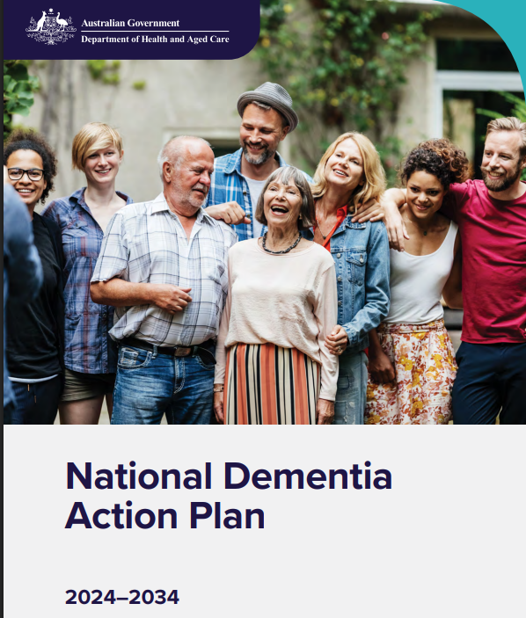
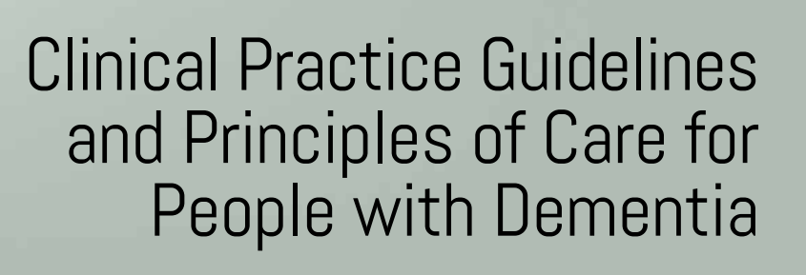
Notes:
Legal care is essential for people diagnosed with dementia.

Slide 3
Research questions
What does it mean for a lawyer to be ‘dementia capable’?
What knowledge, skills, attitudes and behaviours are important so lawyers can meet the needs of people with dementia and other clients seeking to plan ahead for their future?
What strategies would help lawyers to develop those attributes?

Slide 4
Project participants & advisory group
Participants
Legal practitioners (n=22)
wills/estates/elder law specialists
serve on professional committees
community legal sector
People with living experience (n=17)
person living with dementia
support person for someone with a diagnosis
Advisory group (n=6)
consumer and professional representatives
Notes:
Acknowledge StepUp for Dementia Research, Dementia Australia, Law Societies and other legal organisations for assisting with recruitment

Slide 5
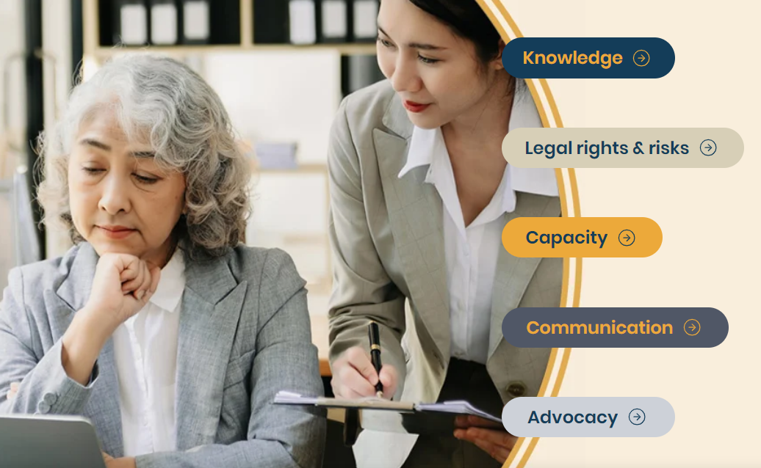

Slide 6
Dementia capability is vital for the legal profession
Legal practitioner: “We need to get a grip on our ageing population and the increasing numbers of clients with dementia. We need to have a much more detailed understanding of how to support clients with dementia.”
Person living with dementia: “having an educated legal group could make a big difference to a lot of people”
Legal practitioner: “There’s been an increase [in people with a dementia diagnosis] coming to us because their doctor has recommended it … So that’s really good, but of course, it would be far better if they came before they had a diagnosis.”

Slide 7
Knowledge A dementia capable legal practitioner:
Knows current information about dementia relevant to legal practice
A person-centred approach is required to identify and meet each client’s unique needs and abilities.

Slide 8
What we heard
Person living with dementia: “There's a stereotype that … you’re going to be really vague, and very old, and maybe not be able to communicate.”
Legal practitioner: “We can be misled by labels. …We can think, well, all right, that person’s got Alzheimer’s therefore they’re not capable of doing this, that or the other. Whereas, of course, it may well be that they are...”

Slide 9
Legal rights and risks A dementia capable legal practitioner:
Provides comprehensive advice on advance planning to enable clients to maintain choice and control in their lives
Uses preventive strategies to reduce risks of exploitation and abuse
Knows how to identify and respond to potential situations of exploitation or abuse
Recognises the needs of diverse persons with dementia and provides relevant legal advice and assistance
Is aware of and has professional networks and referral pathways to relevant services and programs

Slide 10
What we heard
Person living with dementia: “From the minute a person is diagnosed… we need the legal side to come in, in a big way for people with dementia.”
Legal practitioner: “We’re thrown into the deep end where everything’s become urgent. If we had more skilled practitioners in the area, it wouldn’t get to that point. We don’t need to be dealing with a crisis all the time. We could actually ensure that these clients have the ability to put documents in place” to plan for the future.

Slide 11
Capacity A dementia capable legal practitioner:
Understands principles of decision-making capacity
Identifies when client capacity may be in question and carries out appropriate steps to assess client capacity
Applies strategies that support decision-making for people with dementia
Recognises and responds appropriately when they cannot act for a person due to a lack of capacity

Slide 12
What we heard
Person living with dementia: “[My solicitor] has been very empathetic and understanding and helpful … one of the things was checking on capacity. He said to me early on that he needed to do that, but he was very respectful.”
Legal practitioner: “We [the legal profession] have such significant challenges with people understanding capacity. [We think] this person’s got dementia and they don’t have capacity.”

Slide 13
Communication A dementia capable legal practitioner:
Communicates effectively with clients
guided by the client’s preferences
listens with empathy
focuses on the client in situations where a support person is present
Uses respectful communication
inclusive and non-stigmatising language

Slide 14
What we heard
Person living with dementia: “You can have lawyers who have plenty of knowledge, but if you haven’t got the empathy … then the knowledge is pretty dry.”
Person living with dementia: “The emphasis should be on the communication. [The lawyer] taking time to make sure that they’re understood, and they don’t get carried away with too much technical language.”

Slide 15
Advocacy A dementia capable legal practitioner:
Considers and acts on opportunities to advocate for changes to laws, legal systems and practices
promote the rights of people living with dementia
support prevention by reducing risk factors for dementia

Slide 16
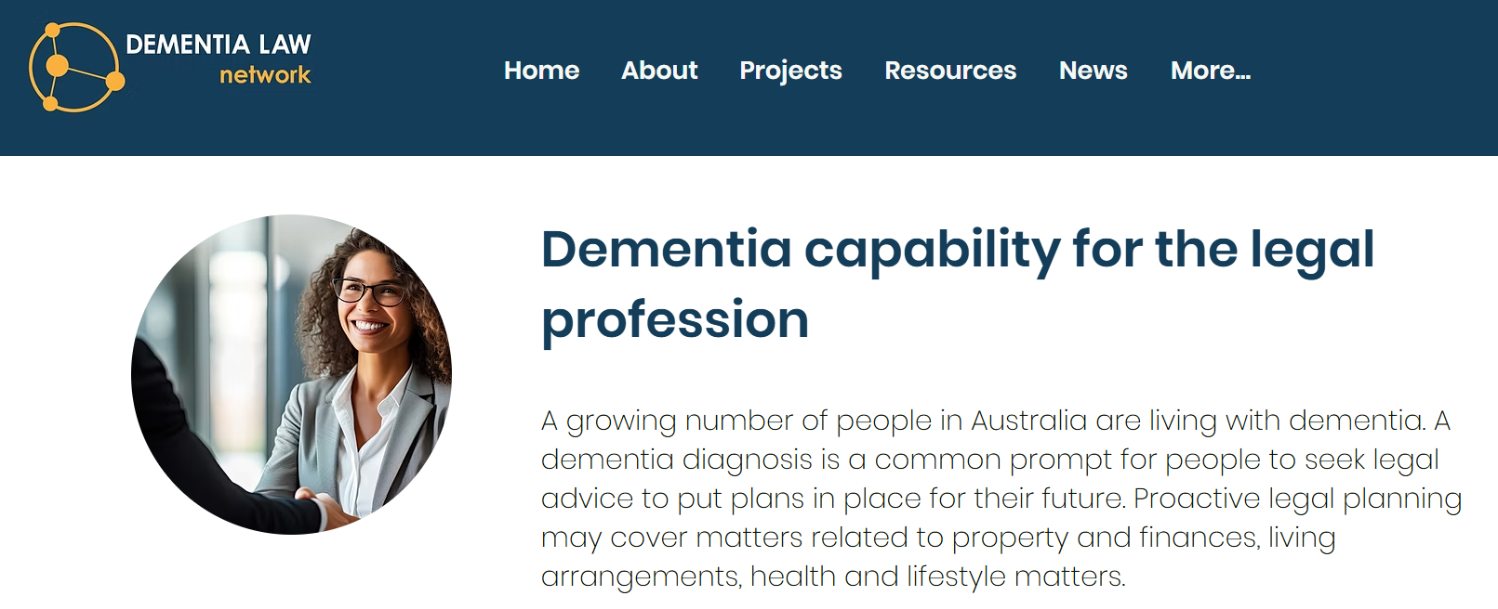
For more information
www.dementialawnetwork.org/dementia-capability
With thanks to Karen Donner, PhD candidate, UTS Law
Funding support is gratefully acknowledged from the Australian Community of Practice on Research on Dementia (ACcORD), an initiative funded by the National Health and Medical Research Council

Slide 17
Discussion

Slide 18
Key practice tips
If a client has a diagnosis of dementia, find out more information so you can better understand and meet the client’s needs.
Re FEPOAs: Urge careful selection of attorneys and always attempt to put conditions when drafting EPOAs.
Be familiar with and use the Queensland Handbook for Practitioners on Legal Capacity.
Be familiar with and use Dementia Australia’s language guidelines so you can talk and write about dementia in a respectful way.
Contribute to law reform submissions; have a say in improving laws, legal systems and practices.

