Slide 1

Belonging and bullying prevention

Slide 2

Everyone belongs
The theme for the 2024 Bullying No Way: National week of action is Everyone belongs.
When we feel like we belong, bullying struggles to find a place.
Belonging means we all have a role in preventing bullying.
Notes:
Belonging is like a superpower against bullying.
It's what brings us together, makes us stronger and helps us understand and support each other.
Belonging is about embracing who we are, respecting everyone's differences and standing up together against unkindness.
We’re also encouraged to speak up and create a safe place – where everyone feels supported and respected, and our voices are heard and valued.

Slide 3
What is bullying?
Bullying is when one person (or a group of people) with more power than someone else repeatedly hurts or upsets them.
This power can come from being seen as more popular, stronger or part of a group.
They might repeatedly try to hurt the person physically, or socially exclude them, or say and do mean or embarrassing things to them.
Notes:
[Use this slide for Primary school students. Delete it for Secondary school students]
Bullying has three main features:
it involves a misuse of power in a relationship
it is repeated and ongoing and
it involves behaviours that can cause harm.

Slide 4
What is bullying?
Examples of bullying could be when someone:
keeps picking on you again and again and tries to make you feel bad
says or does lots of mean things that upset you
makes fun of you a lot
tries to stop you from joining in or to make others not like you
keeps hurting you (such as hitting or punching).
Notes:
[Use this slide for Primary school students. Delete it for Secondary school students]

Slide 5
What is bullying?
Bullying can happen in person or online.
It might be something people can see or it might be hidden.
Sometimes you might have an argument or a fight with someone. If it happens once, it is not bullying – even though it can be upsetting.
If you sometimes fight with a friend and you can sort it out, that is not bullying either.
Bullying is never OK. You are entitled to feel safe.
Notes:
[Use this slide for Primary school students. Delete it for Secondary school students]
If someone behaves in a mean or aggressive way on one occasion, it isn’t bullying, even though it is not respectful or acceptable.

Slide 6
What is bullying?
An ongoing and deliberate misuse of power in relationships.
Repeated verbal, physical and/or social behaviour.
Intended to cause physical, social and/or psychological harm.
It can involve an individual or a group misusing their power (or perceived power), over one or more persons who feel unable to stop it from happening.
Notes:
[Use this slide for Secondary school students. Delete it for Primary school students]
Bullying has three main features. It:
involves a misuse of power in a relationship;
is ongoing and repeated; and
involves behaviours that can cause harm.

Slide 7
What is bullying?
Bullying can happen in person or online.
It might be something people can see or it might be hidden.
If someone behaves in a mean or aggressive way on one occasion, it isn’t bullying, even though it is not respectful or acceptable.
A fight or disagreement between two people of equal power or status isn’t bullying.
Bullying is never OK. You are entitled to feel safe.
Notes:
[Use this slide for Secondary school students. Delete it for Primary school students]

Slide 8
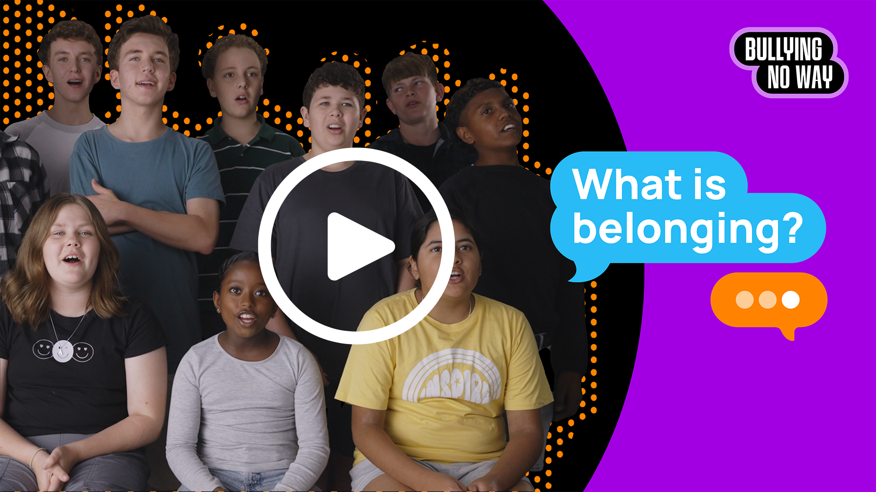
Everyone belongs
Notes:
Australian students talk about what belonging means to them and how it can help prevent bullying.
[Play 60-second video about belonging at school]

Slide 9
Everyone belongs at our school
To create a positive sense of belonging we:
Challenge stereotypes – don’t judge people first, get to know them
Promote empathy – treat people how you would like to be treated
Embrace diversity – celebrate different backgrounds, interests and identities
Foster positive relationships – accept and respect people for who they are
Provide support – know who you can turn to for help.
Notes:
More about how we create a positive sense of belonging at our school:
Challenge stereotypes - Recognise and challenge biased beliefs we may hold and promote a culture of acceptance and inclusion.
Promote empathy – Having understanding and compassion for others makes it less likely we will engage in hurtful behaviour.
Embrace diversity - Appreciate and celebrate the differences between us all.
Foster positive relationships - When we feel connected to others, and valued for who we are, people are less likely to engage in bullying behaviour.
Provide support - Know where to turn for help and that your concerns will be taken seriously and addressed quickly.

Slide 10
At [school name] we:
[List your school values and behaviour expectations]
[Mention bullying prevention policies, behaviour policies and/or student wellbeing and engagement policies]
Notes:
[Talk about your school’s values, behaviour expectations and how your school will manage reports of bullying.]

Slide 11
Remember…
Bullying is never ok.
Being bullied is never your fault.
There is always someone you can reach out to for help.
Notes:
It’s ok to ask for help if you see or experience bullying or cyberbullying.
You could talk to:
A trusted person – This could be a parent, carer, family member, guidance officer, counsellor or friend who will listen and be supportive.
Your teacher or principal – They can provide support and advice about how to make it stop.
headspace –They provide free online and telephone support and counselling to young people.
Kids Helpline – They have counsellors available at any time who will listen and support you.

Slide 12
Supports at our school
[List the student wellbeing supports available at your school – this can include staff members and/or programs.]
Notes:
[Talk about the supports available for students at your school – e.g. guidance officer, counsellor, wellbeing staff and/or wellbeing programs.]

