Slide 1
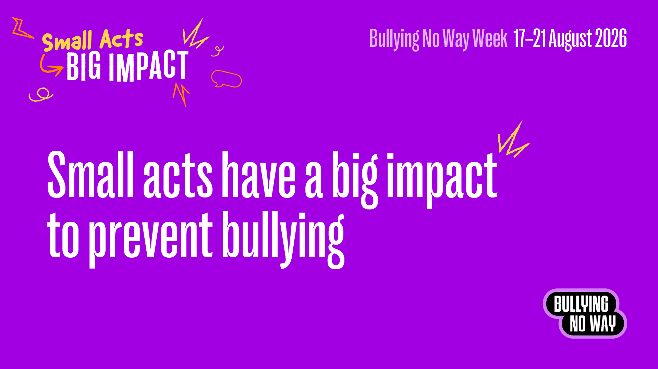
Preventing bullying at school (Years 7 – 12)

Slide 2
Bullying No Way Week
The theme for 2026 Bullying No Way: National week of action is
Small Acts, Big Impact.
Bullying can happen anywhere—at school, online and in the community.
But every small act to be kind and respectful can have a big impact in stopping bullying.

Slide 3
What is bullying?
Ongoing and deliberate misuse of power in relationships.
Repeated verbal, physical and/or social behaviour.
Intended to cause physical, social and/or psychological harm.
It can involve an individual or group misusing their power, or perceived power, over one or more persons who feel unable to stop it from happening.
Notes:
Bullying has three main features:
it involves a misuse of power in a relationship
it is ongoing and repeated, and
it involves behaviours that can cause harm.

Slide 4
What is bullying?
Bullying can happen in person or online. It might be something people can see or it might be hidden.
If someone behaves in a mean or aggressive way on one occasion it isn’t bullying, even though it is not respectful or acceptable.
A fight or disagreement between two people of equal power or status isn’t bullying.
Bullying is not OK. You have the right to feel safe.

Slide 5

Small Acts, Big Impact
How can small acts have a big impact to stop bullying?
Watch the video
Notes:
What does it look like to engage in small acts for big impact at our school?
[Play main campaign video]

Slide 6
How can we stop bullying?
Small acts matter: Words and actions
Kindness creates impact, even the tiny moments
You have the power to make things better
Pause before you speak, text or communicate online
Together, our small actions create big change
Notes:
How else can we explore what it means for small acts to have a big impact:
1. Small acts matter: Words and actions - Your voice can lift someone up and help create a safer, kinder school. Checking in with someone, offering help or speaking up can make a big difference. Even small actions can brighten someone’s day and shape a more positive school experience.
2. Kindness creates impact, even the tiny moments - A smile, a compliment, sitting with someone new, or inviting someone into a group can make a huge difference. Small acts of kindness build a school culture where everyone feels like they belong.
3. You have the power to make things better - Bullying affects everyone, not just the person being targeted. If you see it happening, do not ignore it. Your support, even a quiet and simple action, sends a clear message that bullying is not okay here.
4. Pause before you speak, text or communicate online - Your words have power online and in person. Before you say or send something, think about how it might impact someone else. A small moment of reflection can prevent harm and help create a safer and more respectful community.
5. Together, our small actions create big change - When everyone contributes, even in small ways, our school becomes kinder, safer and more inclusive. Be the reason someone feels supported. Your actions inspire others and help build a culture where bullying has no place.

Slide 7
At [insert school name] we:
[List your school values and behaviour expectations]
[Refer to your relevant bullying prevention policies, behaviour policies, or student wellbeing and engagement policies]
Notes:
[Talk about your school’s values, behaviour expectations and how your school will manage reports of bullying]

Slide 8
Help is available
If you are being bullied or see someone being bullied, help is available at school:
[List the student wellbeing support available at your school – this can include staff members or programs]
You can also get help from:
Kids Helpline
Headspace
eSafety
Notes:
It’s ok to ask for help if you see or experience bullying or cyberbullying.
You could talk to:
A trusted person – this could be a parent, carer, family member, guidance counsellor or friend who will listen and be supportive
Your teacher or principal – they can provide support and advice about how to make it stop
headspace – they provide free online and telephone support and counselling to young people
Kids Helpline – they have counsellors available at any time who will listen and support you
eSafety – have lots of information about cyberbullying

Slide 9
Remember…
Bullying is never OK.
Bullying is never your fault.
There is always someone who can help you.

Slide 10
We can all make a difference!

