Slide 1
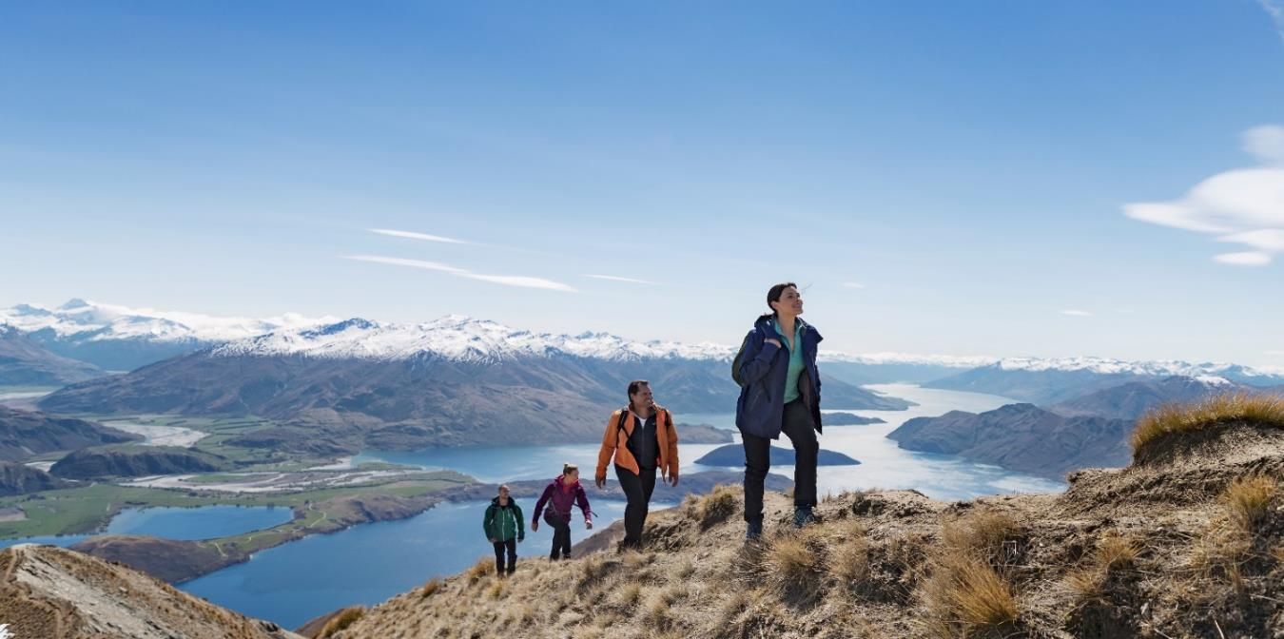
Otago Tourism Policy School
Are we fit for purpose?
Heather Kirkham, GM Tourism, MBIE

Slide 2
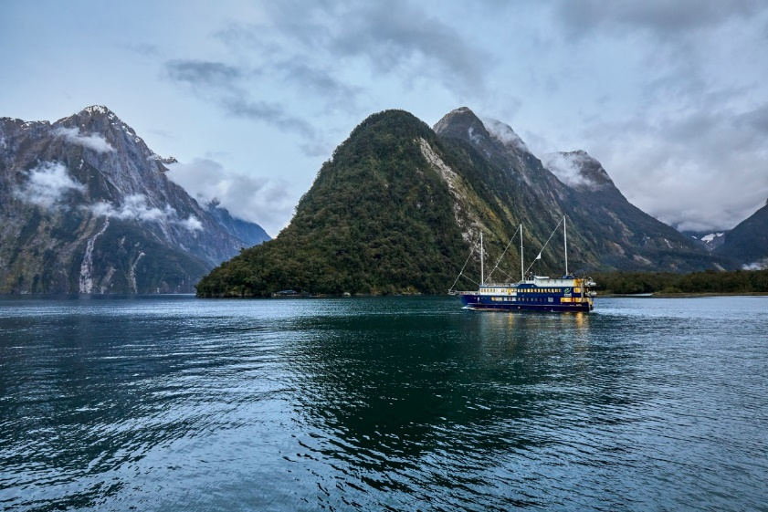
Role of government in Tourism
Steward: looking across the system to make sure it is working effectively
Regulator: linked with other sectors, e.g. international air services, access to public conservation lands
Actor:
eg Investments and interventions: providing public goods used by visitors e.g. roads, broadband, amenities on public land.
Tourism New Zealand, Department of Conservation

Slide 3
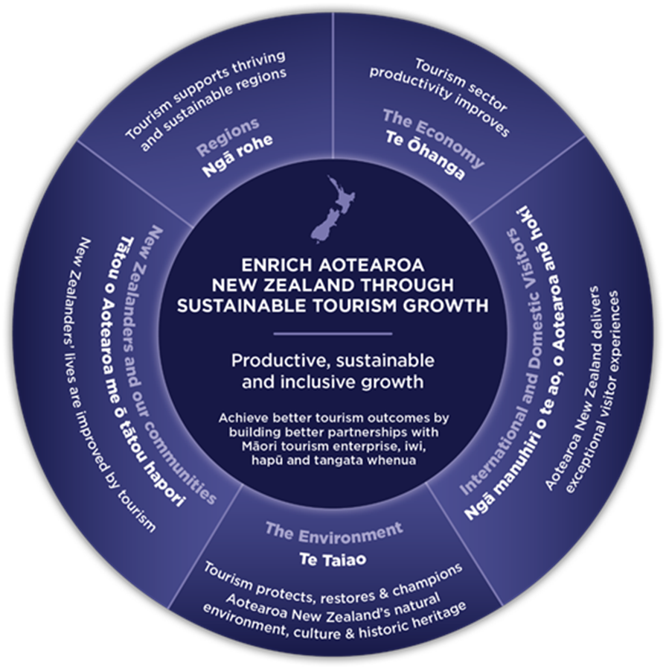
Aotearoa NZ Government Tourism Strategy (2019)

Slide 4
How well was tourism doing up to 2020?
Ohanga / Economy
Manuhiri
Te Taiao
Rohe
Tātou
Tourism value add 2019 $16b Daily spend (intl) 2001 $340/day 2020 $270/day | Visitor satisfaction 2020 Avg 9.13/10 Great Walks 89% met/exceeded expectations | CO2 emissions 2007 13.1m t 2019 12.1m Tiaki awareness 2020 16% intl visitors Cultural experience participation (intl) 2013 62% 2020 45% | Employment 2019 371,100 FTE 221k direct & 150k indirect Regional development Key benefit of tourism But regions under pressure e.g. Qtwn, Rotorua, Akld | Social Licence 54% NZers “growth too high” Median wage 2021 $23.02 cf $25.50 horticulture $29.66 all of NZ

Slide 5
.. And now?
% change from Jan 2019 | Guest nights | Electronic card spend
Domestic | 20% | 15%
International | -35% | 8%
Total | -3%

Slide 6
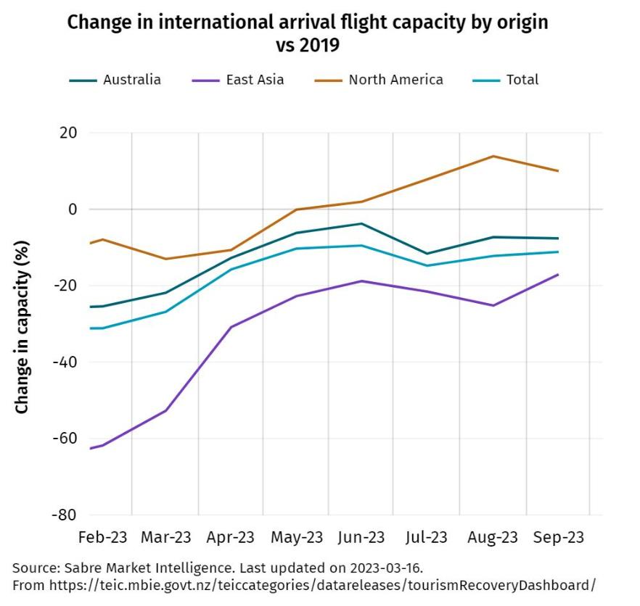
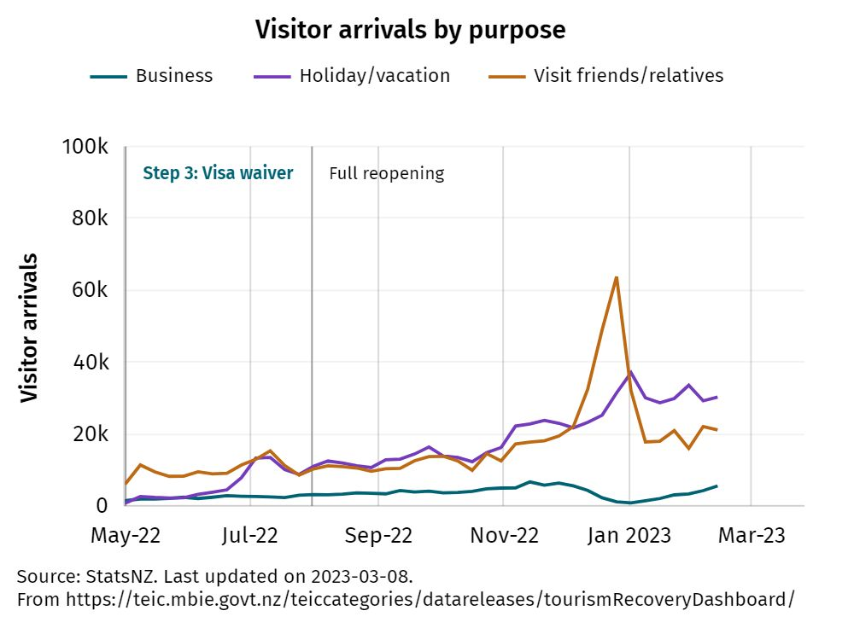
Visitors (and flight capacity returns)

Slide 7
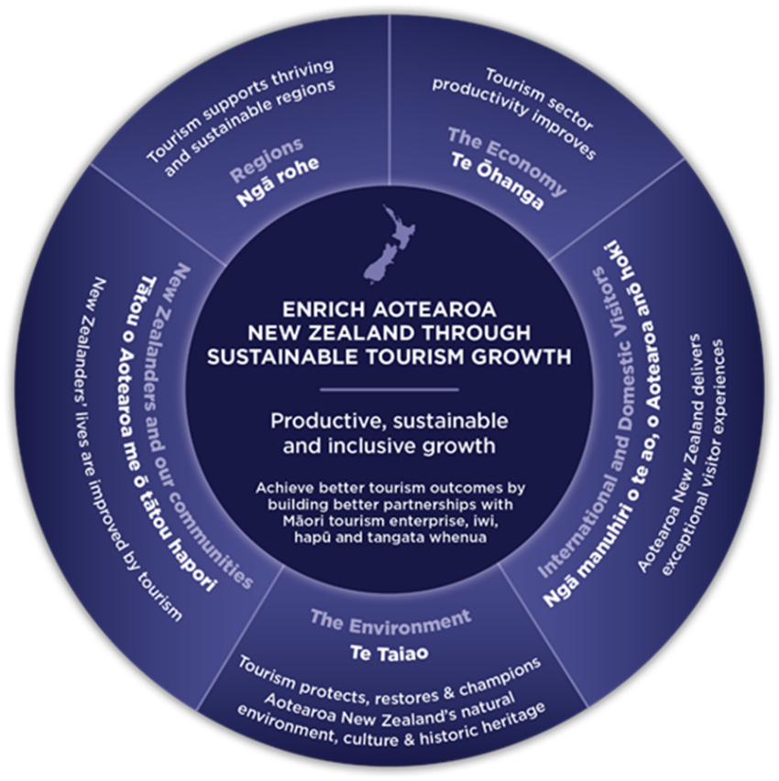
Challenges for Tourism today Tātou: Workforce, wages, conditions Te Taiao: Environment Rohe: Destination management Ōhanga: Innovation Programme Manuhiri: Visitor experience

Slide 8
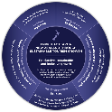
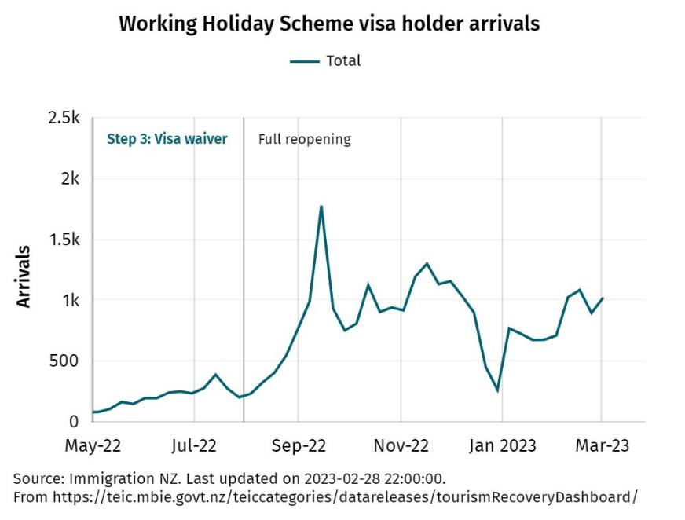
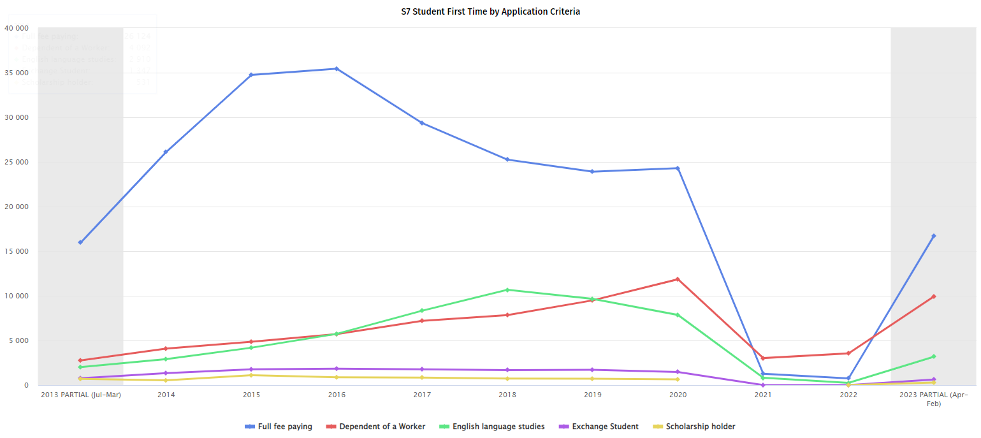
Tātou: Worker shortage
International students (YE March)
(first applications)
40k
35k
30k
25k
20k
15k
10k
5k
2014 2015 2016 2017 2018 2019 2020 2021 2022 2023
(part)

Slide 9
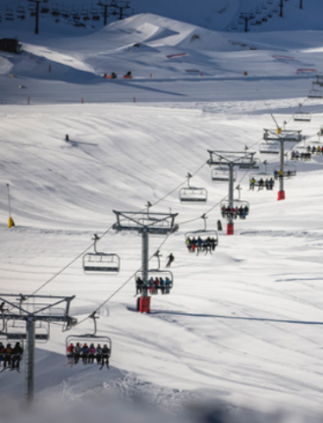
Immigration settings
Tourism Transition
Extensions on working holiday visa settings
Concessions on wage rates for AEWV
Innovation and technology initiatives to reduce reliance on some types of labour
Immigration Rebalance
A longer-term focus, to support transition to a high-wage and low-emissions economy
Focussed on enabling higher-skilled workers to enter Aotearoa

Slide 10
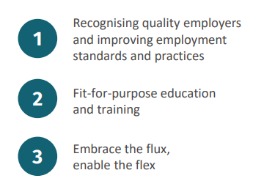
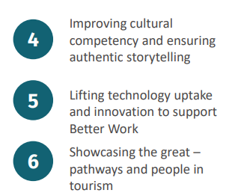
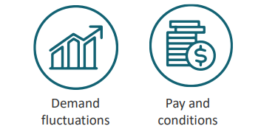
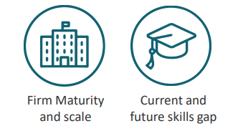
Tātou:
Tourism Industry Transformation Plan
The Better Work Phase identified four systemic challenges
…and 6 Tirohanga Hou to address them

Slide 11
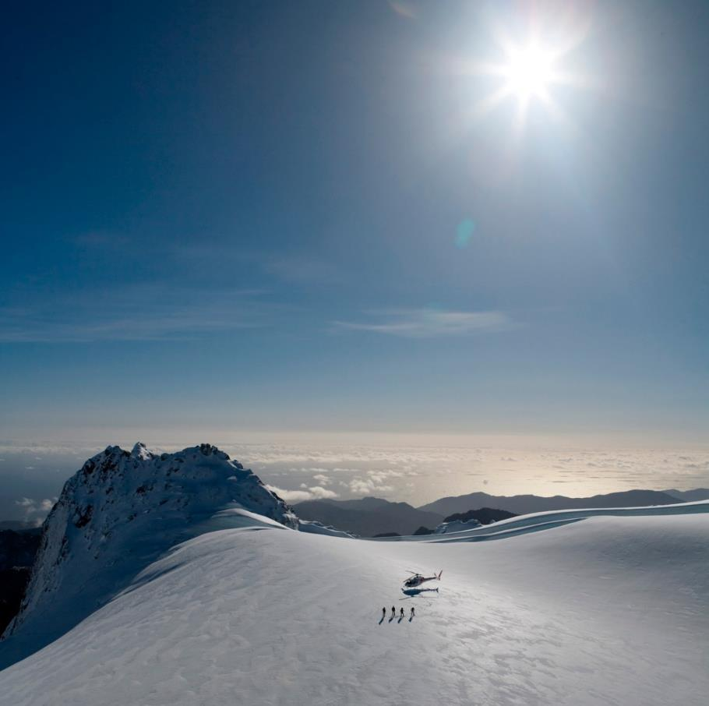
Te Taiao:
Tourism ITP: Environment
The Natural Environment
Addressing challenges and harnessing opportunities related to how the tourism industry interfaces with our natural environment.
Adaptation
Mitigation
Biodiversity
Consultation in July

Slide 12
Rohe: Supporting communities to manage tourism
Destination Management Plans
Tool to give communities input into tourism management for their region.
RTOs building and maintaining strong relationships with mana whenua.
Clear focus on regenerative and sustainable tourism.
$600,000 for RTNZ to improve Destination Management capability.
Milford opportunities project – DM in action
The Milford Road corridor and Milford Sound Piopiotahi have been under stress from over-tourism for years.
Applying the principles of Destination Management
A template for other key tourism destinations across the country.

Slide 13
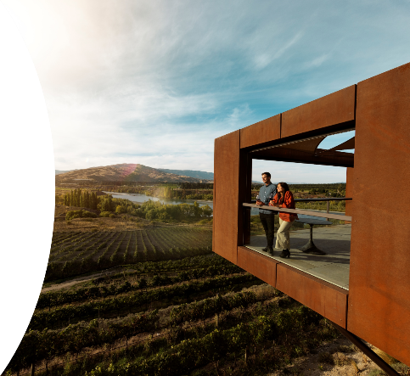
Rohe: Supporting communities to manage tourism
Responsible Camping Reforms to protect our places and communities
The reforms will include:
A regulated system for the certification and registration of self-contained vehicles
Strengthened infringement system
New rules for self-contained vehicles (which includes them having a fixed toilet)
Option to extend to Waka Kotahi and LINZ land (currently includes Conservation Land)
Government is supporting councils with $10m to support transition
Tourism Infrastructure Fund
The aim is to protect and enhance New Zealand’s reputation and support the visitor experience.
Develop tourism-related infrastructure
Support local communities facing tourism pressures to address capacity constraints and/or realise their tourism potential
Projects are co-funded in partnership with local councils (or community organisations with council support)

Slide 14
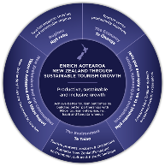
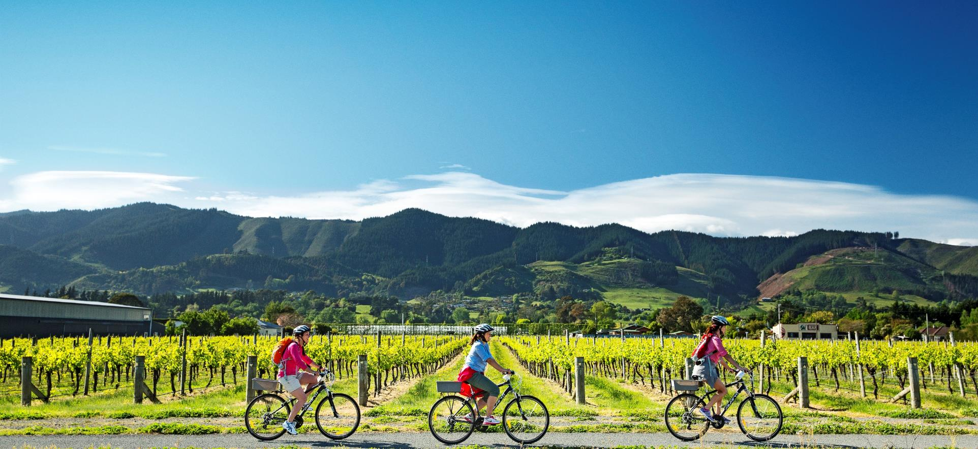
Rohe/Manuhiri: Destinations and improving the visitor experience
Ngā Haerenga New Zealand Cycle Trails
2 million people enjoy the Great Rides of Ngā Haerenga every year, spending $950m
Cycle tourism is a low carbon activity that can help connect visitors to
local communities
local food, beverage and artisanal products, and
local culture and heritage.
Trail users spend $950m pa
1600 businesses associated with Great Ride trails
$11m in health benefits
128km of waterways fenced
25,000 native trees planted
$8m pa in government investment
17,000 hours of volunteer contributions

Slide 15
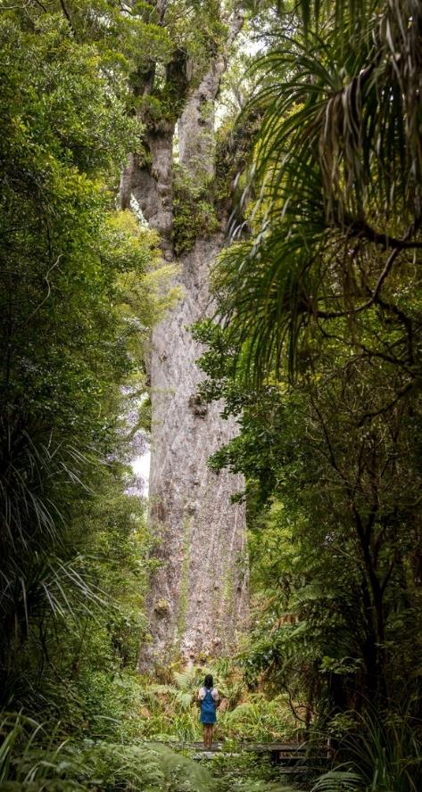
Ōhanga / Taiao:
Innovation Programme for Tourism Recovery
Designed to deliver transformational outcomes for the tourism sector.
Currently assessing stream one (feasibility) and stream two (full business case) applications.
Funding will be provided for projects that deliver on at least one of the following outcomes:

Slide 16
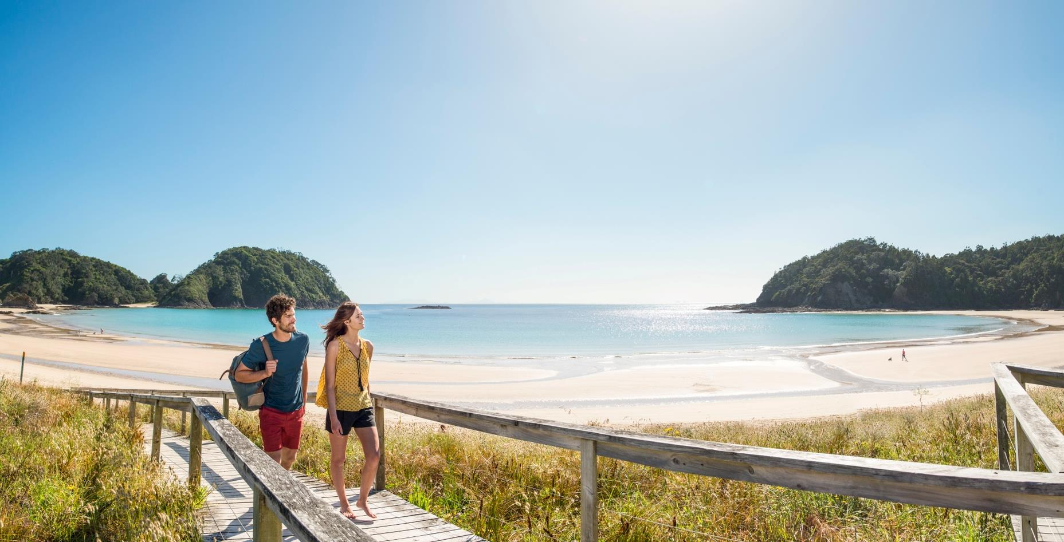
Manuhiri: Tourism New Zealand
$110m per annum to target high quality visitors from key markets.
Support visitors on travelling safely and caring for our home, people and culture.
TNZ works to ensure tourism contributes across four well-being pillars:
Economy The tourism economy thrives and grows adding value
Nature Tourism restores, maintains and nourishes the environment for intergenerational benefit
Culture The tourism story and experience preserve and enhance our values, culture and heritage; the makeup of our identity.
Society People in, and part of, tourism communities thrive through jobs, shared knowledge, and physical and mental well-being.

Slide 17
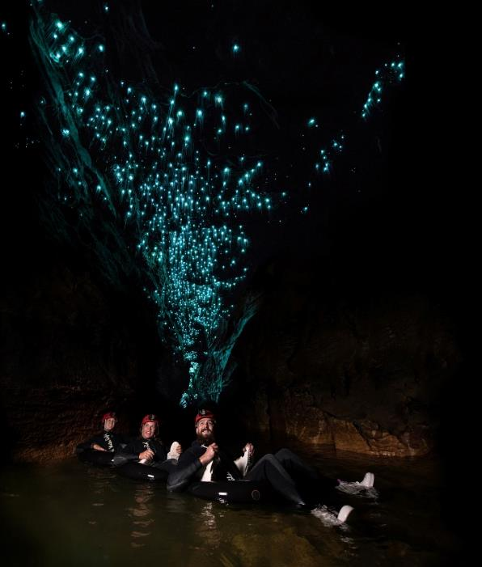
Working in partnership with others
To achieve the vision for tourism and transition the sector to a more regenerative model where our unique stories can be brought to life, we need to build more meaningful partnerships, across Māori, industry, businesses, regions and communities.
Industry Transformation Plans
Tiaki – Care for New Zealand
Created through a collective desire to share a connection to the natural world, inspiring and helping visitors to travel safely and conscientiously.
Strategy guided by a collective of seven organisations across public and private sectors and an independent Tikanga advisor
Data Co-Leadership Group
Developed by a sector-wide Tourism Data and Information Hui
Industry, government, academic, māori, and local government perspectives
Will build on previous work eg sustainable tourism dashboard

Slide 18
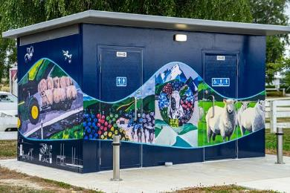
Sustainable funding, pricing, and charging
Acknowledged gap in funding for tourism related services; multi-faceted:
Destination marketing
(Mixed use) infrastructure
Sector-specific services (business advice, data, industry advocacy)
Publicly provided attractions eg cycle trails
Options
(Differentiated) access charging
Targeted rates
Visitor levies (bed taxes, IVL, Stewart Island, Chatham Islands)
(Differentiated) service charges
…
A systems approach
The right funding mechanism to link beneficiary to service and revenue to provider
Funding mechanisms that align with the changes we want to achieve
Cost-effective to collect, fair, and individual tools need to work as a set

Slide 19
Pātai?

