Slide 1
Are we fit for purpose?
Central Structures/Regional Organisations
Kiri Goulter
Director – Destination Management

Slide 2
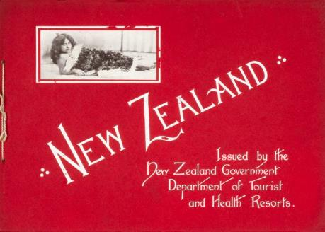
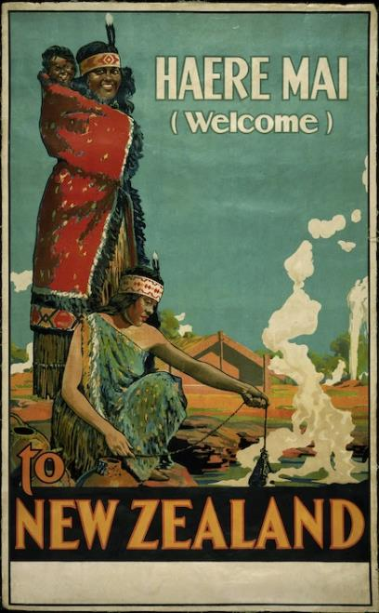
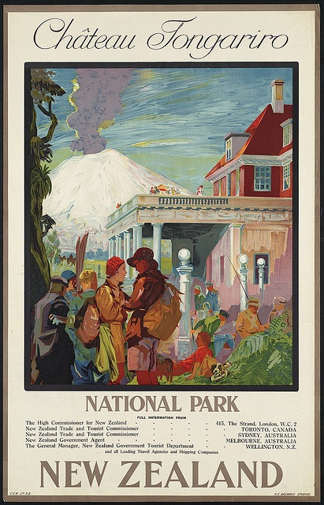

Slide 3
Sustainability: All sector participants will need to embrace the concepts of manaakitanga (hospitality) and kaitiakitanga (guardianship).
Secure and conserve a long-term future: Conserving the natural, built, cultural and social environment with which tourism interacts.
RTOs will take on an expanded role: Destination marketing and management, domestic and international marketing and regional tourism planning and development.

Slide 4
“The NZTS envisages strengthened links between central government, local government and operators, and that tourism planning will be better co-ordinated and managed regionally.
It is also clear that to undertake wider ranging functions proposed by NZTS, RTOs would need to undergo radical changes to their statutory and organisational mandates, funding, and staffing in order to adequately address planning for sustainable tourism.”
RTOs with a wider range of functions

Slide 6
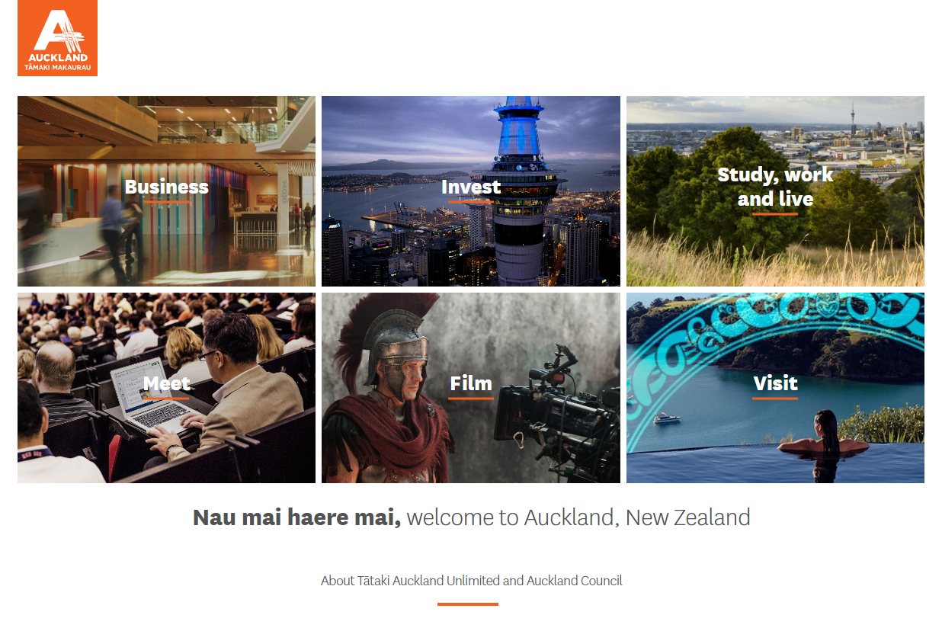

Slide 7
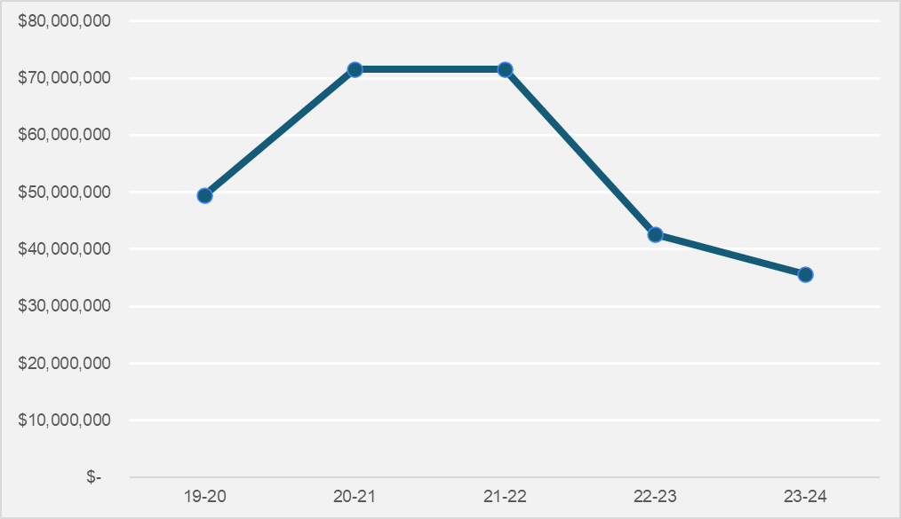
RTO baseline funding set to reduce further
MBIE STAPP/SRR Funding

Slide 8
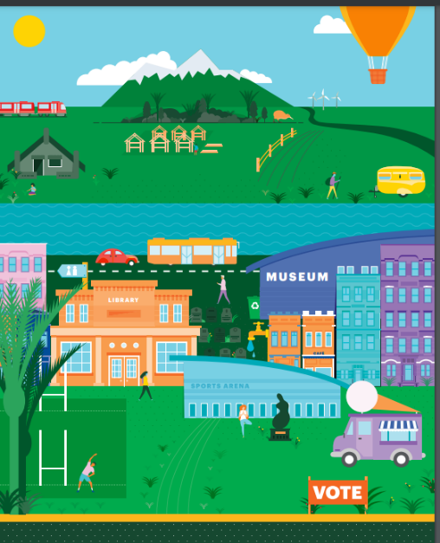
Local Government is a key actor in the system

Slide 9
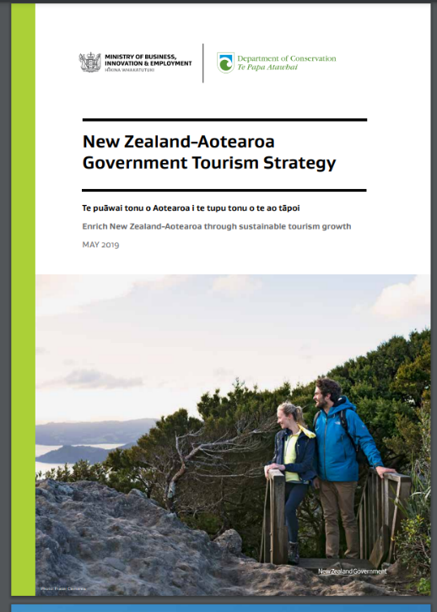
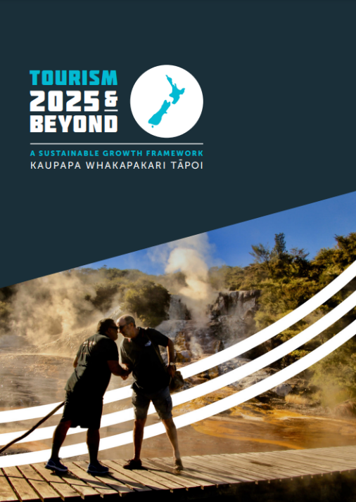

Slide 11
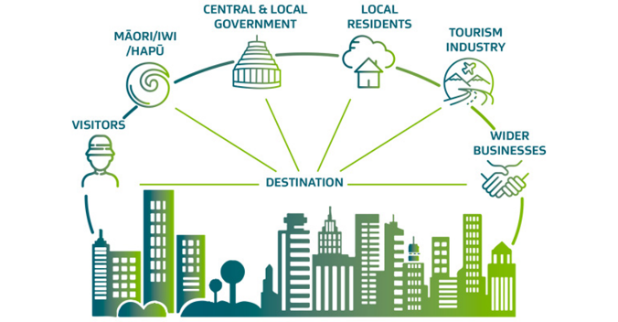
DM involves the management of all aspects of a destination that contribute to a visitor’s experience, including the perspectives, needs and expectations of:
It is an ongoing process that requires destinations to consider the social, economic, cultural and environmental risks and opportunities.

Slide 12
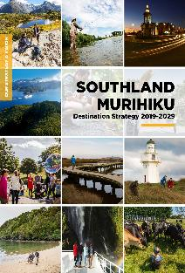
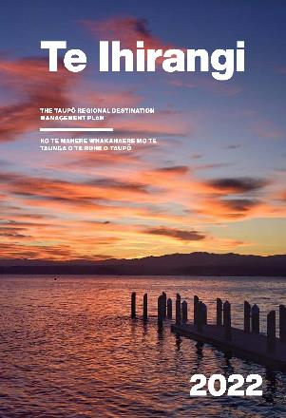
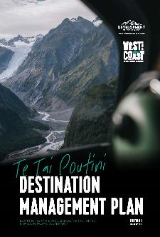
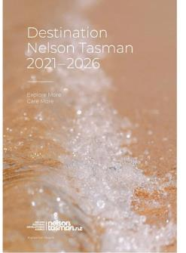
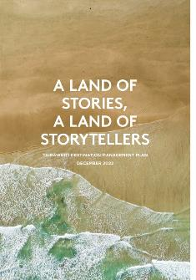
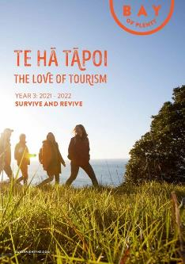

Slide 13
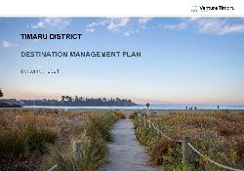
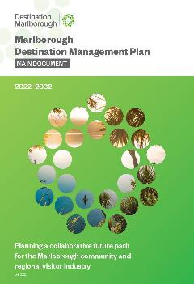
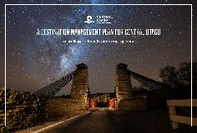
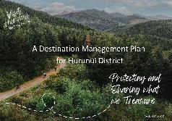
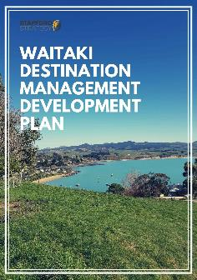
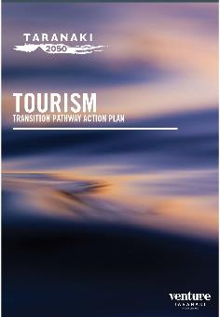
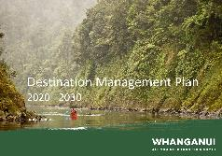
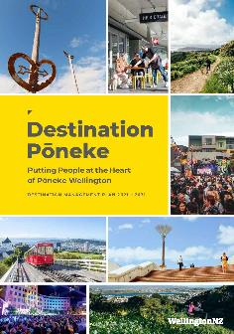
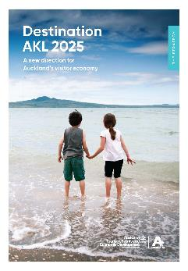
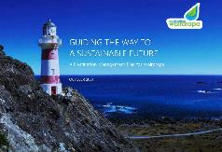

Slide 14
Most destinations globally are also pondering how to be fit for a purposeful future.
Significant barriers to a destination management approach also exist in most other countries and most are challenged with dysfunctional systems that are not fit-for-purpose for residents, funders, or industry.

Slide 15
Are our regional tourism organisations and system
fit for purpose?
And………fit for what purpose?

Slide 16
“Done well, destination management both protects a place and the businesses that rely on the travel industry. Done poorly, it erodes a place, its businesses and everyone’s – including residents’ – experience”.
Reference: World Economic Forum Ten Principles for Sustainable Destinations: Charting a new path forward for travel and tourism White Paper, September 2022.

