Slide 1

Tourism Policy School, March 2023

Slide 2




Airports support New Zealanders’ prosperity and wellbeing
Airports connect communities and families.
They are critical infrastructure that enable rapid transport across New Zealand.
Airports support local communities.
Most airports are fully or partly owned by local councils. Business activity at airport precincts has been estimated to add over $16 billion to the New Zealand economy every year.
Every airport in New Zealand is an important part of a national network
that connects passengers, freight and emergency and medical services to all corners of the country.
Airports connect New Zealand to the rest of the world.
Airports support our tourism industry which in 2022 contributed $27 billion in visitor spend. In 2022 airports carried 19% of New Zealand’s imports and exports - $29 billion in high value products.

Slide 3
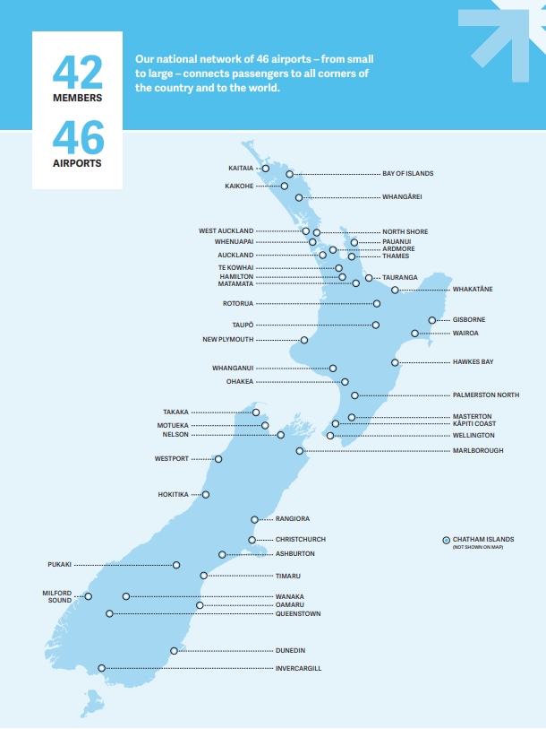
New Zealand’s geography means aviation is essential to our connectivity

Slide 4
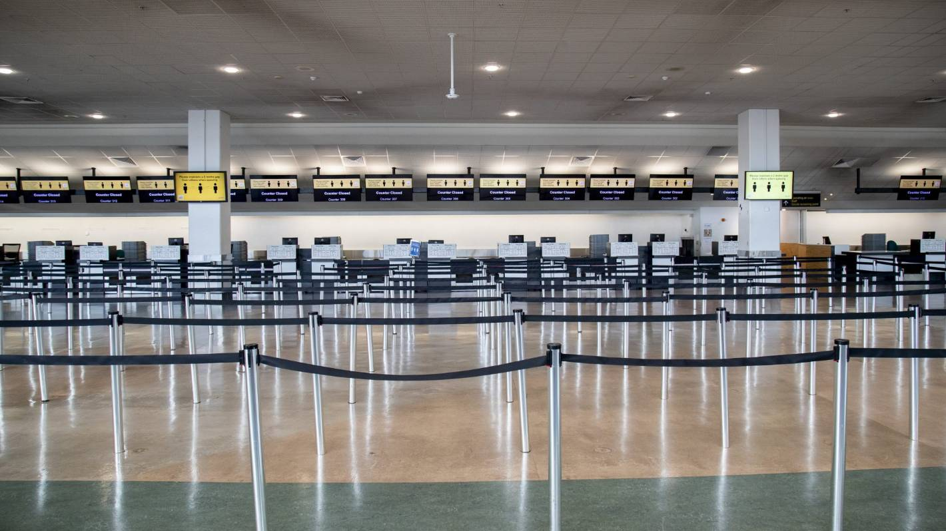
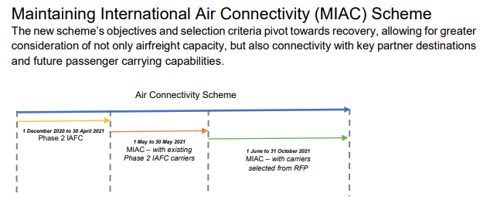
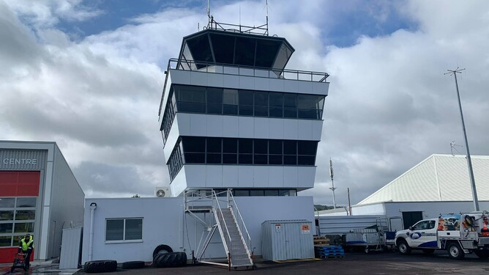
COVID-19 highlighted the essential role of the core air transport network to New Zealand

Slide 5
Aviation is an ecosystem
Consumers
Cargo
Airports
Airlines
Air navigation
Government

Slide 6
Are we fit for purpose? What might that mean?
Recovery
Connectivity
Policy and regulation
Workforce
Infrastructure

Slide 7
Looking ahead – the challenges and opportunities
Decarbonisation. Momentum is building. We need aligned system solutions to scale renewable energy generation, transmission and infrastructure. Airports need to invest now for uncertain scenarios.
Customer experience. Continuous improvement on system performance, holding all actors to a high standard.
New technology. Regulation and investment that keeps up with emerging tech.
Resilience. A clear and agreed view of systems, infrastructure and funding for the core air transport network.
There’s a range of enabling policy and regulatory initiatives that could impact on our progress:
Civil Aviation Bill
New Southern Sky
Air Navigation System review
Sustainable Aviation Aotearoa
Emerging Technologies Unit
Natural and Built Environments Bill
Spatial Planning Bill
Water Services Legislation Bill
Energy strategy

Slide 8
+70%

