Slide 1
DOC’s role in Tourism
Toitū te marae a Tāne-Mahuta, Toitū te marae a Tangaroa, Toitū te tangata. If the land is well and the sea is well, the people will thrive

Slide 2
Outline
DOC’s purpose
DOC’s roles in recreation and tourism
Managing access and opportunity to public conservation lands and waters
Challenges
Opportunities
Purpose and outcomes

Slide 3
DOC’s purpose and outcomes
Toitū te marae a Tāne-Mahuta, toitū te marae a Tangaroa, toitū te tangata. If the land is well and the sea is well, the people will thrive.
DOC’s purpose is to ensure that Papatūānuku thrives and to be an honourable Treaty of Waitangi partner.
Outcomes
Ecosystems and species across Aotearoa New Zealand are thriving from the mountains to the seas
Public conservation lands and waters are maintained and improved for future generations
Connection with nature and cultural heritage enriches people’s lives
DOC is a great organisation

Slide 4
DOC’s roles in recreation and tourism
Conservation Act 1987
Section 6: Functions of Department
The functions of the Department are to administer this Act and the enactments specified in Schedule 1, and, subject to this Act and those enactments and to the directions (if any) of the Minister,—
(e) to the extent that the use of any natural or historic resource for recreation or tourism is not inconsistent with its conservation, to foster the use of natural and historic resources for recreation, and to allow their use for tourism:
Grounded in the Conservation Act

Slide 5
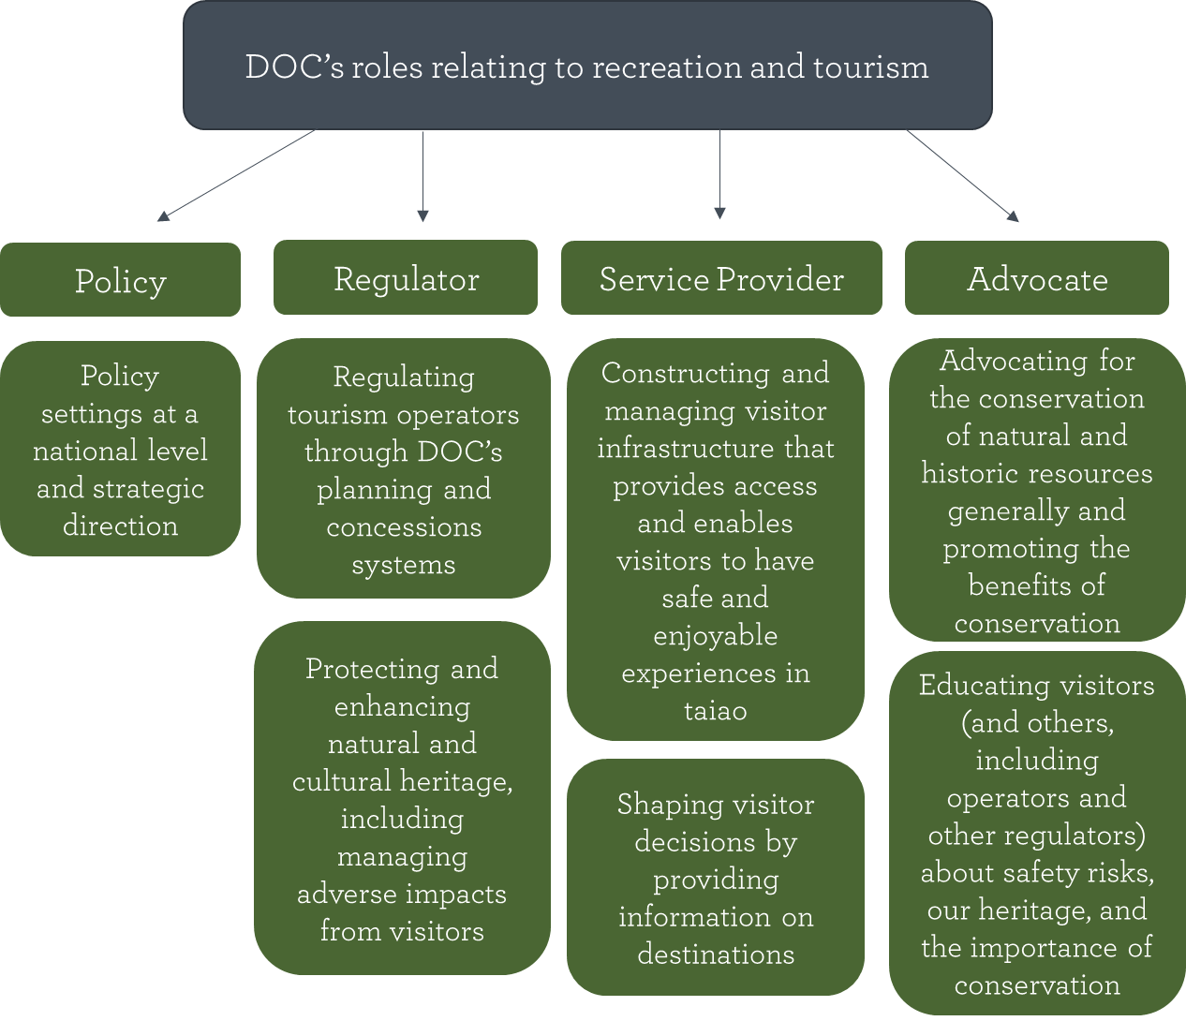
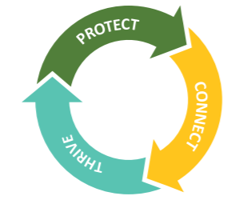
DOC’s roles in recreation and tourism

Slide 6
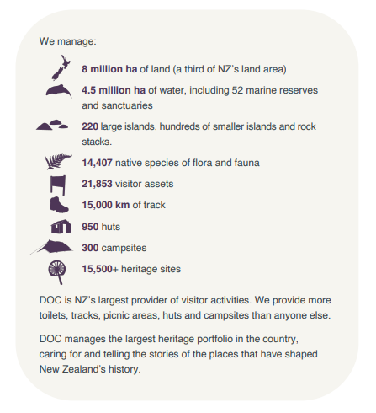

Slide 7
Managing access to Public Conservation Land and Waters

Slide 8
Policy Levers and legislative settings
Hierarchy of policy documents
Conservation General Policy
General Policy for National Parks
Statutory Plans
National Park Management Plans
Conservation Management Plans
Conservation Management Strategies
Concessions, visitor experiences and any limitations on access and/or numbers must be consistent with statutory plans

Slide 9
Soft levers
Infrastructure capacity and design
Access management – carparks and road access
Accommodation limits
Booking services
Contractual requirements
Effects based assessment of capacity
Requires monitoring resource to enforce
Voluntary code of conduct / education

Slide 10
Consequences of the legislative settings
Things to consider
Complexities of multiple overlapping regulatory systems and authorising bodies
Limited ability to exclude self-guided options and prefer paid experiences
Baseline data to understand effects and impose limits is variable
Resourcing to monitor and enforce any policies/restrictions
Need to run fair and transparent processes and public engagement

Slide 11
Key challenges faced by DOC in tourism

Slide 12
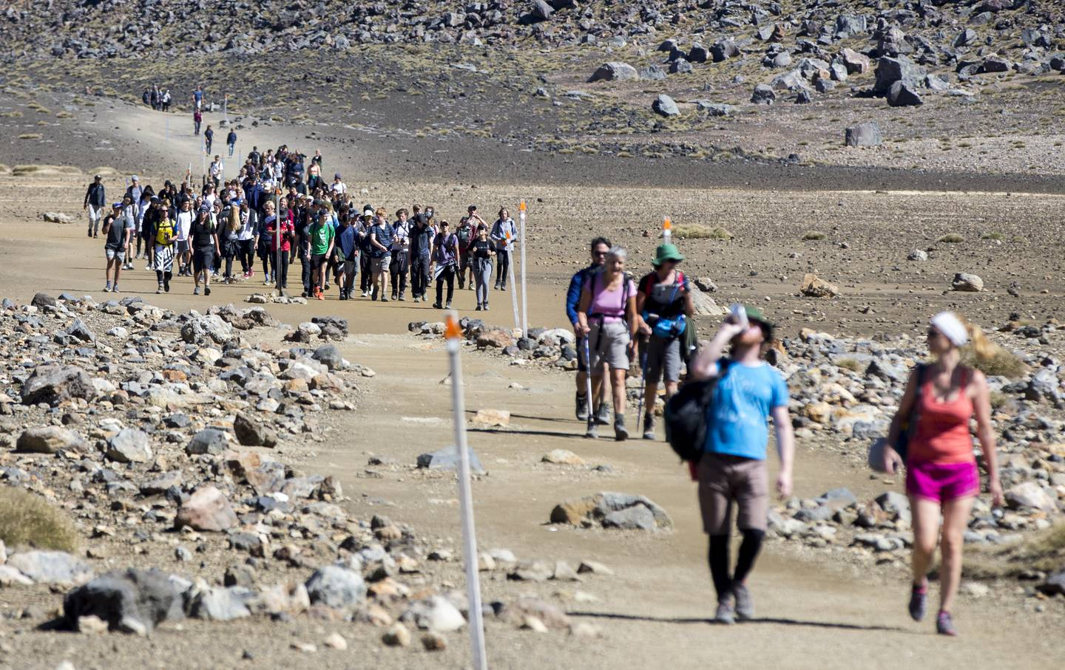
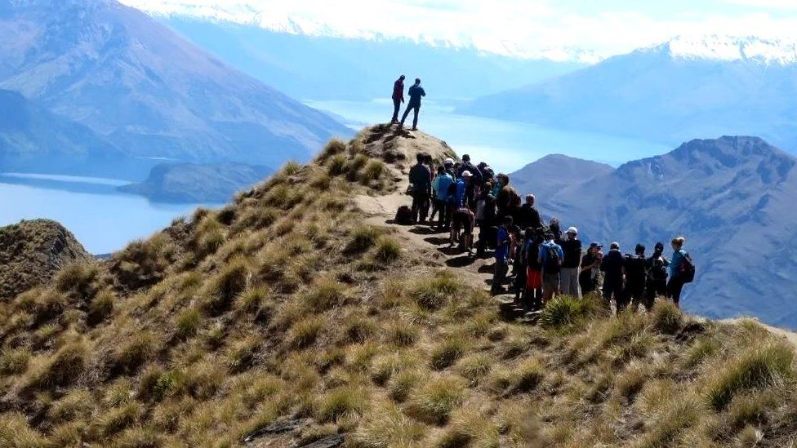
DOC’s key challenges
1. Visitor numbers at popular sites

Slide 13
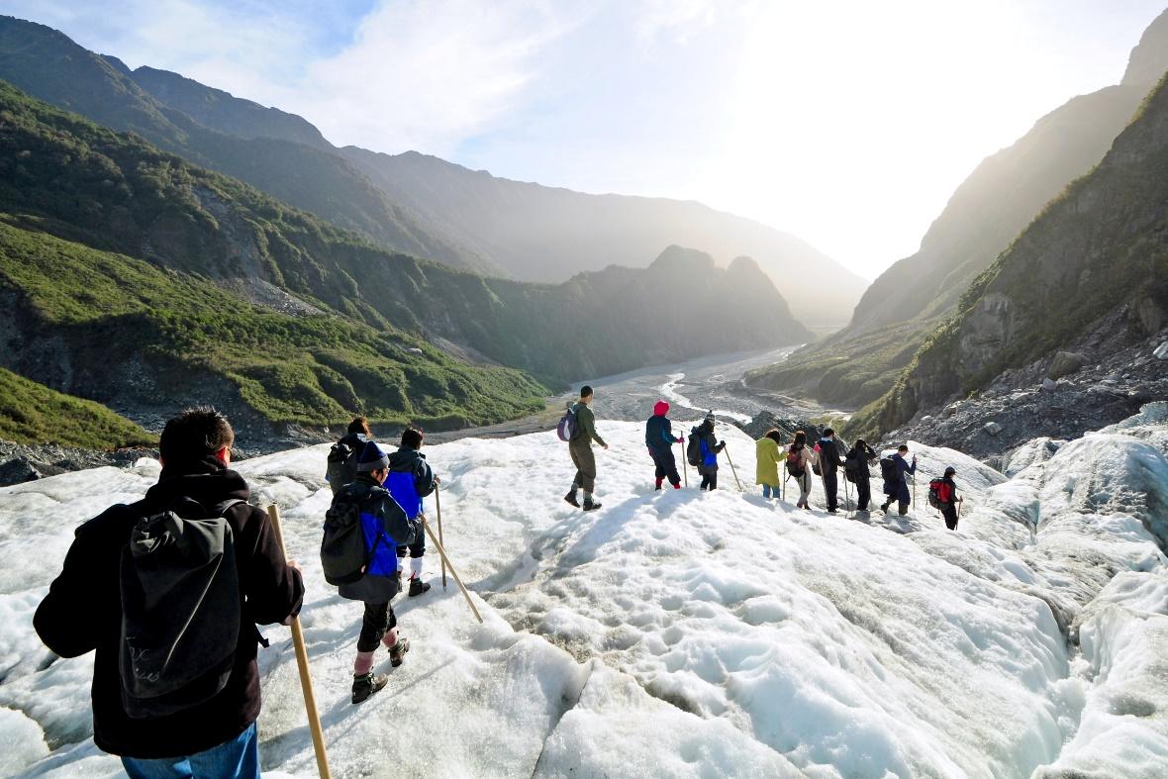
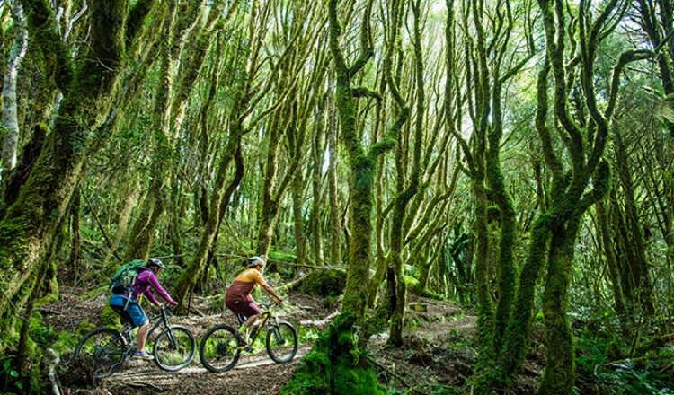
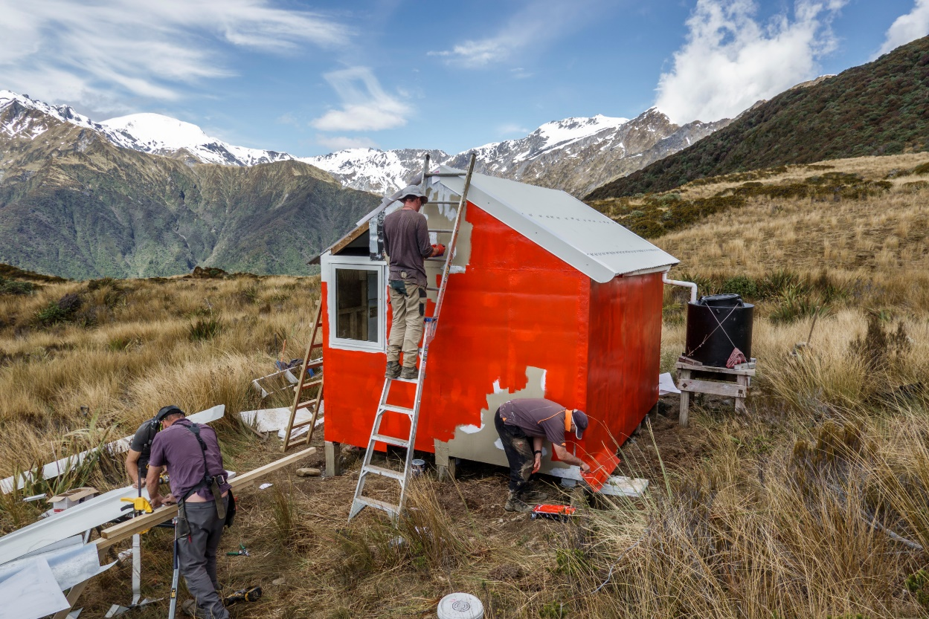
DOC’s key challenges
2. Delivery of visitor experiences by DOC and others

Slide 14
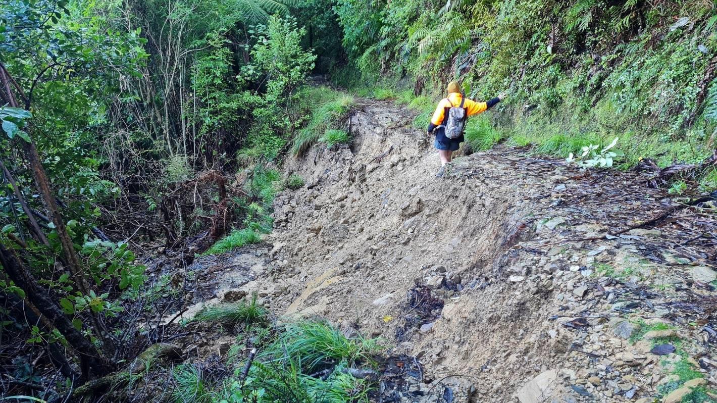
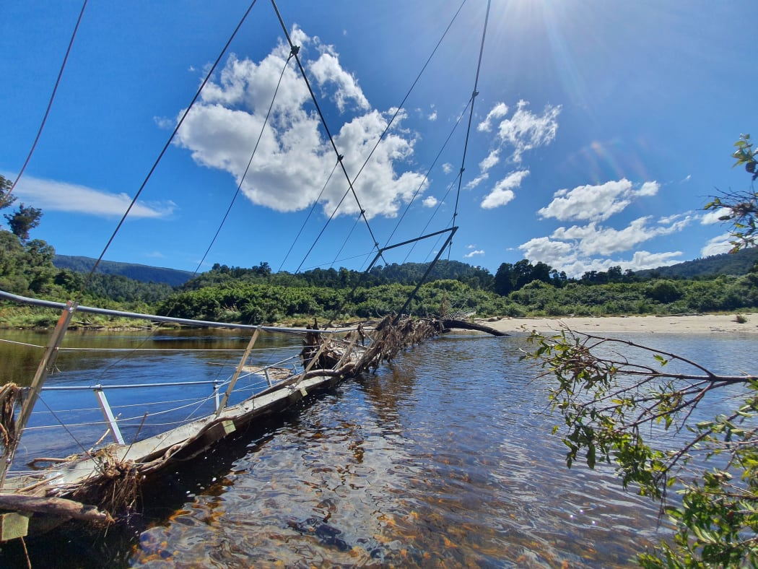
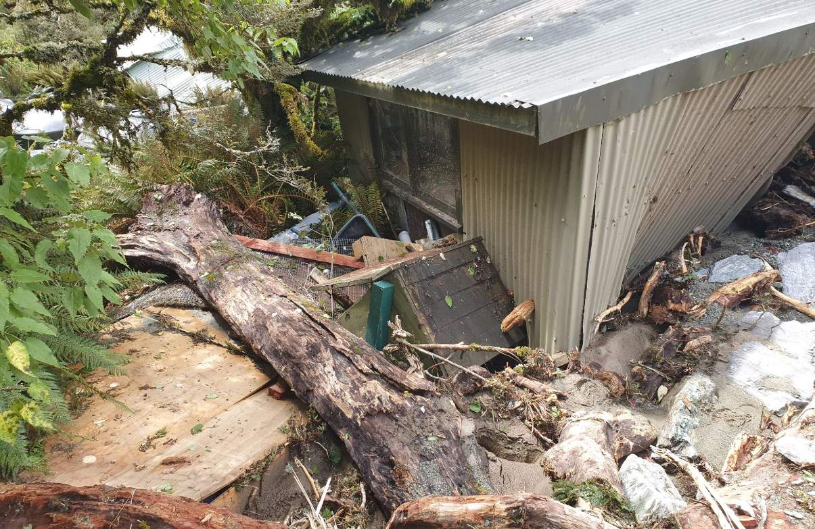
DOC’s key challenges
3. Increased weather events

Slide 15
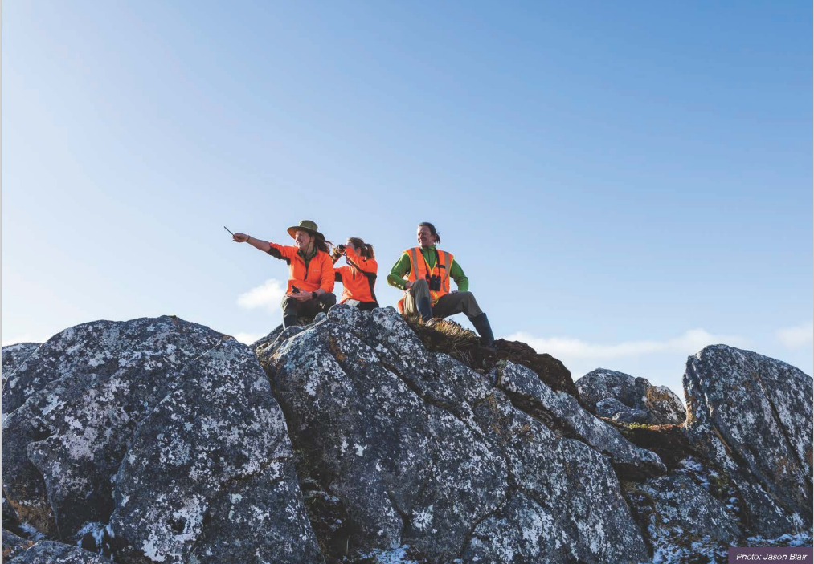
DOC’s opportunity
Strategic, proactive, and transformative

Slide 16
Ngā mihi

