Slide 1
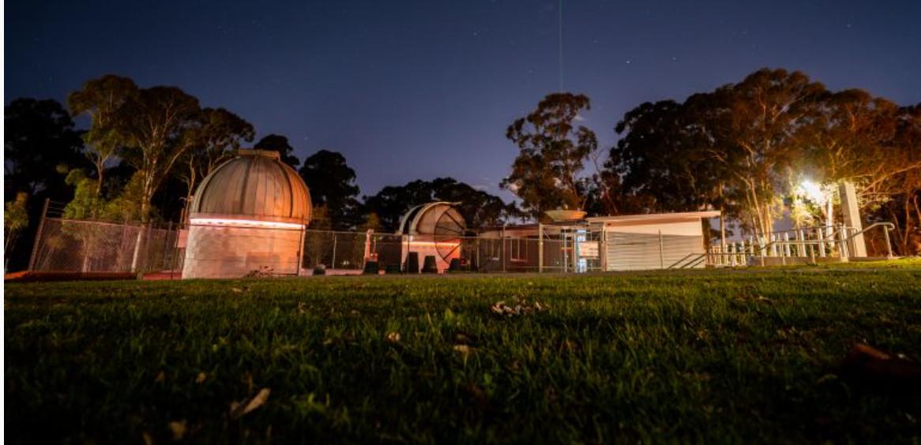

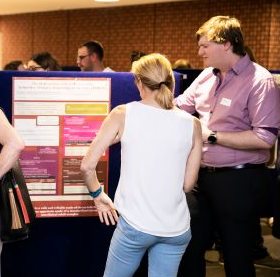
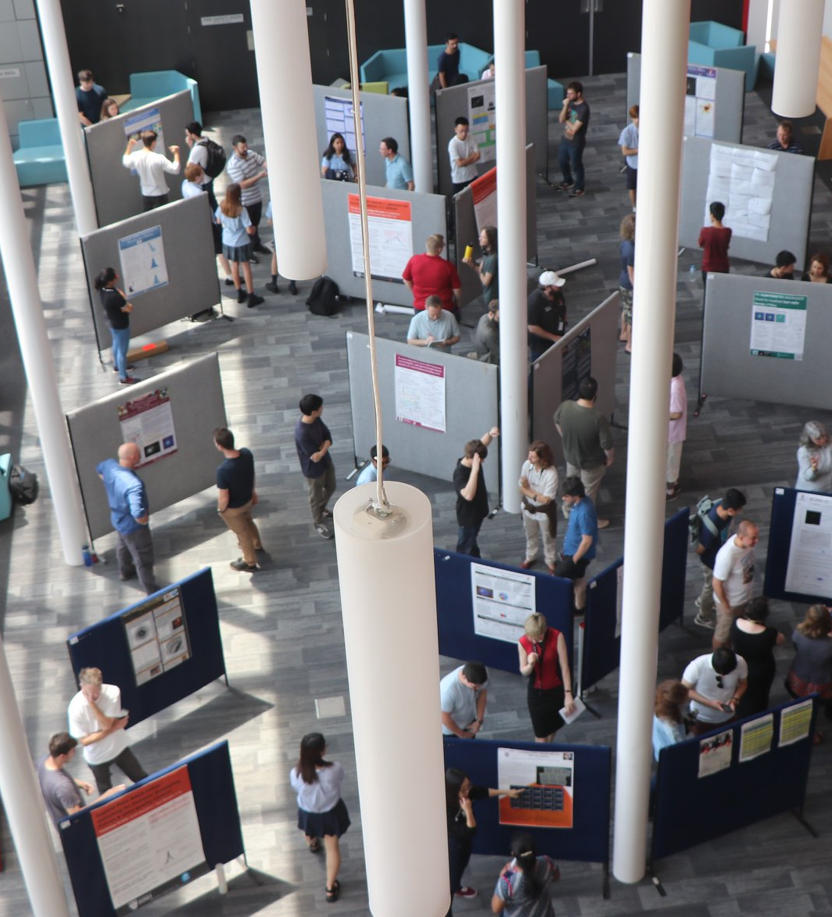
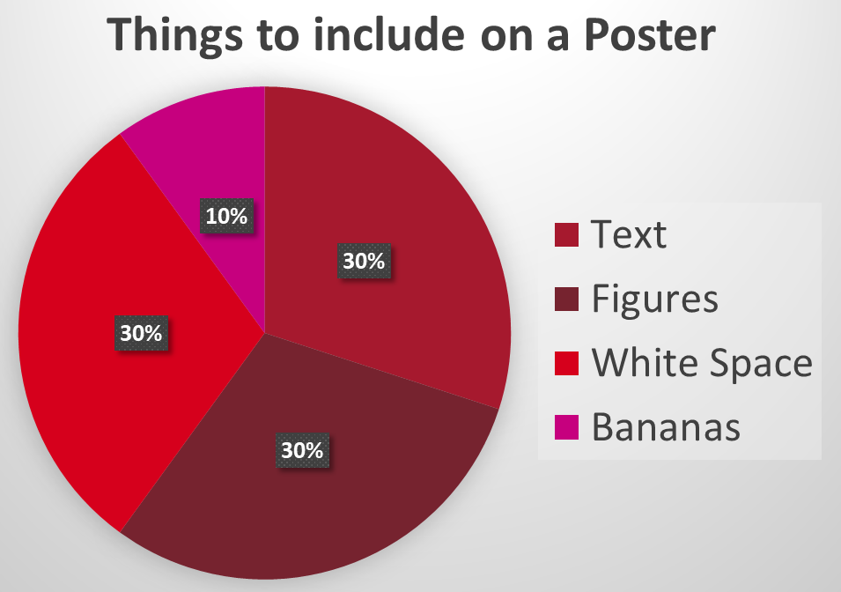

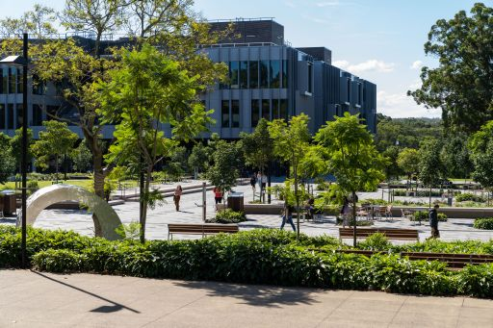
Your School logo?
How to create and present a
poster at a conference
The [Ex]plore conference committee, Macquarie University
1. ABSTRACT
This poster is about how to make a poster. You can use the PowerPoint template, or use something else such as Canva. Nothing is set in stone – make it work for you!
Add you project title, your name and your school logo above, and use this ‘Abstract’ space to get people interested, sum up your project, and sell the key results. People walking past need to get excited, and stop to chat.
4. results
Amazing graph
2. Introduction
In a poster session, poster presenters each display a poster describing their work on poster boards in a large open space. Each presenter stays with their poster, and other people at the conference walk around and chat informally with presenters about their work.
This is the Macquarie University Observatory!
Your poster should be A1 portrait (594 mm wide by 841 mm tall).
You can get your poster printed full size at e.g. OfficeWorks…
…or, you can ‘tile’ print it onto four A3 sheets, and assemble it on your poster board. Google for hints...
Bring your poster on the day, and we’ll allocate you a spot to display it.
Space things out! A good poster might be a third text, and third pictures or graphs and a third white space.
Try not to write too much. You’ll want to cram as much in as possible, but resist! What is the essential story?
Remember that the poster session is about you talking with people about your work – the poster is mainly there so you have images and data to help you explain.
Use fonts and image sizes that that can be viewed from 2 m away – 22pt is good for main text like you are reading in this sentence.
Focus on the central aspects of your project. Even if you love your side-study on bananas, maybe leaving them out is best.
This is where your poster session will be!
Choose your graphics carefully, and concentrate on the key ideas. Avoid unnecessary mentions of bananas.
A poster-presenter chatting to a passer-by
3. Data and methodology
Break things up into small sections. Make it easy to navigate…..this template reads down the left column, then back up to the top of the right column.
Use whatever headings make sense for you (we have some example headings in each white block). You can have more or fewer sections, and make them different sizes to suit your needs.
Try to keep to short sentences or bullet point lists rather than writing long paragraphs of text.
Try to avoid jargon – you’ll be talking to people of all backgrounds including yr10 students.
Cool graph
5. Conclusion
This is Macquarie University campus lake….
Finish off with the take-away message. What was your main conclusion? What needs to be done next?
Now, imagine spending 3 minutes telling someone about your project. Does your poster have the things you’ll want to point at to explain?
Try it out on some fellow students – can you explain your work to them?
…and Central Courtyard.
Questions?
explore@mq.edu.au
6. REFERENCES AND OTHER INFORMATION
https://urc.ucdavis.edu/sites/g/files/dgvnsk3561/files/inline-files/General%20Poster%20Design%20Principles%20-%20Handout.pdf
https://guides.nyu.edu/posters

