Slide 1
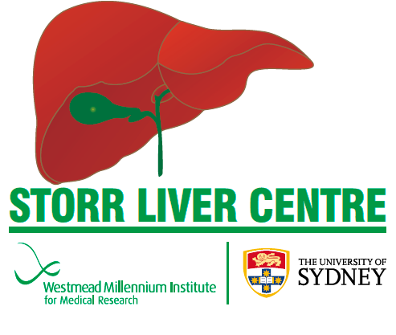
Medical management of MAFLD
Jacob George
Notes:
1

Slide 2
MAFLD, a multisystem disease
Crane & George MedicineToday 2024; 25(6 Suppl): 10-14

Slide 3
The metabolic journey
Adiposity Liver fat IMCL β cell Ath lipids HT IFG/IGT CVD
Adipose Dysf Dysf high insulin CKD
T2DM
`
CM Death/Ca
CM Death/Ca
CM Death/Ca
CM Death/Ca
DCLD
HCC
HCC
Notes:
NAFL is associated with insulin resistance, obesity and CV risk factors
Cirrhosis (fibrosis stage F4) is associated with increased risk of mortality.
CVD is the primary cause of death in people with NASH
People with pre-cirrhotic NASH have an increased risk of HCC

Slide 4
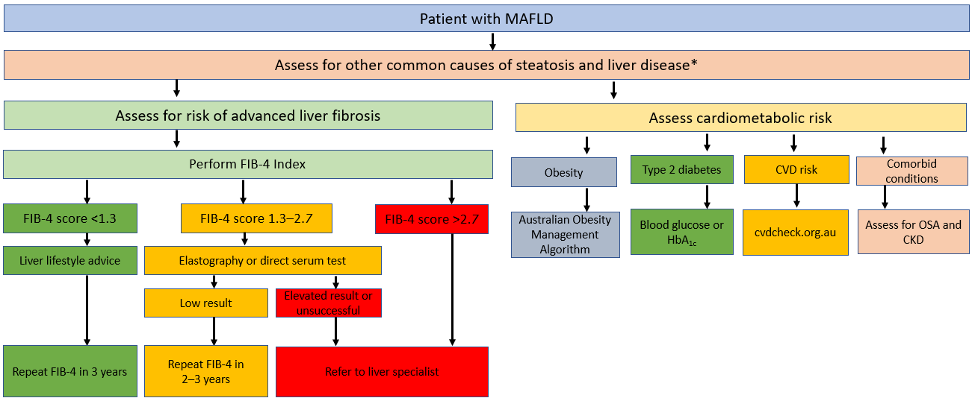
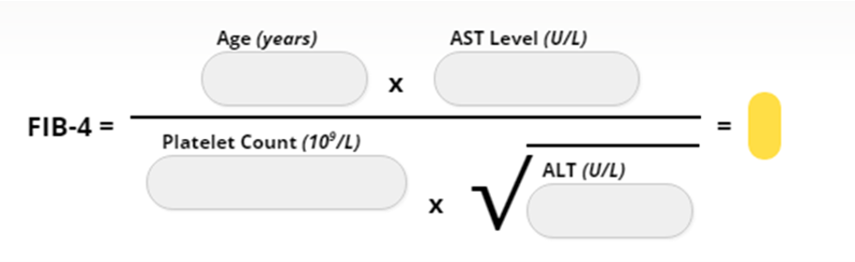
GESA MAFLD assessment guidelines
https://www.gesa.org.au/resources/clinical-practice-resources/metabolic-dysfunction-associated-fatty-liver-disease-mafld-consensus-statement/

Slide 5
Improve clinical outcomes
Do we tackle the disease upstream or downstream?
The philosophical issue
Tackle downstream: Impact liver outcomes
Tackle upstream: Impact all outcomes (CMD/Cancer)
Notes:
Analysis of subjects with low visceral far and low hepatic fat vs. those with both high visceral and hepatic fat showed that that insulin resistance increases proportionally to both visceral and liver fat.
In conditions of insulin resistance, hepatic insulin sensitivity and hepatic insulin clearance are decreased proportionally to both hepatic and visceral fat content

Slide 6
Resmetirom : Dual primary endpoints (week 52): Primary analysis
NASH Resolution*
≥1 Stage Fibrosis Improvement*
LDL Cholesterol
Placebo | Resmetirom | Resmetirom |  | Placebo | Resmetirom | Resmetirom |  | Placebo | Resmetirom | Resmetirom
 | 80 mg | 100 mg |  |  | 80 mg | 100 mg |  |  | 80 mg | 100 mg
n=318 | n=316 | n=321 |  | n=318 | n=316 | n=321 |  | n=318 | n=316 | n=321
p<0.0001
p<0.0001
p=0.0002
p<0.0001
5%
p<0.0001
p<0.0001
30%
March 14: FDA: accelerated approval for resmetirom in conjunction with diet and exercise for treatment of adults with noncirrhotic MASH F2 to F3 fibrosis.
30%
30%
26%
26%
% Change from Baseline
0%
0%
24%
-14%
-16%
% Responders
20%
% Responders
20%
-5%
14%
-10%
10%
10%
10%
-15%
0% 0%
-20%
Both primary liver biopsy endpoints and the key secondary endpoint of LDL cholesterol lowering were met
*NASH Resolution with no worsening of fibrosis; ≥1 Stage Fibrosis Improvement with no worsening of NAS
7

Slide 7
Intervening slightly earlier
Notes:
7

Slide 8
Tackling adiposity
BMI 27-29.9
with risk factors and/or comorbidities or
BMI > 30
BMI 35-39.9
with risk factors and/or comorbidities or
BMI ≥40
BMI 25-26.9
High
Bariatric surgery
Mean weight loss
Anti-obesity medications
with weight loss of 5–10%
Medium
Reduced calorie diet/Very Low Energy diet
Low
Lifestyle & Behavioural changes: Healthy eating, physical activity and psychological intervention
Treatment intensification
Grima M and Dixon JB AFP 2013;42(8):532-41; National Health and Medical Research Council (2013) Clinical practice guidelines for the management of overweight and obesity in adults, adolescents and children in Australia. Melbourne: National Health and Medical Research Council.
Notes:
Facilitator guide:
The figure on this slide depicts the treatment options for weight management and the National Health and Medical Research Council recommendations for management and intensification of treatment based on the range of BMI with/without risk factors and/or comorbidities.
Notes:
There are a few/limited treatment options for weight management with which patients can achieve low to high mean weight loss.
National Health and Medical Research Council (2013) Clinical practice guidelines for the management of overweight and obesity in adults, adolescents and children in Australia recommend lifestyle and behavioural changes, that is nutrition, physical activity and psychological approaches to behavioural change as treatment considerations for patients with the MBI range of 25 to 26.9. Lifestyle and behavioural change, low complexity of treatment, are the first line treatment option for overweight and obesity, but the mean weight loss that can be achieved remains low.
For BMI of 27-29.9 with risk factors and/or comorbidities, or BMI >30, anti-obesity medications and reduced calorie diet or very low energy diets are recommended as adjunct to lifestyle approaches. These treatment approaches are of medium complexity and can achieve medium mean weight loss, when it comes to anti-obesity medications, we have had only 2 options thus far.
On the other end of the spectrum, for patients with a BMI of 35-39.9 with risk factors and/or comorbidities or BMI ≥40, bariatric surgery may be considered. Though high mean weight loss can be achieved with bariatric surgery this treatment option is of high complexity and may not be suited to all patients.
Bariatric surgery is not generally an immediate consideration unless:
other interventions have not been successful
other interventions are contraindicated
a person’s BMI is > 50 kg/m².
Key messages:
In Australia there are limited options for weight loss with which patients can achieve low to high mean weight loss.
More intensive weight management interventions—such as very low-energy diets, weight loss medication and bariatric surgery may need to be considered as adjuncts to lifestyle approaches, especially when a person is obese and/or has risk factors or comorbidities, or has been unsuccessful reducing weight using lifestyle approaches.
Reference:
Grima M and Dixon JB AFP 2013;42(8):532-41
National Health and Medical Research Council (2013) Clinical practice guidelines for the management of overweight and obesity in adults, adolescents and children in Australia. Melbourne: National Health and Medical Research Council.

Slide 9
Primary endpoint met for all doses
Primary endpoint:
Resolution of steatohepatitis with no worsening in liver fibrosis
The primary endpoint of resolution of SH with no worsening in liver fibrosis was met for all doses of semaglutide compared to placebo.
33 of 56 (59%) of patients on semaglutide 0.4mg OD achieved resolution of NASH with no worsening in liver fibrosis compared to 10 of 58 (17%) in the placebo group
The difference was statistically significant p<0.001
n=230 with fibrosis stage 2 or 3 at baseline
Source: Sema NASH (NN9931-4296)

Slide 10
GLP1Ra in CV outcomes in obesity without T2DM (SELECT)
45 yrs or older; n=17,604
CVD; BMI=>27 Kg/m2; no DM
Semaglutide 2.4 mg
3 point MACE: CVD death, non fata MI or CVA
Mean Rx 34.2±13.7 mo, mean follow-up 39.8±9.4 mo
Discontinuation: 16.6% v 8.2% (p<0.001)

Slide 11
Semaglutide1 mg: 24% RRR in people with CKD and T2D
Time to first occurrence of a composite endpoint consisting of:
Onset of persistent ≥50% reduction
in eGFR compared with baseline
Onset of persistent
eGFR <15 mL/min/1.73 m²
Initiation of chronic renal replacement therapy
(dialysis or kidney transplantation)
Renal death
CV death
First composite kidney event: Primary outcome
40
Proportion of participants (%)
35
HR 0.76 (95% CI 0.66, 0.88)
p=0.0003*
Placebo
23.2%
30
25
20
15
Semaglutide 18.7%
10
5
0
0
6
12
18 24 30 36
Time since randomisation (months)
42
48
Semaglutide 1,767 | 1,738 | 1,693 | 1,640 | 1,572 | 1,489 | 1,131 | 742 | 392
Placebo 1,766 | 1,736 | 1,682 | 1,605 | 1,516 | 1,408 | 1,048 | 660 | 354
Perkovic V, et al. N Engl J Med. 2024: DOI: 10.1056/NEJMoa2403347

Slide 12
Intervening at the earliest
(across the lifespan)
Notes:
12

Slide 13
So what should we eat
*Okinawa (Japan), Sardinia (Italy), Ikaria (Greece), Nicoya (Costa Rica), and SDA (CA) (BLUE ZONES)
Variety of food sources
Plant-based diet
At least 5-7 different vegetables, 5-7 different fruits/week
Legumes/Pulses
Nuts
Complex minimally processed carbohydrates
Fish
Minimal animal protein (meat, dairy)
*Okinawa centenarians 68/100,000
9% of energy P, 85% C, P/C: 1:10
High Fibre reduces energy density and obesity

Slide 14
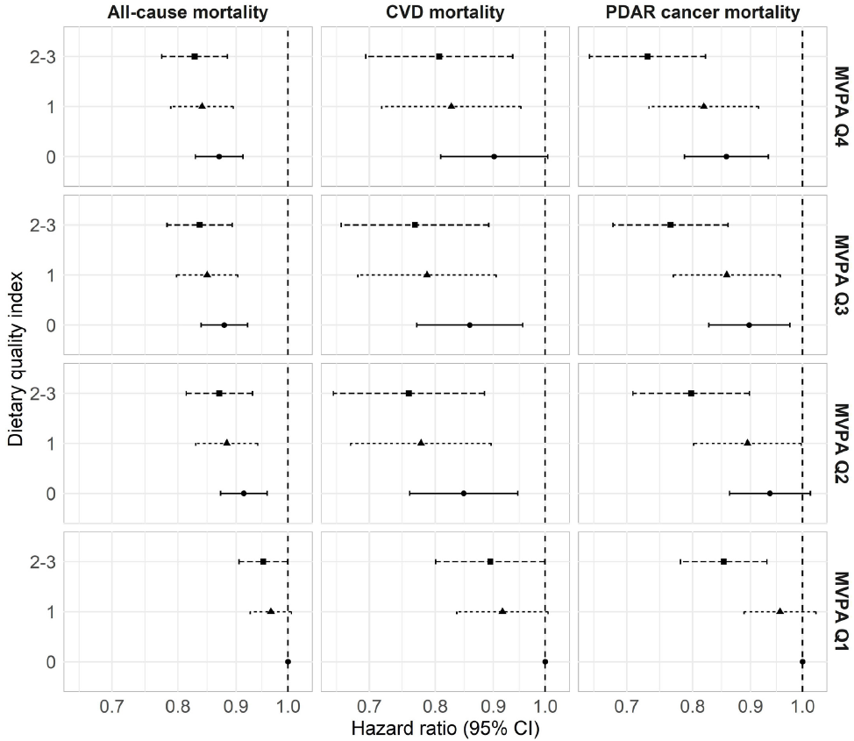
Can you exercise yourself to good health?
N=346 627 UKB (40-69 Yr), linkage to death records; 11 year F/U
All-cause, CVD and PDAR: physical activity, diet and adiposity-related cancer
Good Diet quality: Meeting the target for each category
(ie, ≥4.5 cups/day of fruit and vegetables, ≥2 serves/week of fish, and ≤2 times/week intake of processed meat and ≤5 times/week of red meat
Compared to Q1 of PA: 10-15% red in outcomes
No additive or multiplicative interactions between PA and dietary quality categories
Ding D, et al Br J Sports Med doi:10.1136/bjsports-2021-105195

Slide 15
Keating et al; 2024 Personal communication

Slide 16
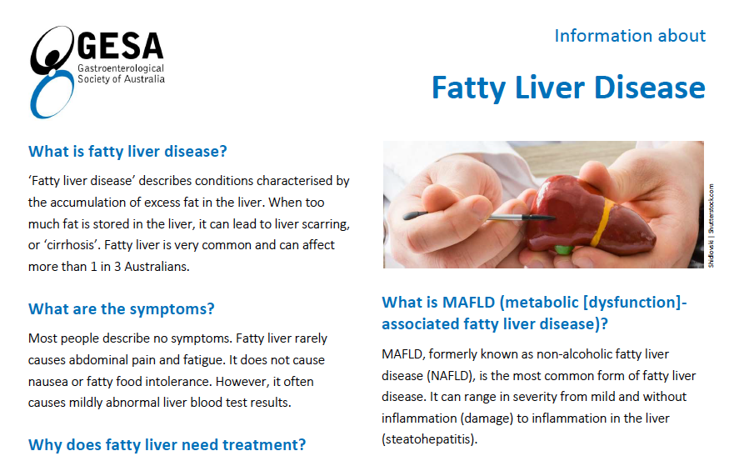
GESA MAFLD Patient factsheet
https://www.gesa.org.au/resources/patient-resources/

Slide 17
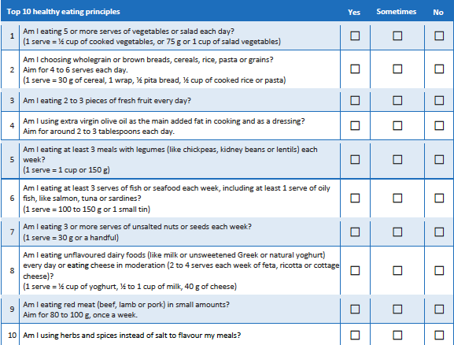
GESA MAFLD Patient factsheet
https://www.gesa.org.au/resources/patient-resources/

Slide 18
Planetary Health Diet Index and mortality
EAT-Lancet commission: high-quality plant-based food; low to moderate amounts of animal sourced foods, low intakes of saturated fats, refined grains, and sugar; feed all and reduce GHG 50% by 2050
66,692 females NHS (1986–2019), 92,438 females NHSII (1989–2019), and 47,274 males from Health Professionals Follow-up Study(1986–2018) all free of cancer, DM, and CVD at baseline
Pooled adjusted HRs were 0.77[95% CI :0.75,0.80] for all-cause mortality (P-trend < 0.0001); lower risk of deaths from CVD (HR:0.86), cancer (HR:0.90), respiratory diseases (HR:0.53), and neurodegenerative diseases (HR:0.72)
Feeding to 2050
GHG emissions 29% lower
Fertilizer needs 21% lower
Cropland use 51% lower
Irrigation water use 13% lower
HR for death
Bui LP et al Am J Clin Nutr 2024; https://doi.org/10.1016/j.ajcnut.2024.03.019

Slide 19

Huang Dee: Nai-Ching (2600 BC, First Medical Text)
Translation:
Superior doctors prevent the disease
Mediocre doctors treat the disease before evident
Inferior doctors treat the full-blown disease

