Slide 1

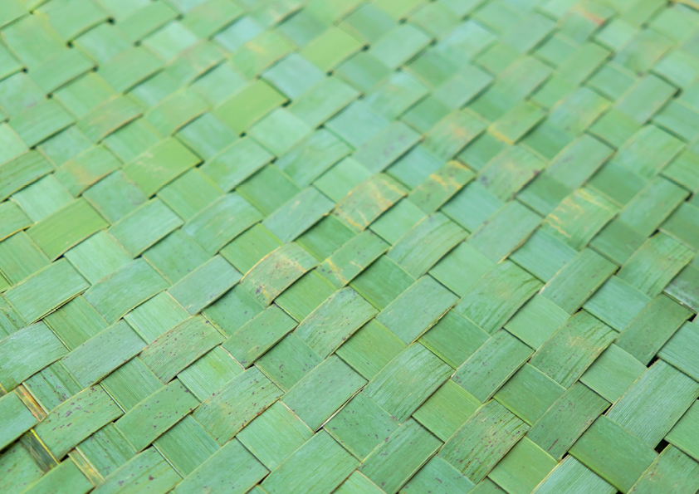

ANZAHPE 2026
ANZAHPE 2026
Weaving Connection
Nau te rourou, naku te rourou, ka ora ai te iwi
29 JUNE – 2 JULY 2026 | ŌTAUTAHI CHRISTCHURCH, AOTEAROA NEW ZEALAND

