Slide 1
Incentives for STI Testing? Impact and challenges in remote communities in central Australia
Australasian Sexual & Reproductive Health Conference, Tarndanya (Adelaide) on Kaurna Country, Adelaide | 16 September 2025
Kate Whitford, Bronwyn Silver, Handan Wand, Stephen Bell, Skye McGregor, Basil Donovan, Christopher Fairley, Rebecca Guy, Nathan Ryder, David Whiley, John Boffa, James Ward, John Kaldor
Notes:
I will begin by acknowledging the Kaurna people as the traditional owners of this land on which this conference takes place, the Tarndunya lands, and pay respects to elders past and present. Always was and always will be Aboriginal land.

Slide 2
Aboriginal and Torres Strait Islander research governance & ownership
This research was designed and conducted in collaboration with Aboriginal and Torres Strait Islander researchers and colleagues guided by the Closing the Gap priority reforms.
Disclosure of interests
I have no relevant financial or non-financial relationships to disclose
Notes:
I acknowledge that ideally this would be co-presented with an Aboriginal researcher, however I can confirm that this research was designed and conducted in collaboration with Aboriginal and Torres Strait Islander researchers and colleagues. This study was conducted some time ago, and those colleagues have moved on to other projects. I will explain the governance and study design, and Aboriginal and Torres Strait Islander input in more detail in the rest of the presentation.
No conflicts of interest to disclose

Slide 3
Background
STIs preventable disease burden
Aboriginal and Torres Strait Islander peoples a priority population
Higher rates in regional and remote areas of Australia
Access barriers to STI testing in health services
Incentives strategy to increase testing
More Options for STI Testing (MOST)– incentives to increase STI testing
Notes:
STIs an important area of health disadvantage in Australia
National STI and blood borne virus reporting highlights higher rates of STIs among Aboriginal and Torres Strait Islander young people / mainstream population
more pronounced in regional and remote areas of Australia
Testing and treating of STIs is a key strategy to reduce onward transmission of infections, however Aboriginal and Torres Strait Islander young people face various barriers to engagement with health services, such as:
Lack of access to culturally safe healthcare,
Services with high case load and multiple competing priorities
High staff turnover
Shame, embarrassment about being seen in the clinic,
Structural barriers such as transport, wait times or difficulties in accessing appointments
Incentives are one strategy that has been proposed to overcome some of these barriers. There has been success with this in other areas such as hepatitis C testing and treatment
This study, More Options for STI testing, or the MOST study, tested whether the provision of incentives- increased STI testing rates in remote communities in central Australia

Slide 4
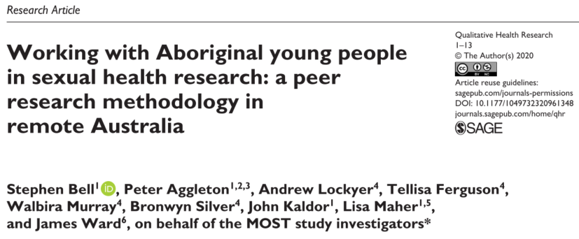
More Options for STI Testing (MOST) Study
2015 to 2020
University researchers, NT Health and Aboriginal Community Controlled Health services (ACCHSs)
Formative qualitative study (Bell et al, 2020) determined:
  Social and cultural acceptability
  Intervention design
7 ACCHSs in central Australia, Northern Territory
Key role played by ACCHSs
Notes:
The MOST study was carried out in partnership with academic researchers, NT Health and Aboriginal Community Controlled Health Services.
The design of the study was informed by a qualitative research component. This used peer-led research methods with Aboriginal and Torres Strait Islander young people to ensure that the design of the study and choice of intervention was suitable to the target population
The trial took place across seven ACCHSs in central Australia
ACCHSs service clinicians and managers had oversight and input into the trial. These services play an important role in delivering holistic primary care to the community, beyond just sexual health services. It is important point out that delivering this incentive was a huge additional workload for these services

Slide 5
Incentive intervention
April 2018 to September 2020
$30 phone voucher
Eligible if:
  Aged 16-29 years
  STI test at a participating clinic (chlamydia, gonorrhoea, syphilis)
Distributed by clinicians
Trial publicised: posters, radio, social media and targeted text messages
Regular reminders for staff
Notes:
Participants were eligible to receive a $30 phone voucher if they were aged between 16-29 years and had an STI test at any of the seven participating clinics during the trial period (April 2018 – September 2020)
They were eligible for another incentive after 6 months or 4 months if they had tested positive at the previous test
The incentive was delivered by the clinician during the appointment and recorded
The trial was promoted through various methods such as radio, posters around the clinic, social media, and text messages to the target population
Clinic staff were reminded regularly at meetings to offer the incentive

Slide 6
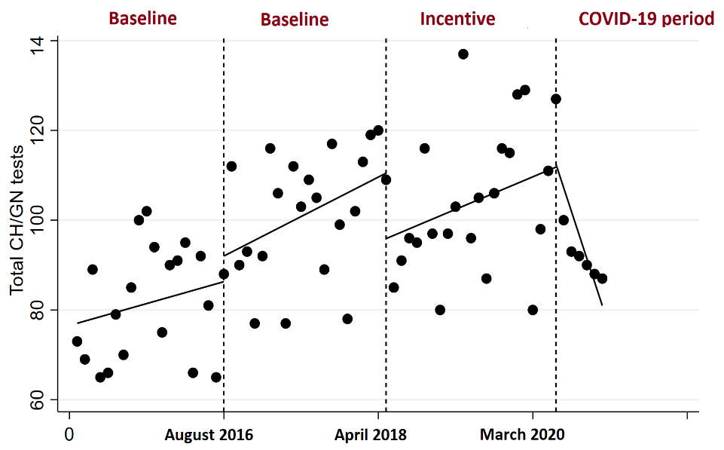
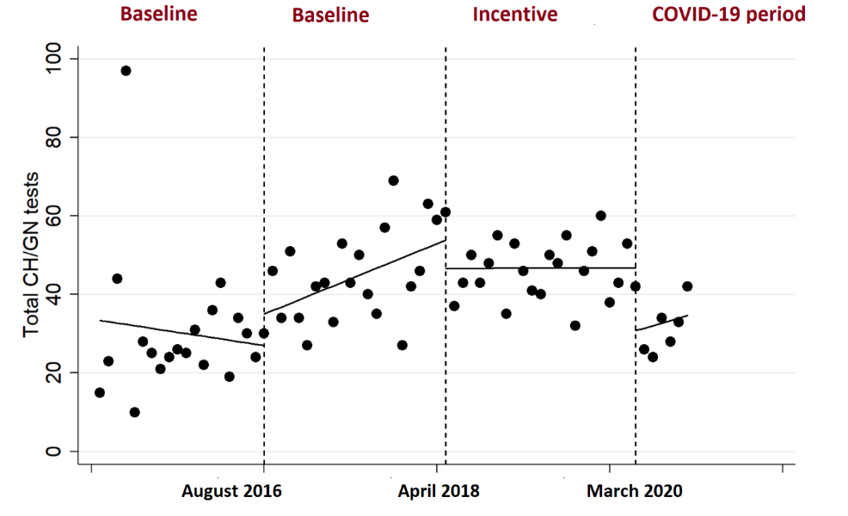
Number of chlamydia/gonorrhoea tests among women, per month
Number of chlamydia/gonorrhoea tests among men, per month
Baseline 1 Baseline 2 Incentives COVID-19
Baseline 1 Baseline 2 Incentives COVID-19
Total CTNG tests
Total CTNG tests
Notes:
STI testing data was extracted from the patient information management systems of participating clinics. We aggregated number of tests per month, and stratified by gender
We used an interrupted time series analysis to compare the uptake of STI testing in the incentives phase with the uptake in the period prior to the introduction of incentives
To account for the introduction of new clinics, and the COVID-19 pandemic during the trial period, we divided the results into four phases, baseline 1, baseline 2 (new clinics), incentives and covid-19/incentives
As you can see, there is a slight increase around the time of new clinics opening, the number of tests remained stable during the incentives phase and decreased when the COVID-19 pandemic started
We also found that STI testing among women 3x that of men across the baseline and incentives period (delete?)
The interrupted time series analysis demonstrated no significant change in testing after the introduction of incentives

Slide 7
Number of chlamydia/gonorrhoea tests among women and men, per month
 | Coefficient (95% CI)
 | Women (Figure 7) | Men (Figure 8)
Overall change in Baseline 1 phase | 0.49 (0.51, 1.48) | -0.34 (-2.04, 1.37)
Overall change in Baseline 2 phase | 0.88 (-0.07, 1.83) | 0.90 (0.19, 1.61)
Overall change in Incentive phase | 0.72 (-0.30, 1.74) | -0.01 (-0.49, 0.51)
Overall change in Incentive/COVID-19 phase | -5.25 (-8.72, -1.77) | 0.64 (-2.32, 3.61)
Notes:
In the analysis, the only significant change was among women only after the COVID-19 pandemic, a significant decrease of 5 visits per month

Slide 8
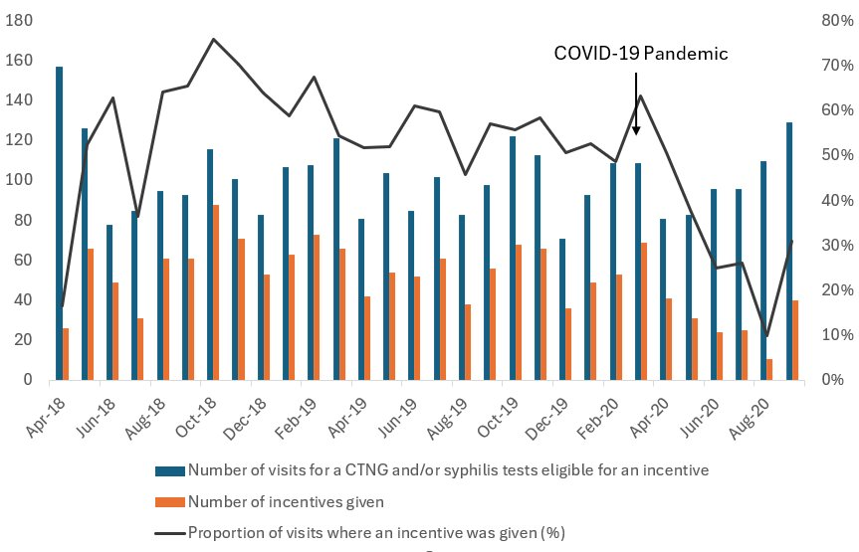
Proportion of eligible visits in which an incentive was given during the incentives phase
Notes:
We also measured the proportion of unique visits in which an incentive was given. This was variable, ranging from 26-76% during the incentives period, dropping to 10-59% of eligible visits after the COVID-19 pandemic

Slide 9
Impact and challenges
Coverage of incentives variable: 26-76% in Incentives Phase
Awareness of incentive
Appeal of incentive
Priority population = higher testing
COVID-19 – reduction in health service visits
Notes:
What are some explanations as to why there was no change in STI testing after the introduction of the incentives program?
Coverage of incentive was variable, Given the difficulties with the logistics of implementing such a large trial, this is quite an achievement in the context of high workload, opening of new clinics and other concurrent health promotion programs. Given that the coverage of the incentive was moderate, it is interesting that it didn’t have more of an impact on STI testing, however, even moderate coverage is only likely to impact people coming back to be re-tested rather than bringing in new clients.
Perhaps people in the community weren’t aware of the incentive. We didn’t collect data on why people came into the clinic so it is difficult to say.
The incentive might not have been enough to overcome barriers to coming into the clinic. Phone voucher was determined to be suitable during the formative qualitative research but differences in patterns of usage of wifi may have meant this was less appealing by the time the trial was underway.,
Aboriginal and Torres Strait Islander people are already a priority population so testing rates of this group my already be higher than in a mainstream service. It is difficult to increase testing rates when rates are already high.
The significant decrease only seen among women could be explained by different testing patterns during the COVID-19 pandemic. We speculated that they may attend more preventative appointments that are more likely to decrease in the context of lockdowns
5 minutes 30

Slide 10
Acknowledgements
Study participants
Dedicated ACCHS staff & Board
Local communities
Abdolvahab (Vahab) Baghbanian
Sam Moore
Walbira Murray
David Whiley
Funded by the National Health and Medical Research Council
Contact: kwhitford@kirby.unsw.edu.au

