Slide 1
2019 JOINT AUSTRALASIAN SEXUAL HEALTH AND HIV&AIDS CONFERENCE
Allgood.org.au
Karen Seager Resources Special Projects Manager
ASHM
Acknowledgements :
ASHM thanks all the individuals and organisations without whose contributions allgood.org.au would not have been possible
Disclosures:
Funding for the project was provided by the Australian Government Department of Health over three years from 2016-2019. No other funding was received in the development of this project.
Join the Conversation @ASHMMEDIA #HIVAUS19 #SH19
Notes:
I acknowledge the traditional owners of the land on which we meet and pay respects to the Elders past, present and emerging.
In 2016, ASHM received funding from the Australian Government Department of Health to develop web-based, culturally appropriate BBV and STI online resources for the priority populations of Aboriginal and Torres Strait Islander people, Sub-Saharan African, Southeast Asian, Indian, Pakistani, Afghani and Chinese people.
Information on HIV, HBV, HCV and STIs (syphilis, chlamydia and gonorrhoea) was developed in 22 languages including Yompla Tok (Torres Strait) and 4 sub-Saharan languages Dinka, Swahili, Somali and Shona.

Slide 2
2019 JOINT AUSTRALASIAN SEXUAL HEALTH AND HIV&AIDS CONFERENCE
CHALLENGES
_______________________________________________________________________________________
cultural and linguistic appropriacy across widely differing social norms
appropriate sexual health information
Join the Conversation @ASHMMEDIA #HIVAUS19 #SH19
Notes:
Developing a multi-lingual resource about BBVs and STIs for culturally diverse populations, (including Aboriginal and Torres Strait Islander populations) was a balancing act between the necessity of providing basic appropriate health information in a straightforward, non-clinical manner with the challenges of cultural and linguistic appropriacy across widely differing social norms. Such challenges stemmed not only from references to sexual practices, but the language used to describe them.

Slide 3
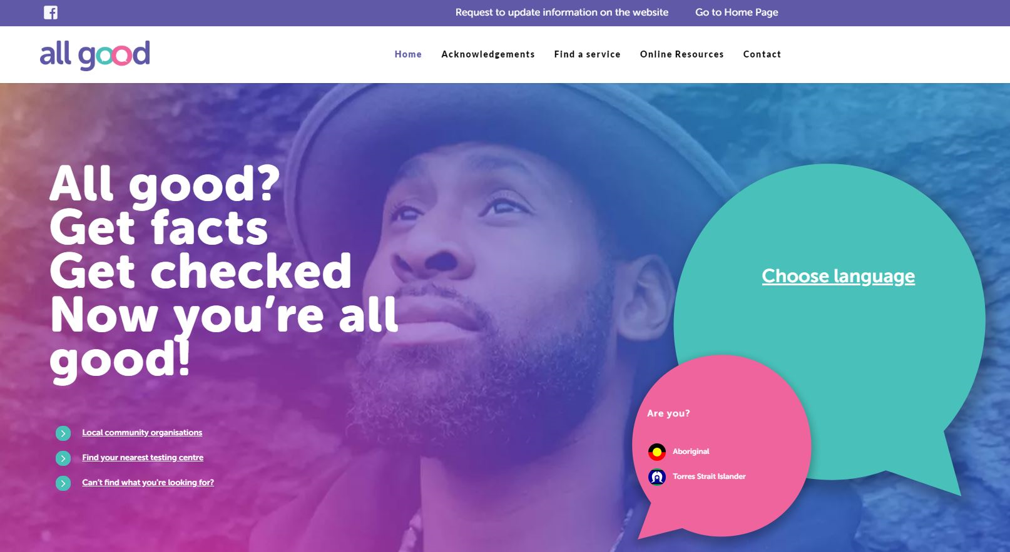
2019 JOINT AUSTRALASIAN SEXUAL HEALTH AND HIV&AIDS CONFERENCE
Content challenges:
Translators, editors, proof-readers, in 22 languages
Emerging languages with no NATTI translators e.g. Shona, Dinka
Recording challenges
Voiceover artists
finding talent who were comfortable recording the content (in case they were recognised in their communityadd text
Join the Conversation @ASHMMEDIA #HIVAUS19 #SH19
Join the Conversation @ASHMMEDIA #HIVAUS19 #SH19
Notes:
Working with 22 languages, some of them emerging languages in Australia, presented difficulties with translations, accuracy, proofing, and editing. Difficulties finding translators and editors for some of the emerging languages, particularly from Sub-Saharan Africa. How do you find accurate and reliable translators when there is no formal (NATTI) accreditation?
Issues arose when the translator or editor accepted then refused the work due to the content and subject matter. Or worse, just didn’t do it but didn’t want to admit they found the content too confronting but kept promising to deliver.
RECORDING
Further challenges were associated with sourcing voiceover artists prepared to record material which may be confronting for them since they are also part of the community being targeted, and the project delays this inevitably caused. Sometimes these challenges were not brought up until the day of the recording

Slide 4
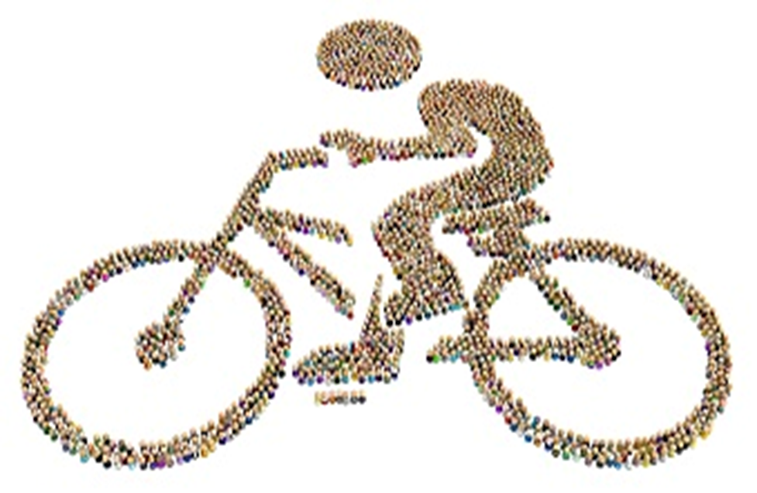
2019 JOINT AUSTRALASIAN SEXUAL HEALTH AND HIV&AIDS CONFERENCE
Results
374,331 unique website users to 31 July 2019
In-language information highly valued
You get a lot of information about these diseases on
allgood website. I get to know that HIV is not transferred
through just by shaking hand or even drinking HIV infected person water from the same glass which I was not
aware before.
Urdu –speaking man
We can choose our language and we can understand easily.
Khmer - speaking woman
Join the Conversation @ASHMMEDIA #HIVAUS19 #SH19
Notes:
Don’t try to do it all yourself
In years 1 and 2 we handled all the translators and reviewers ourselves. This meant dealing with at least three people for each of the first 17 languages. (51+ people)
Don’t ride your own race..
Take others along for the ride
In the third year, we used two separate and unrelated agents who sourced the translators and editors. Each language had at least 4 sets of eyes reviewing the translations, checking spellings, vocabulary and changes being made even on recording day (88+ people).
Plan for delays
It will always take longer than you expect regardless of contracted timeframes!
Communication
Such information needs to be dealt with sensitively. Being able to get the language speakers to acknowledge and accept the importance of the overall resource and helping them deal with their own cultural taboos whilst working on the project meant spending a great deal of time and patience with many individuals.
RESULTS
External evaluation showed that the provision of information in multiple languages was highly valued by community members and was enhanced by the availability of in-language audio which was regarded as innovative and very useful.
In-language information was considered important in reducing embarrassment and discrimination and improving access to health services.

