Slide 1
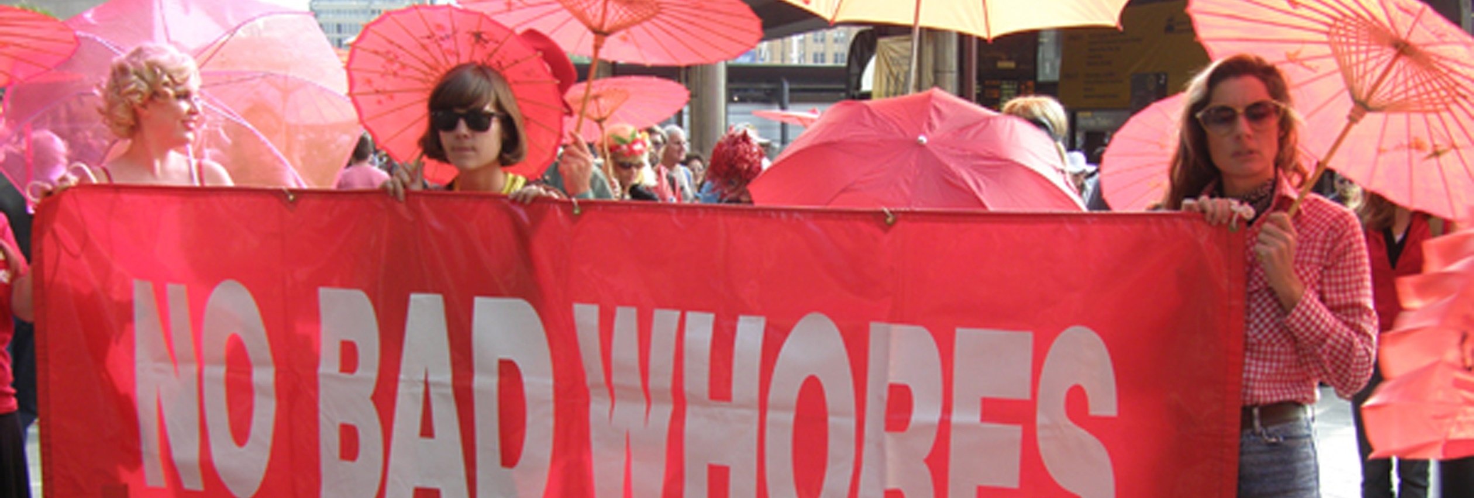
Implementing human rights HIV responses through the decriminalisation of sex work. By Kali Kanivale (Scarlet Alliance, Australian Sex Workers Association)

Slide 2
Content
- How does criminalisation impact the HIV response?
- What is the decriminalisation of sex work?
- How does decriminalisation assist the HIV response?
- Decriminalisation campaigns in Australia.

Slide 3
Punitive laws, policies and practices around sex work reduces sex workers access to HIV prevention, treatment and support.
Image from the Lancet: HIV and sex work.
Notes:
Experience and research show that “punitive laws, policies and practices around sex work does not reduce the number of sex workers or our clients”.
Instead, they change the way sex workers work, increasing vulnerabilities by disrupting our work environment, support networks and safety and harm reduction strategies, and reduce our access to justice, health and support services.
Criminalisation has been shown to negatively impact HIV programs and services for sex workers.
This is because criminalisation rushes negotiations with clients, creating barriers to talking about and implementing safer sex practices.
Within criminalisation, condoms are used as evidence of sex work by police, it creates barriers to carrying adequate amounts of condoms.
When sex workers carry sexual health and harm reduction resources, these things can also be used by the police as evidence of sex work.
It also creates obstacles in accessing HIV prevention, treatment and support as sex workers fear that using services will result in being revealed or reported to the authorities.

Slide 4
“The decriminalisation of sex work would have the greatest effect on the course of HIV epidemics across all settings, averting 33-46% of HIV infections in the next decade.”
Notes:
The Lancet series on HIV and sex work that was published in 2014 found that ‘the decriminalisation of sex work would have the greatest effect on the course of HIV epidemics across all settings, averting 33-46% of HIV infections in the next decade’.
This is significant because the Lancet series also found that scale-up of ART alone will avert HIV infection by 9–34%.
However, this is in contrast to 33–46% reduction achieved by decriminalising sex work alone. This is because decriminalisation has an immediate and sustained effect on violence, policing, safer work environments, and condom use.
Research has consistently found that efforts to roll out targeted HIV programs, including biomedical programs, are hindered by structural factors such as criminalisation and other punitive laws and practices towards sex workers.
The scale up of effective HIV responses for sex workers is only feasible alongside other structural change, such as law reform and addressing stigma.

Slide 5
What is Decriminalisation?
Removes police as regulators of the sex industry
Repeals criminal laws specific to the sex industry
Regulates sex industry businesses through standard business, planning and industrial codes
Does not single out sex workers for specific regulation
Is a whole-of-government approach to regulation.
Slide by Jules Kim, “The Full Decriminalisation of Sex Work for Sex Workers Rights, Health and Safety”.
Notes:
Decriminalisation is the removal of criminal laws pertaining to sex workers HIV status, sexuality, sex and gender identity, work, workplaces and our clients.
However, decriminalisation does not mean de-regulation or no-regulation.
Within decriminalisation, sex industry businesses are treated like any other business and are subject to existing regulatory mechanisms, such as local council planning; zoning and location controls; workers compensation requirements; occupational health and safety standards; and industrial rights obligations. Police are not involved as regulators at any level unless there is a breach of law.
Existing laws are sufficient to regulate the sex industry:
Business
Industrial
Planning
Health
Criminal laws
Decriminalisation supports the development and enforcement of work health and safety standards, access to industrial protections, and allow sex workers to organise for better working conditions.

Slide 6
Decriminalisation of sex work must also include the removal of criminal laws around HIV and STIs, sex and gender identity, sexual health testing and condom use.
Image from the Lancet: HIV and sex work.
Notes:
Decriminalisation of sex work must also include the removal of criminal laws around HIV and STIs, sex and gender identify, sexual health testing and condom use.
Other laws and practices continue to target sex workers for prosecution and create barriers to ensuring an enabling environment for the implementation of effective HIV responses targeting sex workers.
In Australia, the intersection of criminalisation and stigma and discrimination against trans and gender diverse sex workers has resulted in the targeting of LGBTIQ sex workers for policing and harassment. As a result, the removal of stigma and discrimination against sexuality, sex and gender identity is an integral part of the decriminalisation of sex work.
Mandatory condom use, which we also have in Australia, singles out sex workers for specific, unnecessary regulation.
Mandatory condom use laws are difficult and costly to enforce, leading to entrapment of sex workers by police and barriers to sex workers’ access to health and justice services.
Mandatory condom use fails to recognise that it was the implementation of sex worker peer education programs that has been central to maintaining low rates of STIs and BBVs amongst sex workers, not mandatory condom use. Peer educator programs in Australia were instrumental in persuading brothel managers and workers to adopt safer sex practices.
Mandatory sexual testing of sex workers is ineffective, costly and a violation of sex workers’ human rights.
Australia’s HIV and STI National Strategies explicitly indicate that mandatory sexual health testing of sex workers is a key barrier to evidence-based prevention, access to testing and healthcare services.
This is because mandatory testing ‘endorses a false sense of security’ as sexual health testing cannot actually confirm an individual’s current health status as sexual health tests cannot pick up recent BBV or STI transmission and undermines the need to use safer sex practices.
Criminalisation of sex workers with HIV, which we also still have in Australia, undermines the HIV response in a number of ways.
While Australia has moved to repeal criminal laws against people with HIV as it is recognised to be an ineffective strategy to prevent the transmission of HIV as well as unnecessary and a violation of the rights of people with HIV, also in the major medical advances in treating HIV and U=U, sex workers with HIV continue to be explicitly criminalised in a number of states in Australia.
The criminalisation of sex workers with HIV also creates disincentives for all sex workers to test and know their HIV status as a positive HIV result can lead to instant exclusion from the regulated sex industry, unemployment, stigma and discrimination, and if one continues to work with HIV, criminal charges, incarceration and fines.
Fear of criminal investigations and having our confidentiality breached creates barriers for sex workers living with HIV to disclose their status and sex work, reducing health professional’s ability to comprehensively assess the health needs of sex workers living with HIV.

Slide 7
Australian Capital Territory
Repeal criminal laws against sex workers and clients.
Removed registration of independent sex workers.
Sex industry operators required to provide safer sex supplies
Updated stigmatising language
Notes:
As Australia’s sex industry laws are regulated at the state level, there are a number of active decriminalisation campaigns happening in various states and territories in Australia. These campaigns are sex worker driven and have gained wide support from the local community, politicians and other community organisations.
In the Australian Capital Territory, local sex workers, SWOP ACT and Scarlet Alliance in partnership with AIDS Actions Council of the ACT were successful in bringing forth some important law reforms. Importantly, laws against seeing or being a sex worker was removed.
In its place, sex workers and clients were decriminalised and brought in line with the ACT’s Public Health which require that all individuals ‘take reasonable precaution against’ transmission.
Also, the Act removed the remove the requirement for independent sex workers to register as it was recognised that registration was a policy failure as very few sex workers were willing to disclose their legal names to a government authority.
Sex industry businesses were also required to provide safer sex supplies to sex workers free of charge.
Updated language, such as replaced the word prostitute with sex work and sex worker.
ACT sex workers continue to campaign for full decriminalisation and the removal of counterproductive laws against sex workers.

Slide 8
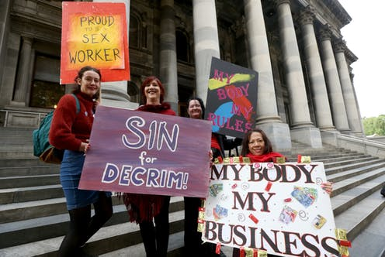
South Australia
Notes:
The peer sex worker organisation in South Australia, the Sex Industry Network of South Australia, along with Scarlet Alliance and individual sex workers are currently campaigning for the Decriminalisation of Sex Work Bill to be passed in parliament.
The South Australian sex industry is largely criminalised. The Bill has passed the upper house and waiting to be approved by the lower house. If this bill is passes, South Australia will be the first state to fully decriminalise sex work, leaving no one behind.
The Decriminalisation of Sex Work Bill was put together in consultation with sex workers. It provides sex workers with anti-discrimination rights, replaces outdated terminology, and ensures sex workers can gain access to our workers rights.
This bill has received wide support from women’s groups, politicians and the community.

Slide 9
Queensland
Notes:
The Decrim Queensland Campaign, driven by the local sex worker organisation, Respect Inc, and individual sex workers, is advocating for the removal of Queensland’s archaic sex industry laws. Decrim Queensland has produced many videos, factsheets and conducted forums highlighting the negative impact of current sex industry laws on the safety and health of sex workers.

Slide 10
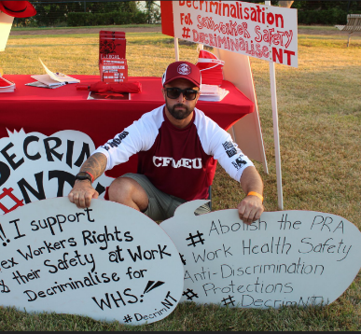
Northern Territory
Notes:
In the Northern Territory, the local sex worker organisation, Sex Workers Outreach Program, and the Sex Worker Reference group have made positive progress in mobilizing various political parties to put a decriminalisation bill on their agenda. In 2019, one of the major political party’s committed to consulting sex workers to put together a decriminalisation bill that addresses sex workers anti-discrimination rights, removal of outdated and stigmatising language, removal of criminal penalties relating to sex work and ensure sex workers access to our labor and workplace health and safety rights.

Slide 11
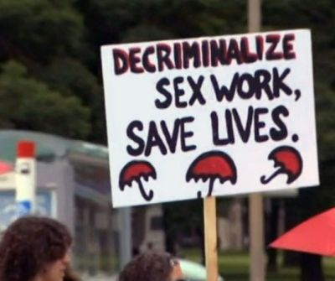
Notes:
At the 2014 International AIDS conference, there were unanimous and united calls for decriminalisation of sex work.
Decriminalisation is also supported by United Nations, UNAIDS, UNFPA, UNDP, Amnesty International, International Labor Office (ILO), World Health Organisation, Lancet Medical Journal, Global Alliance Against Trafficking in Women, Global Network of Sex Work Projects, Asia Pacific Network of Sex Workers, and within Australia’s National BBV and STI Strategies.
There are sex worker organisations and decrim campaigns in the states and territories in Australia and throughout the Asia Pacific Region. Decriminalisation of sex work is a critical component to scaling up the HIV response and meeting the targets to reducing HIV transmission and increasing access to treatment and care. The HIV community need to support us in our decrim and law reform campaigns to make sure that sex workers, an already under-served community, are not left behind in the HIV response.

