Slide 1

Cybersecurity and people with HIV
Understanding Threats, Prevention, and Best Practices
Aaron Cogle
Executive Director
Notes:
Welcome everyone! Today, we’ll explore the importance of cybersecurity, common threats, and how to protect ourselves in an increasingly digital world.
And to make this relevant to NAPWHA – we have seen that we are under attack as well…

Slide 2
Why should you care about Cybersecurity?
Cybersecurity and people with HIV
Saysana –
Communication /
Community
Engagement
Good Quality of Life for People with HIV
End HIV transmissions
You don’t own
your data
You never know
to what future uses
your data will
be put
Data reveals things
about you
Legal or
authorised use of
your data can also
be used against you
or for someone
else
Unauthorised
misuse of your data
can be used against
you or for
someone else
Online social environments are detrimental to our relationships, to
our personal
security and to our wellbeing
2
Notes:
Cybersecurity is essential in a world where we rely on digital services daily. It prevents unauthorized access, data breaches, and cyberattacks.
Cybersecurity protects systems, networks, and data from cyber threats.
It involves technologies, processes, and best practices to safeguard digital assets.
It’s about protecting data at rest, during transmission and during processing
There’s an inverse relationship between cybersecurity and convenience: secure systems are hard to use.
Cybersecurity is about protecting the confidentiality, integrity and availability of data

Slide 3

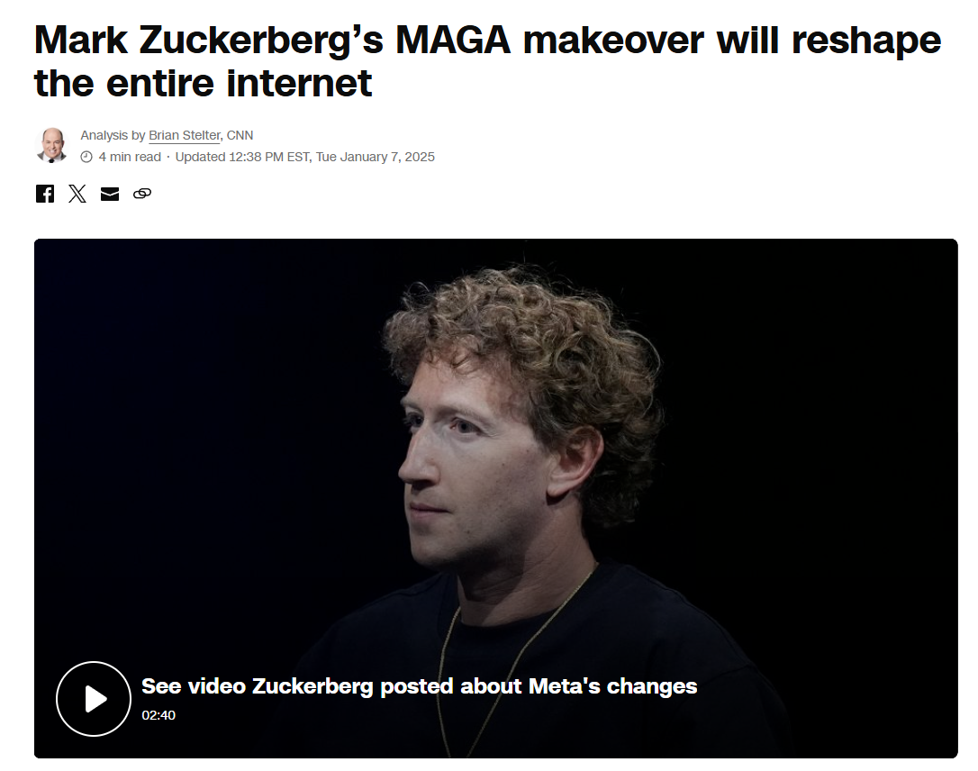
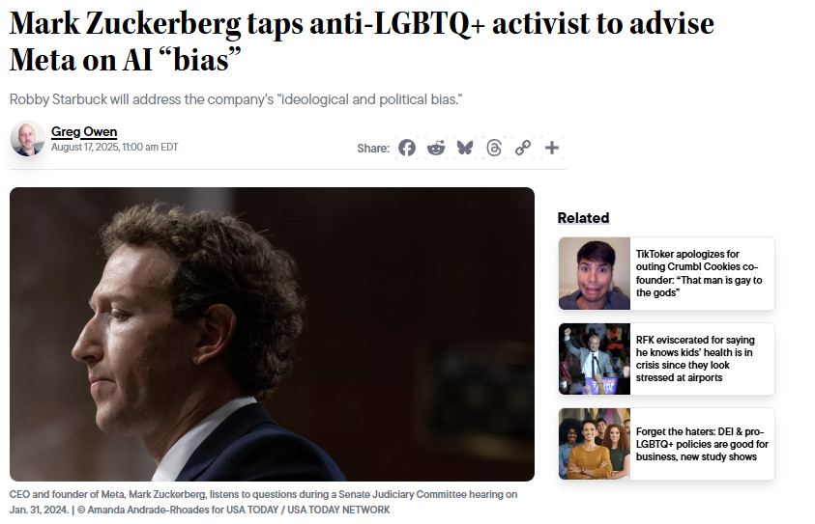
New social media threats
Cybersecurity and people with HIV
Saysana –
Communication /
Community
Engagement
Good Quality of Life for People with HIV
End HIV transmissions
3
Notes:
Cybersecurity is essential in a world where we rely on digital services daily. It prevents unauthorized access, data breaches, and cyberattacks.

Slide 4
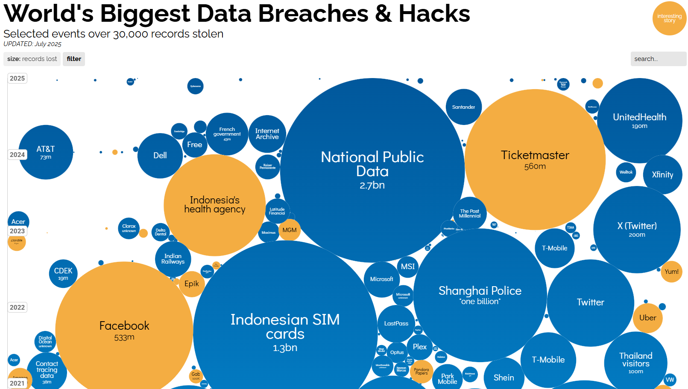
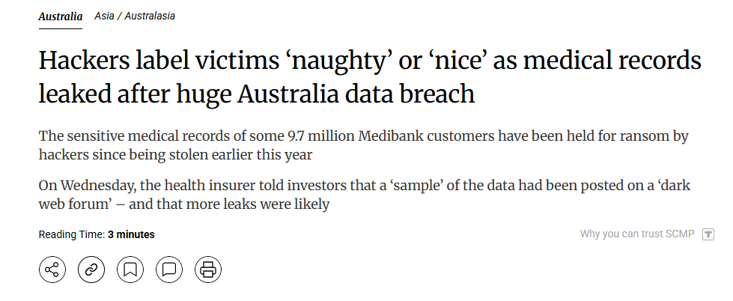
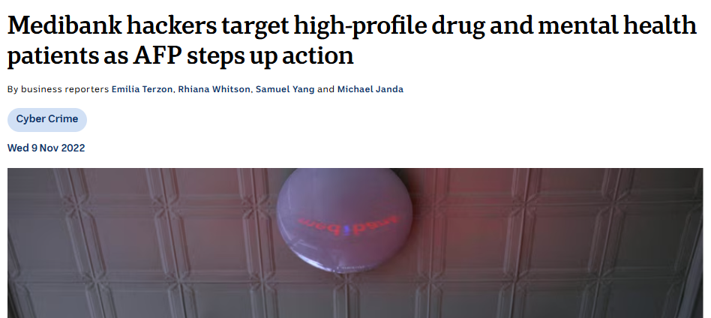
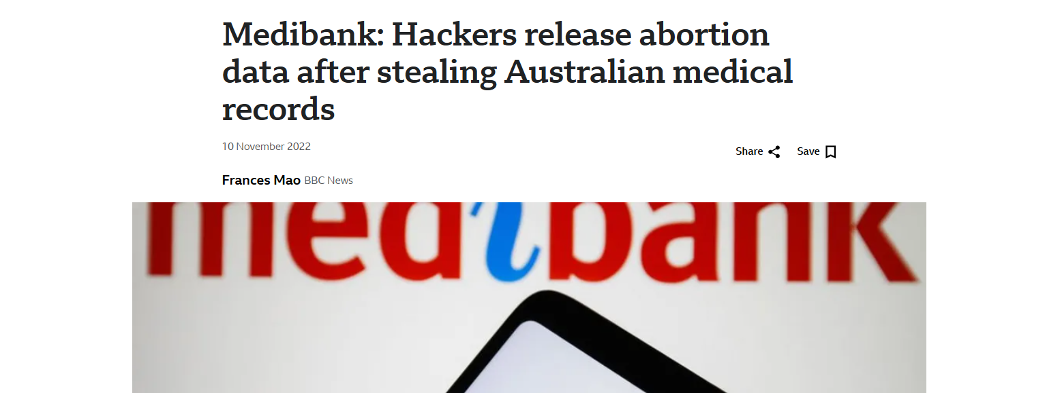
Breaches of Cybersecurity
Cybersecurity and people with HIV
Saysana –
Communication /
Community
Engagement
Good Quality of Life for People with HIV
End HIV transmissions
https://informationisbeautiful.net/visualizations/worlds-biggest-data-breaches-hacks/
4

Slide 5
Existing Cyber Threats of the Social
Cybersecurity and people with HIV
Saysana –
Communication /
Community
Engagement
Good Quality of Life for People with HIV
End HIV transmissions
Cyber Abuse
Provides a tool to stalk, harass, discriminate, ’out’ and otherwise stigmatise people with HIV
Unhelpful Comparisons Negatively impacts self esteem and creates an imaginary view of the lives of others
Constant Anger
Invites us to focus on division and to disagree
Misinformation
Even if you identify it as false, the agenda changes you because you are looking at a curated feed
Addictive
Undermines concentration and removes ability to undertake restorative practices
Poorly Simulates real human Connection
Always at the expense of an actual human interaction. What else could you be doing?
5
Notes:
These are some of the most common cybersecurity threats, with phishing and malware being the most frequent.

Slide 6
New Cyber Threats of the Social
Cybersecurity and people with HIV
Saysana –
Communication /
Community
Engagement
Good Quality of Life for People with HIV
End HIV transmissions
ALGORITHMIC ATTACK
UNMODERATED
UNREGULATED OR INEFFECTVIELY REGULATED
CREATION OF DATABASES OF THE SURVEILLED MARGINALISED
LIMITED POSSIBILITY FOR REDRESS
1
2
3
4
5
The algorithm is now trying to radicalise you with visions of hate, untethered to reality
Deceptive emails tricking users into revealing sensitive information
Intercepting communications to steal data
Overloading networks to cause downtime
Attacks targeting unknown software vulnerabilities.
6
Notes:
These are some of the most common cybersecurity threats, with phishing and malware being the most frequent.

Slide 7
What do we do?
Cybersecurity and people with HIV
Saysana –
Communication /
Community
Engagement
Good Quality of Life for People with HIV
End HIV transmissions
Admit we have a problem
Analyse why we are using these platforms
Resolve to take action
Respond individually and collectively (as a community and as community organisations)
7
Notes:
These best practices can protect you from most cyber threats. A strong security foundation is essential for everyone.

Slide 8
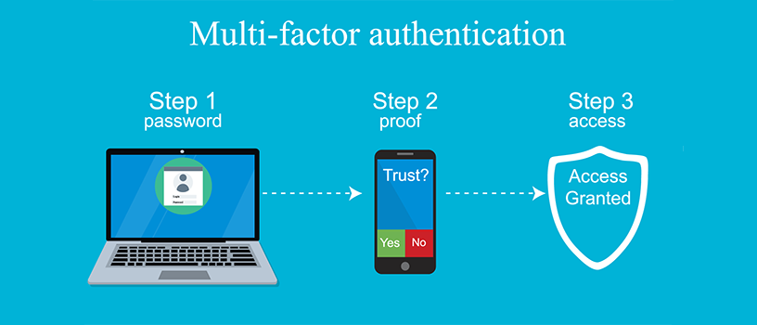
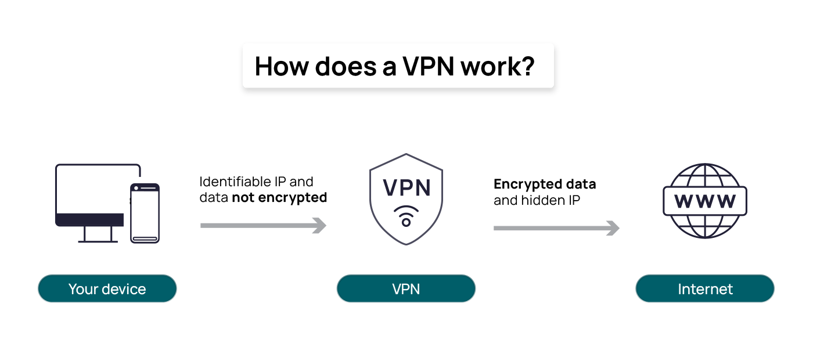
What do we do personally?
Cybersecurity and people with HIV
Saysana –
Communication /
Community
Engagement
Good Quality of Life for People with HIV
End HIV transmissions
Basic Cyber Security protections – VPN, Strong passwords
Think about if you need to be on social media at all. Minimise interaction.
Lock down your accounts.
Block and mute accounts you find problematic or harmful. Backup and Encrypt Important Data Regularly.
Manage your public presence (be anonymous).
8
Notes:
These best practices can protect you from most cyber threats. A strong security foundation is essential for everyone.

Slide 9
What do we do collectively?
Cybersecurity and people with HIV
Saysana –
Communication /
Community
Engagement
Good Quality of Life for People with HIV
End HIV transmissions
Only collect data that is absolutely necessary
Minimise our use of social media (especially riskier platforms)
Create opportunities for more fulfilling connection and peer support (phone, email, face to face etc.)
Help our communities manage their own risk
9
Notes:
These best practices can protect you from most cyber threats. A strong security foundation is essential for everyone.

Slide 10
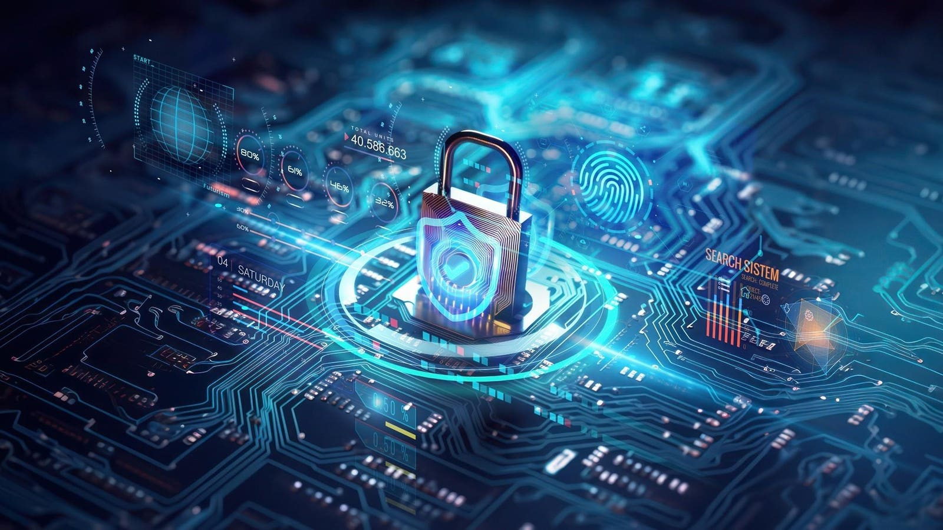
Final thoughts
Cybersecurity and people with HIV
Saysana –
Communication /
Community
Engagement
Good Quality of Life for People with HIV
End HIV transmissions
There are workplace related protections that cover online work
Common law protections
Anti-bullying protections and anti harassment protections
Anti-discrimination protections
Online Safety Act
Privacy Act
Australian Consumer Law
Duty of Digital Care?
10
Notes:
Thank you for your time! Cybersecurity affects all of us, and staying informed is the first step in staying secure. Now, I’d love to hear your questions!

Slide 11

Thanks to my contributors
Cybersecurity and people with HIV
Saysana –
Communication /
Community
Engagement
Good Quality of Life for People with HIV
End HIV transmissions
Daniel Reeders
Kath Albury (and her team)
Beau Newham
Scott Harlum
NAPWHA Team
11
Notes:
Thank you for your time! Cybersecurity affects all of us, and staying informed is the first step in staying secure. Now, I’d love to hear your questions!

Slide 12
Why is Cybersecurity important?
Cybersecurity and people with HIV
Saysana –
Communication /
Community
Engagement
Good Quality of Life for People with HIV
End HIV transmissions
Cybercrime costs trillions of dollars annually.
Data breaches expose personal & financial information.
Cyberattacks disrupt businesses and critical infrastructure.
Unsafe cyber spaces can negatively impact wellbeing. Redress is unlikely.
12
Notes:
Every day, cyberattacks target individuals, companies, and governments. Protecting our data is crucial for privacy and financial security.

Slide 13
Common Cyber Threats
Cybersecurity and people with HIV
Saysana –
Communication /
Community
Engagement
Good Quality of Life for People with HIV
End HIV transmissions
Malware
Viruses, worms, ransomware, spyware
Phishing
Deceptive emails tricking users into revealing sensitive information
Man-in-the-Middle Attacks Intercepting communications to steal data
Denial-of-Service (DoS) Attacks Overloading networks to cause downtime
Zero-Day Exploits
Attacks targeting unknown software vulnerabilities.
13
Notes:
These are some of the most common cybersecurity threats, with phishing and malware being the most frequent.
*note on how attackers operate

Slide 14
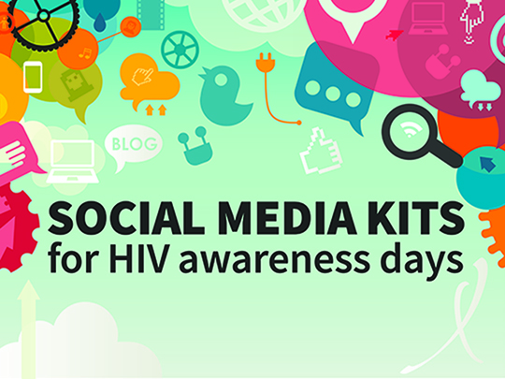
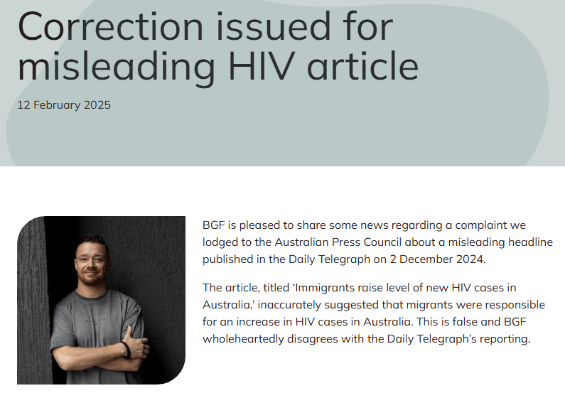

What do we do (personally)?
Cybersecurity and people with HIV
Saysana –
Communication /
Community
Engagement
Good Quality of Life for People with HIV
End HIV transmissions
Admit we have a problem– Mix letters, numbers, and symbols; long and complex, avoid predictable patterns
Mine our communities for existing mechanisms of resistance
Adopt methods of personal resistance and protection.
Respond collectively as a community and as community organisations.
14
Notes:
These best practices can protect you from most cyber threats. A strong security foundation is essential for everyone.

