Slide 1
Developing a digital tool that *actually* tells people where they can get an STI test
Australasian Sexual & Reproductive Health Conference
Jordan Murray
  Senior Program Manager, STI Programs Unit
  NSW Ministry of Health
September 2025
Notes:
My name is Jordan Murray and I work as a Senior Program Manager at the NSW Health STI Programs Unit and I am so happy to be here today to talk to you about a digital tool that we launched at the end of last year that *actually* tells people where they can get an STI test.

Slide 2
Disclosure of interest
The development of this tool was paid for by NSW Health
Notes:
I will note that the development of this tool was paid for by NSW Health .

Slide 3

Acknowledgement of Country
We acknowledge the Traditional Custodians of the lands that we are meeting on today. We pay our respects to Elders past, present and emerging and celebrate the diversity of Aboriginal peoples and their ongoing cultures and connections to the lands and waters of NSW.
We also acknowledge and pay our respects to our Aboriginal and Torres Strait Islander people/colleagues joining us today.
This artwork, titled Shared Journeys, was created by Charmaine Mumbulla. It features weaving lines of land and waterways found on Country throughout NSW. Together they symbolise connection and togetherness on a shared journey towards sexual health.
Notes:
Before I get started, I would like to acknowledge the traditional custodians of the land on which the conference is taking place, the Kaurna people of the Adelaide Plains. I pay my respects to their elders past, present, and any Aboriginal people in the room today. I am grateful for the opportunity to gather and learn on this beautiful land and acknowledge that it always was, and always will be, Aboriginal land.​

Slide 4
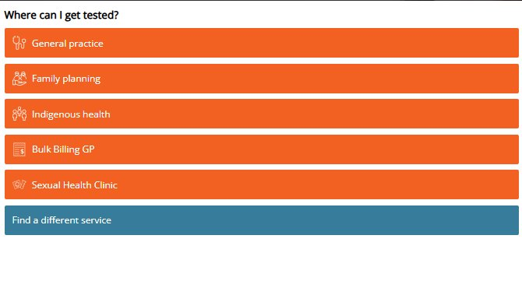
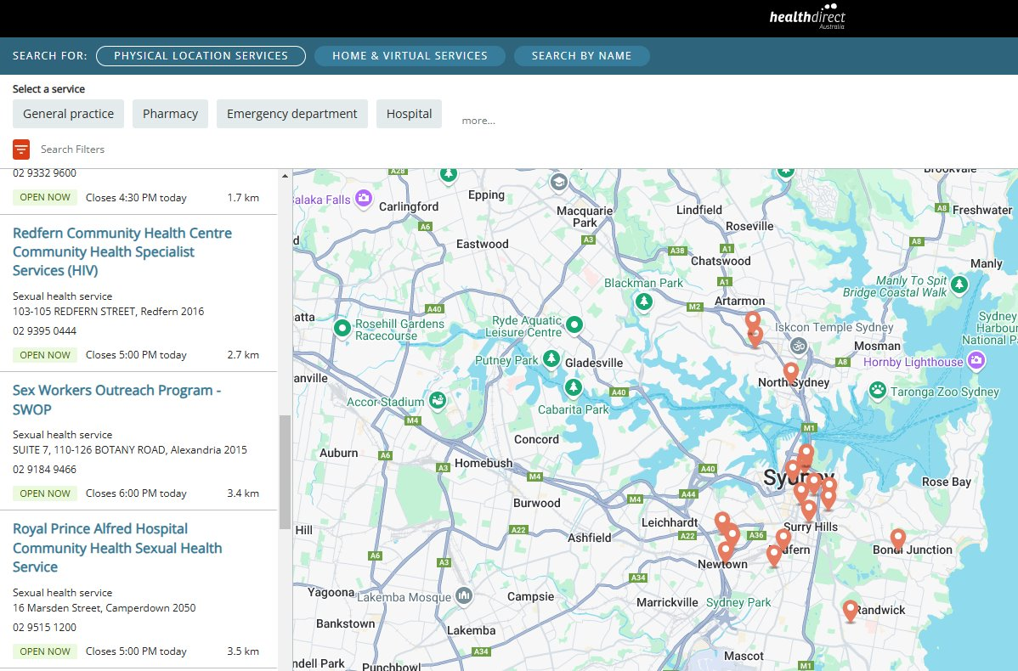
Background
Play Safe is NSW Health’s leading sexual health prevention program for young people aged 15–29.
Young people in NSW remain disproportionately affected by STIs, accounting for 53% of notifications, yet only 46% have ever been tested.
Increasing barriers to testing for young people include lack of knowledge of services, cost and appointment availability.
The previous healthdirect widget was no longer fit for purpose.
Previous healthdirect widget on the Play Safe website
Notes:
Play Safe is NSW Health’s leading sexual health prevention program for young people aged 15–29. It provides clinically accurate, engaging, and accessible information about STIs and HIV, primarily through digital health promotion strategies.
Young people remain disproportionately affected by STIs, accounting for 53% of notifications, yet only 46% have ever been tested, according to our annual Play Safe user survey. Reported barriers include limited awareness of where to go, cost, appointment availability, and reduced access to bulk-billing options. With increasingly strict eligibility criteria and limited capacity at publicly funded sexual health clinics, asymptomatic young people often struggle to know where to get tested.
Historically, the Play Safe website relied on an outdated healthdirect widget to connect young people with nearby services. However, the widget was not mobile-optimised (despite mobile making up more than 85% of site traffic), was often blocked by ad blockers, offered no ability to filter or personalise results, and frequently directed users to irrelevant services such as vasectomy clinics, NGO offices, or relationship counselling services.
To address these challenges, the NSW STI Programs Unit developed and launched a new interactive STI Testing Locator on the Play Safe website.

Slide 5
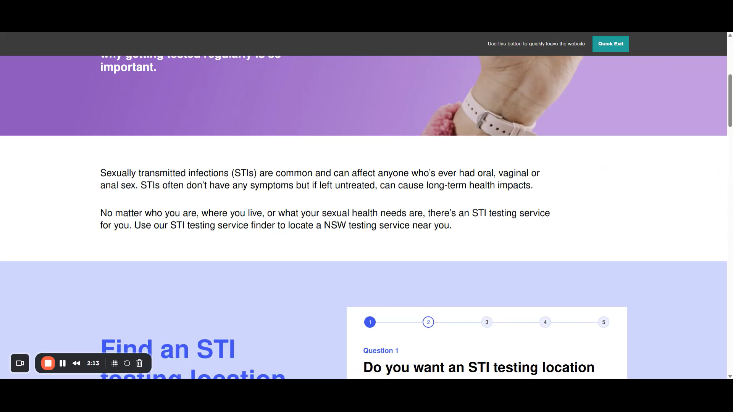
Play Safe STI Testing Locator
Powered by the healthdirect Service Finder API
Users asked five simple questions to receive tailored results based on their answers:
  Bulk billing preference
  Accessibility needs (optional)
  Aboriginal or Torres Strait Islander status
  Age
  Postcode
Notes:
The Play Safe STI Testing Locator is a user-friendly tool designed to connect young find convenient STI testing services across NSW.
Powered by the healthdirect Service Finder API, we worked with a developer to configure the dataset to display GPs, sexual health clinics, family planning services, youth health services with testing facilities and Aboriginal Medical Services (for users who identify as Aboriginal and/or Torres Strait Islander). From what we can gather, this is the first tool of its kind in Australia to integrate both primary care and specialist sexual health services into one streamlined search experience.
Accessible via the Play Safe website, the locator guides users through five simple, non-identifiable questions covering bulk billing preference, accessibility needs, Aboriginal or Torres Strait Islander status, age, and postcode. Based on the responses, the tool displays a range of nearby STI testing services (or the closest available options in rural areas) via a map or list. We have also incorporated key messages in place of listings throughout the search results to promote priority messages.
Users can then click on a service listing which brings up a landing page with key details about the service including phone number, opening hours, practitioner information (where available), directions via Google Maps, and accessibility information.
All service information is automatically refreshed every 20 minutes via the healthdirect API, eliminating the need for manual updates and ensuring accuracy. We have also incorporated key messages in place of listings throughout the search results to promote priority messages.
By highlighting that STI testing is available in primary care settings as well as specialist clinics, the locator helps reduce barriers to testing, improve access through general practice, and ease demand on publicly funded sexual health services. This ensures resources are directed to those who need them most. The tool is also valuable for health professionals, who can use it to quickly identify and refer patients to suitable testing options.

Slide 6
Results and findings
Early evaluation data indicates:
Over 25,000 people have used the locator since it launched in November 2024
There has been a 240% increase in searches, compared to the previous tool.
Form/questionnaire completion rate is 89%
User search data insights
68% of users aged between 16-29 years
6% identified as Aboriginal and/or Torres Strait Islander
57% searched for bulk billing only services
Notes:
Early evaluation data indicates that since the Play Safe STI Testing Locator launched in November 2024, over 25,000 people have used the tool, and there has been a 240% increase in searches since the new locator launched.
In terms of completion rates, we have been pleasantly surprised, with about 89% of people who start using the tool, finishing answering questions and viewing search results.
Looking at user search data, 68% of users are aged between 16 and 29 years, 6% identified as Aboriginal and/or Torres Strait Islander, and 57% searched for bulk billing only services.
We are finalising a Google Data Studio dashboard to track performance, monitor trends, and understand which services and features users are engaging with, which we are very excited about.

Slide 7
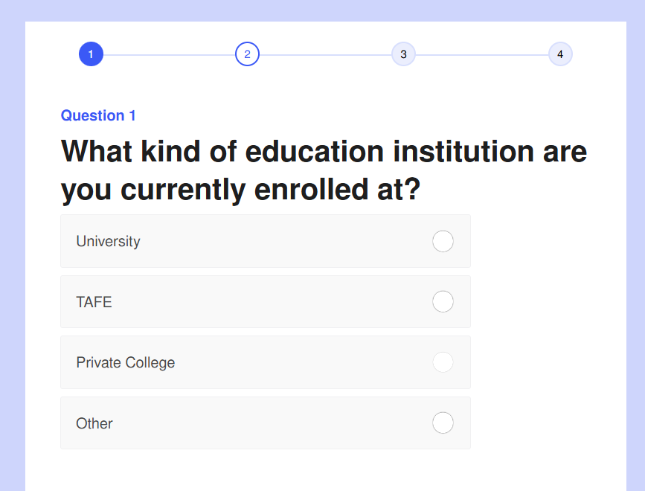
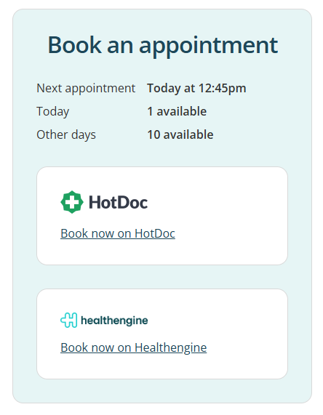
What's next
International Student Health Hub adaptation
Take Blaktion adaptation
Future optimisations include:
  improved load times
  online appointment booking options (through HotDoc etc.)
  Filter options by practitioner language and gender
Screenshot from the International Students
Health Hub adaptation
Online booking integration
example on healthdirect
Notes:
So, what's next for the locator?
One of the good things about this technology is that it can be adapted and implemented by organisations across Australia and has already been modified for the International Students Health Hub website. We also have plans to develop another adaptation of the tool for our Take Blaktion program, which supports young Aboriginal people aged 15–29 across NSW.
Looking ahead, we are exploring several optimisations, including faster load times, click-to-book appointment functionality (currently a limitation of healthdirect), and new filters such as language spoken by the practitioner, along with other enhancements to further improve the user experience.
For anyone wondering how much this cost, the tool cost about to develop, all of which was spent on the developer we engaged for this project (Defyn Digital). healthdirect kindly provided full access to their API free of charge (available to government departments and NGOs on application) so if this is something you’re interested in developing, be sure to reach out to the team at healthdirect.

Slide 8
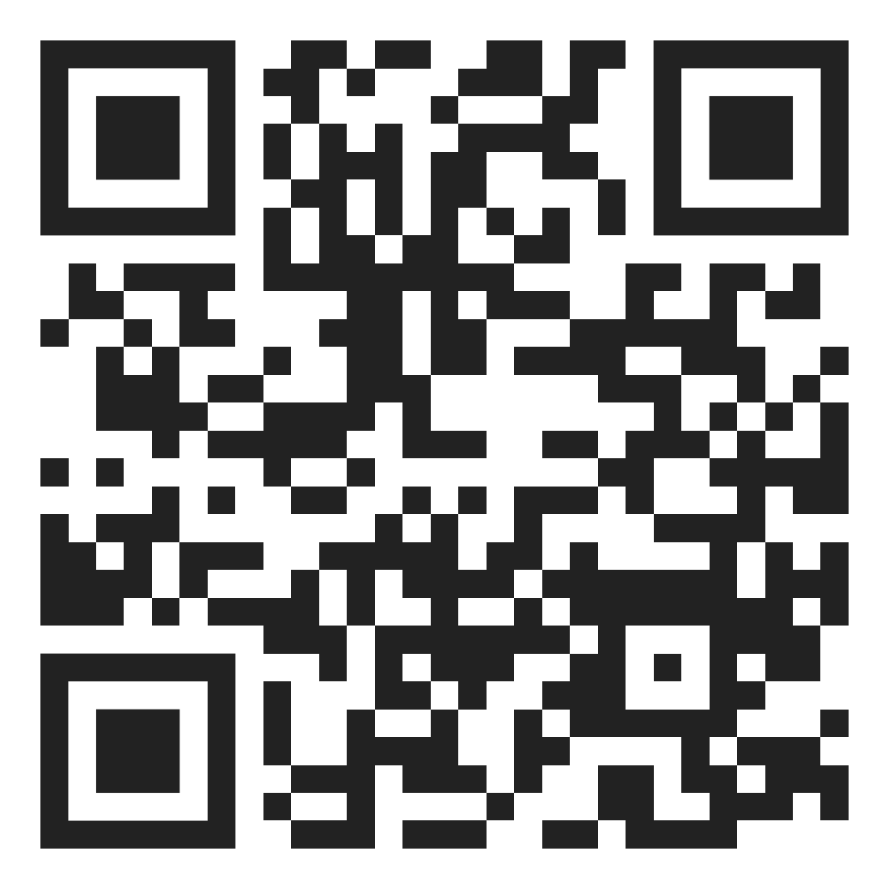
Thank you
NSW Health
Questions? jordan.murray@health.nsw.gov.au
Notes:
If you'd like to try out the locator for yourself, please feel free to go ahead and scan the QR code or visit the Play Safe website. If you have any specific questions, be sure to reach out.
https://playsafe.health.nsw.gov.au/sti-testing-locator/

