Slide 1
‘Not PALMing it off’
A collaborative approach to addressing the sexual health needs of PALM scheme workers in NSW
Australasian Sexual & Reproductive Health Conference
Jordan Murray
  Senior Program Manager, STI Programs Unit
  NSW Ministry of Health
September 2025
Notes:
My name is Jordan Murray and I work as a Senior Program Manager at the NSW Health STI Programs Unit and it has been my absolute pleasure to co-lead this project of work over the last 12 months alongside my colleague, Eliza Basheer (who is on maternity leave).

Slide 2
No disclosure of interest to declare.

Slide 3
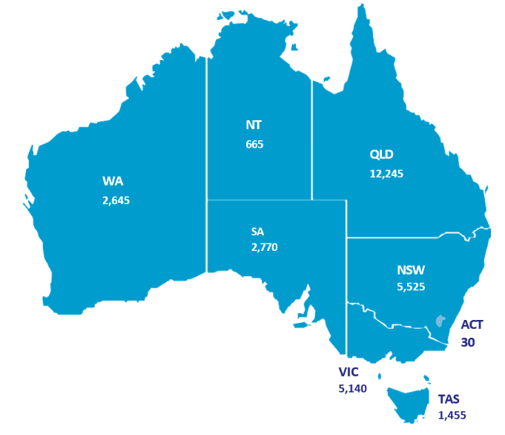
What is the PALM scheme?
The Pacific Australia Labour Mobility (PALM) scheme allows eligible Australian businesses, often agriculture and industry businesses, to hire workers from nine Pacific Island countries and Timor-Leste when there are not enough Australian-based workers to undertake business requirements.
As of June, there were currently over 31,000 PALM scheme workers in Australia​, employed at 513 approved employers across the country.
Workers are not eligible for Medicare and are required to hold private health insurance which in Australia. Employers are required to arrange this prior to worker’s arrival.
Number of PALM workers by state
(July 2025)
Credit: The PALM scheme
Notes:
Commencing in April 2022, the Pacific Australia Labour Mobility (PALM) Scheme allows eligible Australian businesses, particularly in agriculture and industry, to hire workers from nine Pacific Island countries and Timor-Leste when there are not enough Australian-based workers to undertake business requirements. Workers can obtain short-term visas (up to nine months) or long-term visas (up to four years). The scheme is managed by the Department of Employment and Workplace Relations (DEWR) and the Department of Foreign Affairs and Trade (DFAT).
As of June, there were currently over 31,000 PALM Scheme workers in Australia​, employed at 513 approved employers across the country.
Workers are provided with the same working rights as any other Australian worker. However, unlike most other migrant workers, PALM participants are not eligible for Medicare. Instead, employers are required to arrange private health insurance for workers before they arrive in Australia. These premiums are deducted from workers’ wages. Currently, nib provides health insurance coverage for about 92% of PALM workers.
​In addition to this, under the PALM Scheme Employer Guidelines, employers have a number of other health related responsibilities including:
assisting workers to access medical care​
appointing a welfare and wellbeing officer
develop and execute a welfare and wellbeing plan (specific links to sexual health advice required)​
conduct arrival briefings ​
____________________________________________________________________________
Countries: Fiji, Kiribati, Nauru, Papua New Guinea, Samoa, Solomon Islands, Tonga, Tuvalu, Vanuatu and Timor Leste.
NSW: NSW hosts almost 5.5k PALM scheme workers, employed by approximately 110 approved employers, making up around 17% of all PALM workers in Australia. Around 75% of PALM workers in NSW hold long-term visas.
Top sending countries in Australia: Vanuatu, Fiji and Solomon Islands.
Short-term vs. long-term: About 53% are long-term, 47% short-term
Top industries: Agriculture, meat processing

Slide 4

The sexual and reproductive health of PALM scheme workers
Many workers come from countries with high rates of STIs, HIV, hepatitis and tuberculosis, including Fiji, which is currently experiencing an HIV outbreak.
Over the last 18 months in NSW there has been an increase in:
syphilis, gonorrhoea and chlamydia diagnoses
several instances of late-stage HIV
hepatitis diagnoses
late-stage pregnancy presentations (with no prior antenatal care)
Credit: ABC News
Notes:
Many workers come from countries with high rates of STIs, HIV, hepatitis and tuberculosis, including Fiji, which is currently experiencing an HIV outbreak. There are growing concerns regarding the health and wellbeing of NSW PALM Scheme workers, particularly in relation to their sexual and reproductive health, however, empirical and current country-level data is scarce.
Although there is very limited empirical data on the PALM worker health care in Australia (due to most workers seeking health care via private health and having limited information regarding visa status on cases which are notifiable), anecdotal evidence and experiences from NSW Health staff indicates that over the last 18 months, there has been an increase in syphilis, gonorrhoea, chlamydia as well as well as several instances of late-stage HIV, and hepatitis diagnoses amongst PALM Scheme workers in NSW. Local Health District teams have also reported a significant rise in late-stage pregnancy presentations, with no prior antenatal care.
Workers often report challenges to accessing adequate health care, with both workers and PALM Scheme employers citing limited availability of services in regional areas and other socio-structural challenges including knowledge, transport, language, stigma, cost and limited cultural responsiveness of services.
There is significant opportunity to support the sexual and reproductive health of PALM Scheme workers during their time in Australia. As mentioned, Local Health Districts (LHDs) have been working at a local level to address emerging health issues amongst PALM workers in NSW and recognised the need for a coordinated approach led by the Ministry of Health.

Slide 5
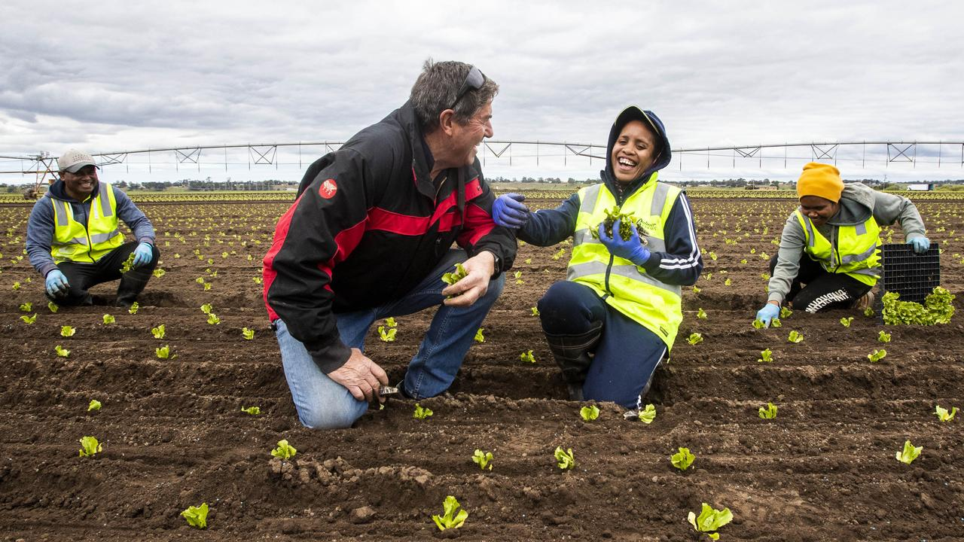
Phase 1: Listening and learning
Conducted a literature review
Established a working group
Consulted over 40 stakeholders including (but not limited to):
        PALM employers
        Department of Employment and Workplace Relations (DEWR)
        Department of Foreign Affairs and Trade (DFAT)
        Country Liaison Officers
        Community Connections teams
        nib insurance
        subject matter experts.
Credit: The PALM Scheme
Notes:
In lieu of a nationally coordinated approach, before we did anything, we undertook a comprehensive literature review to better understand the publicly available evidence on the sexual and reproductive health needs of PALM Scheme workers and opportunities for NSW Health to support PALM Scheme workers and stakeholders and to inform the development of a collaborative and sector-led response workplan. ​
Through this process, we identified a number of recommendations for actioning by NSW Health, the Commonwealth Government and other stakeholders which informed the development of a NSW Health workplan. There is limited empirical evidence and literature regarding the health priorities of PALM Scheme workers and in NSW and wider Australia. Primarily, information was found through DFAT, DEWR and PALM’s website, consultations with HP, LHDs, NGOs as well as with NIB, DFAT and others. Though now there is some additional literature available in this space thanks to Dr Haylee Fox (Central Queensland University) and Lindy Kanan (ANU).
At this stage, we convened a statewide PALM Scheme sexual and reproductive health working group with representatives from the NSW STI Programs Unit, HIV/STI Policy Team, Hepatitis Policy Team, Health Protection, local health districts with a high proportion of PALM workers, including clinical and non-clinical staff, the Multicultural HIV and Hepatitis Service (MHAHS), ASHM and Family Planning Australia to implement these recommendations.
To validate the recommendations from the literature review and get a better understanding of the issues, STIPU undertook a series of over 40 consultations with PALM Scheme employers, and stakeholders, including Country Liaison Officers, Community Connections workers and the NSW Council of Pacific communities to further understand on the ground needs. We have also formed relationships with other PALM scheme stakeholders including DEWR, DFAT, nib health insurance and subject matter experts.
Consultations highlighted the need to improve health outcomes for PALM Scheme workers in NSW, strengthen primary care workforce capacity, and increase capacity and accountability of PALM Scheme employers to provide access to health care, information, and support.
Some of the key identified issues included:
Limited access to condoms, contraception, antenatal care, and pregnancy termination services
Low health literacy and knowledge of STIs/BBV
Difficulty navigating the Australian healthcare system, including privately held insurance
Limited health information and resources available in Pacific languages
Hesitation to access healthcare services due to perceived risks to visa and employment status (taking time off in addition to any potential diagnoses)
It also helped us to identify opportunities to contribute to pre-departure and arrival briefings to embed sexual health and NSW health system navigation information
The literature review and consultation findings were summarised, reported back to the working group and then used to develop a statewide workplan.

Slide 6



Phase 1: Listening and learning
Key issues identified:
Limited access to condoms, contraception, antenatal care, and pregnancy termination services
Low health literacy and knowledge of STIs/BBV
Difficulty navigating the Australian healthcare system, including privately held insurance
Limited health information and resources available in Pacific languages
Hesitation to access healthcare services due to perceived risks to visa and employment status (taking time off in addition to any potential diagnoses)
Notes:
Some of the key identified issues included:
Limited access to condoms, contraception, antenatal care, and pregnancy termination services
Low health literacy and knowledge of STIs/BBV
Difficulty navigating the Australian healthcare system, including privately held insurance
Limited health information and resources available in Pacific languages
Hesitation to access healthcare services due to perceived risks to visa and employment status (taking time off in addition to any potential diagnoses)
It also helped us to identify opportunities to contribute to pre-departure and arrival briefings to embed sexual health and NSW health system navigation information
The literature review and consultation findings were summarised, reported back to the working group and then used to develop a statewide workplan.

Slide 7
Phase 2: Developing a plan
Workplan objectives:​​
Improve health outcomes, inclusive of knowledge and health literacy of PALM Scheme workers in NSW​​
Increase the capacity and accountability of PALM Scheme providers to provide access to health care, information and support for PALM scheme workers​​
Increase the capacity of the primary care workforce to support PALM Scheme workers and pilot innovative models of wrap around health system supports​​
Understand the needs of PALM Scheme workers, employers and stakeholders in NSW​​
Advocacy to the Commonwealth to address emerging issues​​
Notes:
Our workplan includes a range of short, medium and long term activities that are grouped into the following themes:
Theme one: Improve health outcomes, inclusive of knowledge and health literacy, of PALM Scheme workers in NSW
Theme two: Increase the capacity and accountability of PALM Scheme providers to provide access to healthcare, information and support for workers
Theme three: Increase the capacity of the primary care workforce to support PALM Scheme workers and pilot innovative models of wrap around health system supports
Theme four: Understand the needs of PALM Scheme workers, employers and stakeholders in NSW
Theme five: Advocacy to the Commonwealth to address emerging issues
This workplan is very much a living, breathing document and is updated as new work as opportunities emerge.

Slide 8

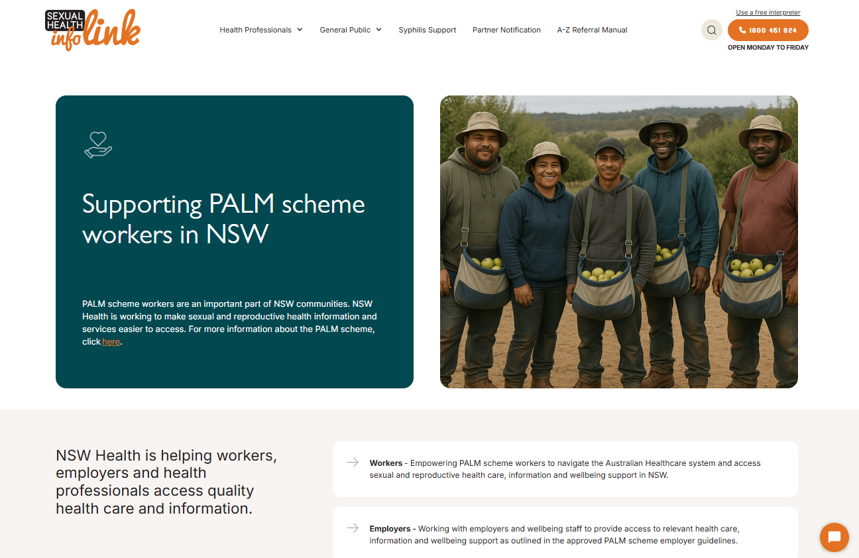
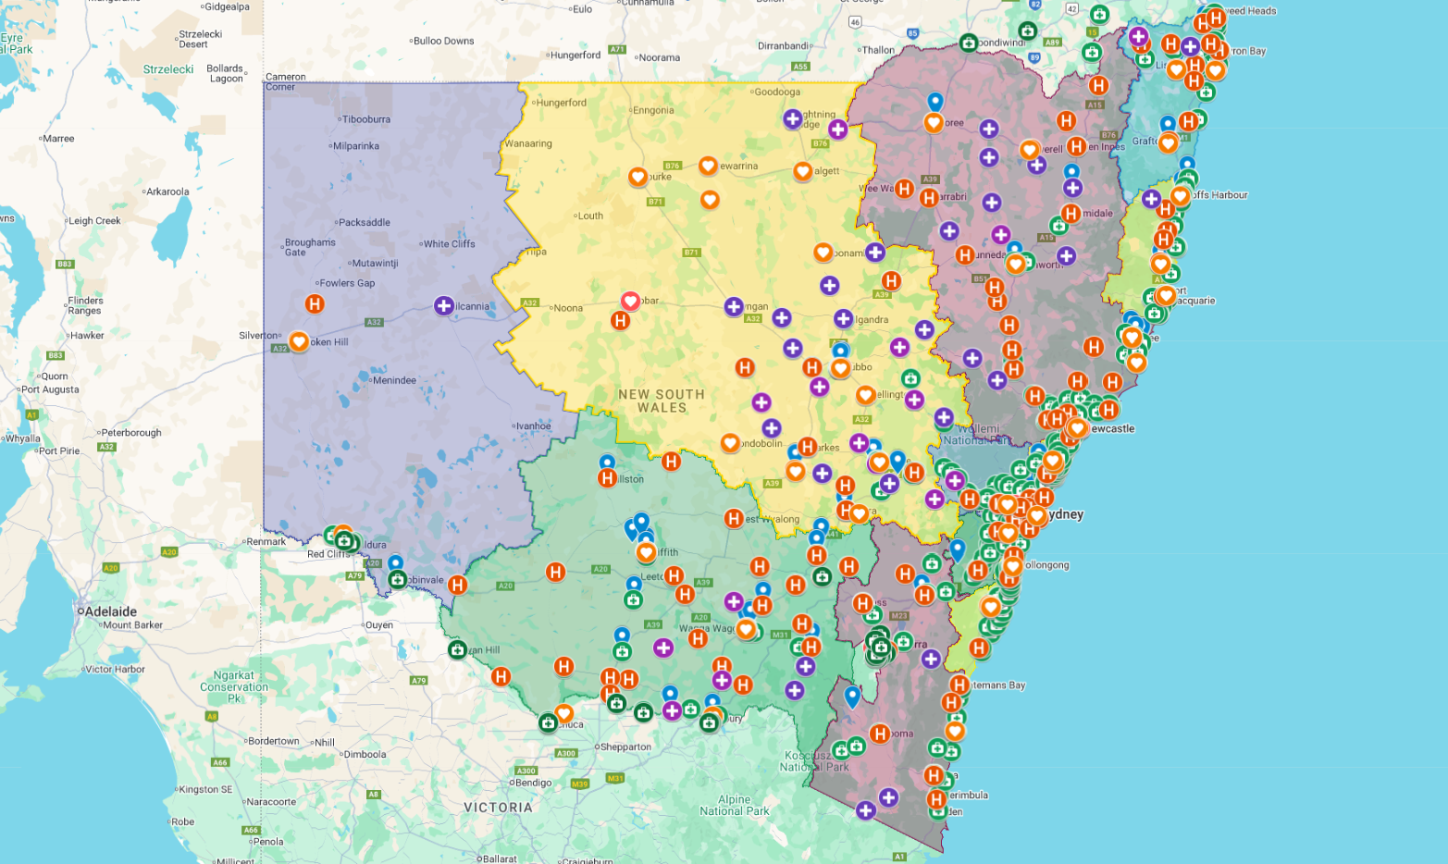
What have we done?
Contacted all NSW approved employers to offer support
Developed and distributed a health education package to employers
Mapped NSW PALM scheme employer worksites
Built a PALM website landing page
Developed two funding proposals for DEWR
PALM health education package
PALM website page on the SHIL website
NSW PALM worksites and health services
Notes:
So, speaking of our workplan, I thought it might be helpful to run through some of the key activities we have undertaken as part of the workplan to date.
We have…
Contacted all NSW approved employers to offer support – Reached out to all NSW approved employers with offers of support and links to existing infrastructure and resources including free condoms and resources for workers.
Developed and distributed a health education package to employers - Developed and distributed an employer education package in collaboration with 17 PALM scheme employers. This package has a focus on sexual and reproductive health and includes facilitator notes that employers can use to support the delivery of health information during worker arrival briefings.
Mapped NSW PALM scheme employer worksites - Mapped NSW PALM scheme worksites and overlayed each of the local health district borders to help local health teams visualize the workers in their region. We also added all NSW sexual health clinics, community health services, emergency departments and GPs to help employers identify nearby services.
Built a PALM website landing page – Developed a PALM website landing page on the NSW Sexual Health Infolink website. This page features information, referral links and resources for PALM workers, employers and health professionals.
Developed two funding proposals for DEWR - Developed two funding proposals for DEWR (one focusing on developing a pilot peer education model and the other focusing on piloting an outreach preventive healthcare model)

Slide 9

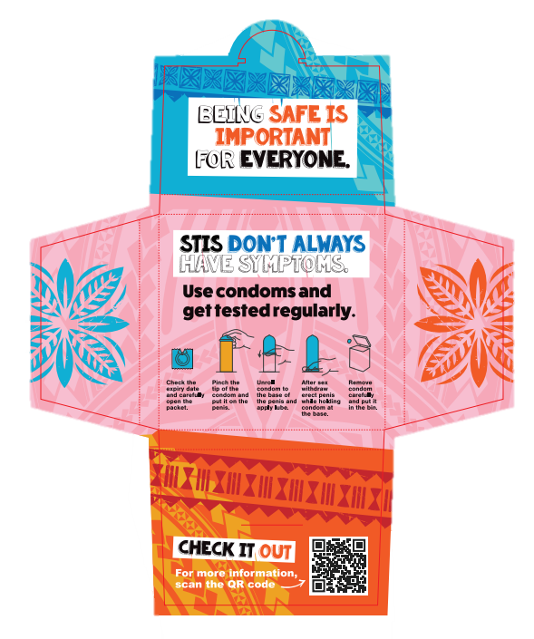

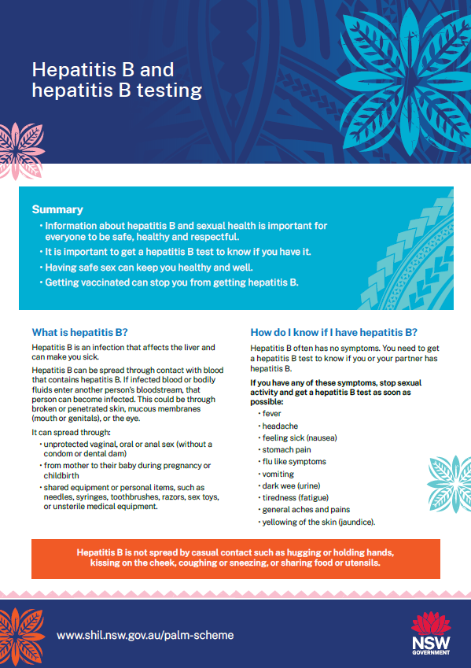
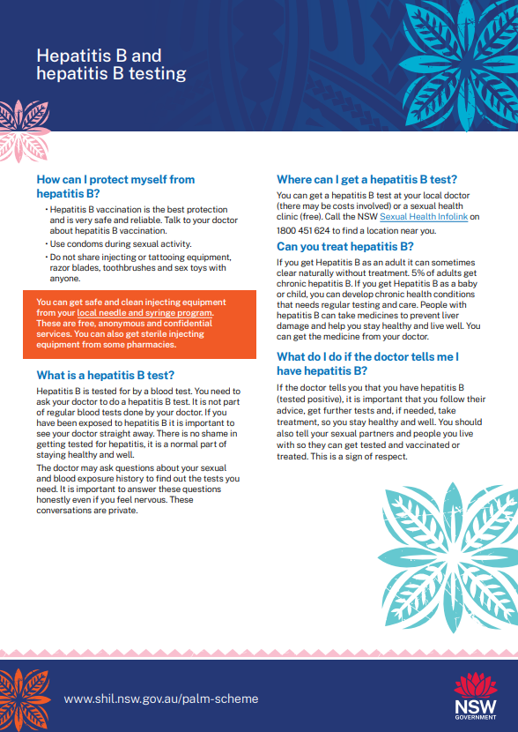
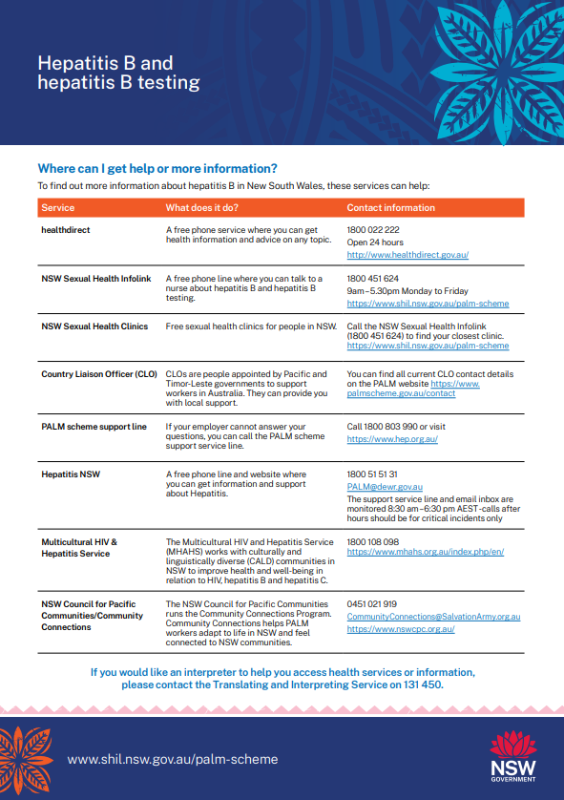
What are we currently doing?
Creating PALM-specific safe-sex kits (with MHAHS)
Designing physical information kits for workers (led by MHAHs)
Developing a suite of in-language factsheets
Progressing our PALM research project
Creating a health roadmap
Developing a series of in-language animated video resources
Exploring opportunities in the pre-departure space
PALM specific safe sex pack designs
PALM condom
dispenser designs
PALM factsheet example (available in multiple languages)
Notes:
We also have a lot of different work that is in progress including…
Safe sex and information kits - We have been working with a Pacifika graphic designer to develop a number of PALM specific resources including sex packs and a pocket-sized information kits specifically, which is being led by the NSW Multicultural HIV and Hepatitis Service (MHAHS).
Develop a suite of in-language factsheets - Developing of a suite of in-language factsheets - (Contraception options in Australia, STIs and STI testing, HIV and HIV testing, Hepatitis B) - Fijian, Bislama, Samoan and Tongan
Progressing our PALM research project – We have engaged the University of Sydney to undertake a needs assessment of PALM Scheme workers, approved employers and health professionals servicing PALM Scheme workers in NSW
Health roadmap - Developing a health roadmap template to help workers and employers identify and navigate local services
Develop a series of in-language animated video resources - Developing in-language animated videos that communicate important sexual and reproductive health messages (based on the Family Planning Australia video resources)
Explore opportunities in the pre-departure space - Supporting Family Planning Australia, ASHM and nib explore opportunities within the pre-departure briefing space

Slide 10

What’s next?
Increasing capacity of primary care and health professionals
Implementing a PALM peer education model (alongside Family Planning Australia and MHAHS)
Increasing the number of direct billing GPs across NSW
Continuing to advocate to the Commonwealth government
Scope out an outreach preventive healthcare model
Develop LHD and primary care toolkits to support outreach
Credit: The PALM Scheme
Notes:
In terms of what’s next for this project, we will be focusing on:
Increasing and enhancing the capacity of primary care and health professionals to provide sexual health care to PALM Scheme workers in NSW
Alongside MHAHS and FPA, we will be developing and implementing a PALM peer education model (alongside MHAHS and FPA)
Working with nib and local health districts to increase the number of direct billing GPs across the state
Continuing to advocate to the Commonwealth government
Working with ASHM to scope out a pilot outreach preventative healthcare model which will incorporate sexual and reproductive care, as well as other preventative health services including things like liver checks, diabetes support etc.
Develop tailored toolkits for primary care practitioners and health districts to help guide and support local outreach, education and care.

Slide 11

Key takeaways
Consolidate your approach
Start talking to people
Explore what data is available to you
Develop a plan that makes sense for you
Sources of information:
PALM scheme website
PALM scheme data
NSW Health PALM landing page
nib PALM health hub
Credit: The PALM Scheme
Notes:
This is something that impacts every state and there is significant opportunity to support the sexual and reproductive health of PALM Scheme workers during their time in Australia.
There is an opportunity for health teams across the country to work with PALM Scheme employers to strength their capacity to provide access to health care, information and wellbeing support and advocate to the Commonwealth for a coordinated national response.
In lieu of that, here are some of our key takeaways.
Review available data - Begin by reviewing PALM scheme data available online, then connect with your data and epidemiology teams to identify what’s known about your local PALM population. It won’t take long, there isn’t much data, but we found that each state’s PALM population looks quite different.
Consolidate your approach - It sounds obvious, but before reaching out to employers, peak bodies, government departments, or subject matter experts, check in with internal teams to build a coordinated approach. Most stakeholders are time poor, so respecting their time and expertise means presenting as a united front and offering one clear point of contact. Where possible, involve representatives from other health disciplines in your project team or working group. Several stakeholders have told us that, in the past, multiple people from the same team have contacted them separately, sometimes with conflicting requests, which can be frustrating and confusing.
Start talking to people - It’s time to get comfortable with cold emails and calls. There’s no way around it: the best way to understand the landscape in your region is by starting conversations. We’ve found people to be surprisingly generous with their time, and a friendly, semi-informal approach helps build trust and rapport.
Develop a plan that works for you - Whatever approach you take, make sure it fits your local context: your PALM workers, your governance structures, your health system, your priorities, and your team.
I’ve also included some of our most-frequented websites, that are worth bookmarking if you’re looking to work in this space.

Slide 12
Thank you
NSW Health
Questions? jordan.murray@health.nsw.gov.au
Notes:
And finally, I just wanted to acknowledge all the stakeholders who have welcomed us with open arms and been so generous with their time and knowledge and a huge shout out to our amazing and passionate working group who have been working hard to make all of this work possible.
If you have any questions, please reach out and I would be happy to chat further.

