Slide 1


Effect of Pathogen Adaptation on Human T Cell Function and T Cell Receptor Diversity
HIV – a sneaky virus!
Silvana Gaudieri
School of Human Sciences, UWA
Division of Infectious Diseases, Department of Medicine, Vanderbilt University Medical Center
Institute for Immunology and Infectious Diseases, Murdoch University

Slide 2
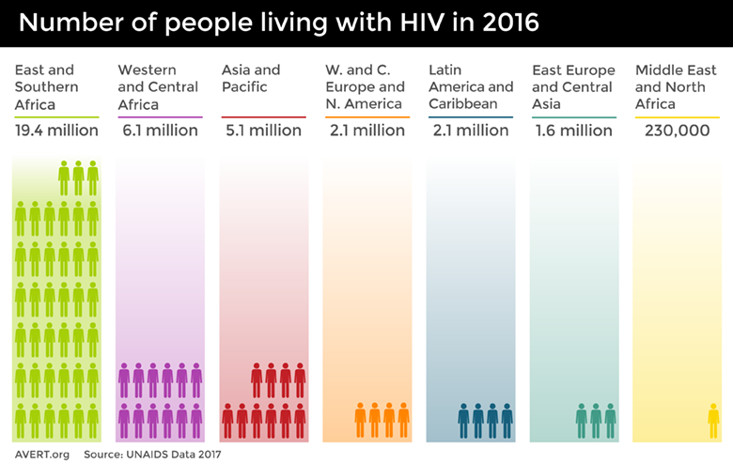
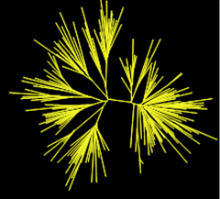
HIV is highly prevalent worldwide and genetically diverse
Diversity is, in part, due to selection pressure from the host’s anti-HIV immune response and is an impediment to vaccine design
HIV diversity
1996 global
H3N2 viruses
Notes:
HIV is a lentivirus that causes immunosuppression and a progressive deterioration of immune function, eventually leading to AIDS and death
36.7 million, 1 million people died. 1.8 million of these were children, vertical transmission.
diverse virus due to its high mutation rate.
vaccine design - therapeutic/preventative
Lifelong treatment – expensive/high-prevalence areas do not have good access – vaccine is holy grain-

Slide 3
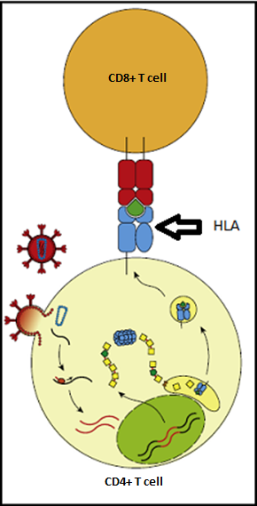
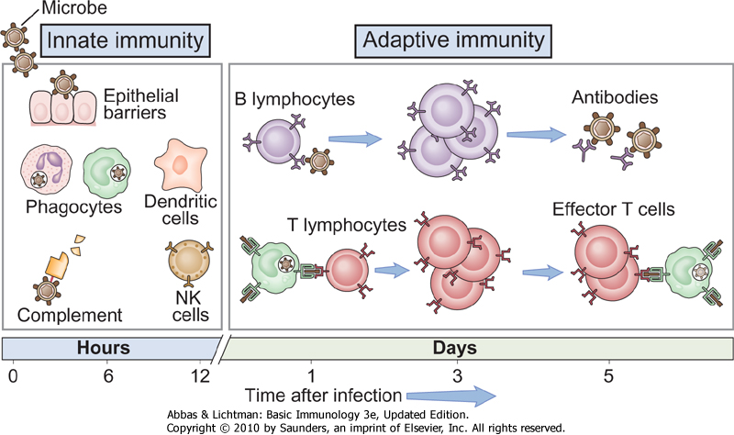
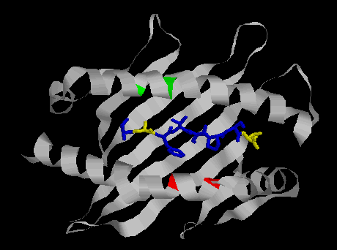
Immune response to pathogens
Mutations in HIV genome allow immune escape (adaptations)
T cell receptor
= TCR
HIV
fragment
(Image from Carlson et al., 2015)

Slide 4
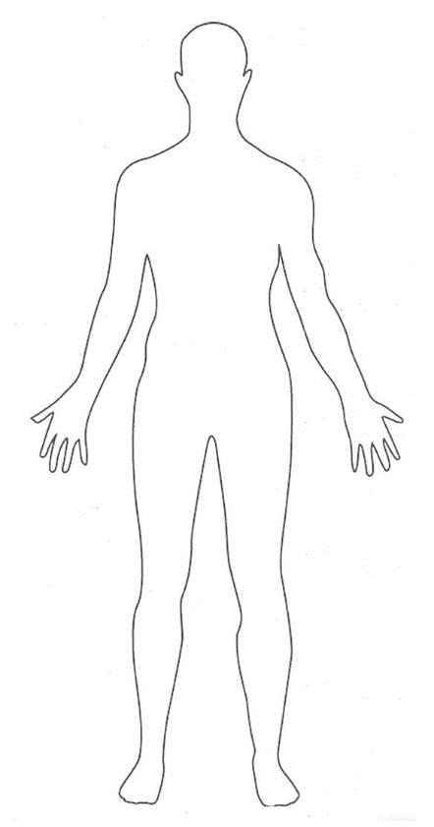

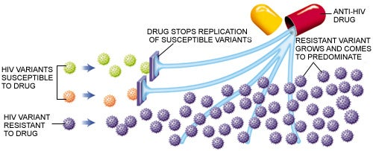
ANALOGY: Immune responses (HLA) = drug and HIV mutations leading to immune escape = drug resistant mutations
Adaptation can become dominant strain
= poorer outcome for individual
Anti-HIV Immune drug
Notes:
Put red dashes in for adaptations

Slide 5
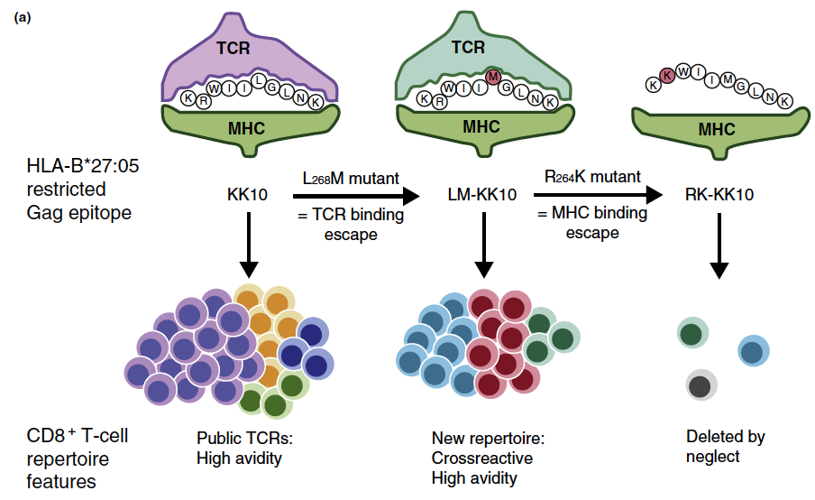
Mechanisms of HIV adaptation
“Classical” adaptation
Non-adapted (NAE)
T cell receptor = TCR
Adapted (AE)
HIV
fragment
F
K
E
K
G
G
F
L
K
E
E
G
G
L
HLA
L
HLA
L
HLA
Loss of recognition
= immune escape
TCR diversity, spectrum of avidities
Marker of immune response (IFNγ)

Slide 6
Marker of immune response (IFNγ)
“Classical” adaptation
“Non-classical” adaptation
Non-adapted (NAE)
Adapted (AE)
NAE
AE
F
K
E
K
G
G
F
L
K
E
E
G
G
H
E
R
Y
H
E
H
E
K
Y
H
S
L
HLA
L
L
E
E
S
W
Q
E
N
W
HLA
HLA
Q
N
HLA
HLA
HLA
HLA
HLA
Loss of antigen recognition
TCR diversity, spectrum of avidities
TCR diversity, spectrum of avidities
Select TCRs
Invisible to T cells
Still visible to T cells
Leads to T cell dysfunction

Slide 7
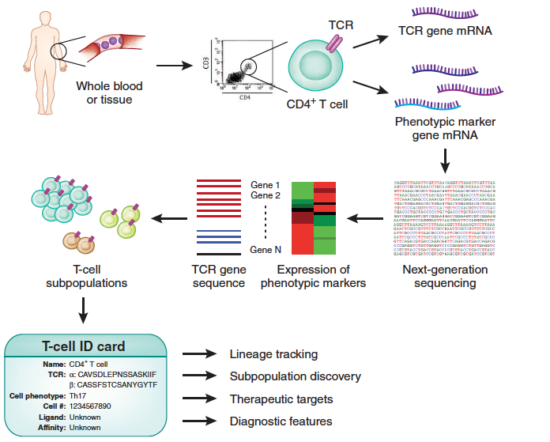
Examine different mechanisms of viral adaptation
= ID card for T cells
Jiang, Zhang and Ma Nat Biotech 2014
Notes:
Figure 1 The method of Han et al.2 determines paired TCR α- and β-sequences and phenotypic-gene expression in single cells. T cells are sorted by FACS into single cells. Gene-specific primers and nested PCR are used to amplify the genes encoding the TCR α- and β-chains and a set of phenotypic markers. TCR gene sequences and the presence or absence of phenotypic markers are revealed by next-generation sequencing. Combining these data with the results of single-cell functional assays, such as assays of antigen specificity and affinity, yields an ID card bearing all the information for each T cell. This correlated information can be used to track T-cell lineage, discover subpopulations, and screen for therapeutic targets and diagnostic features.

Slide 8
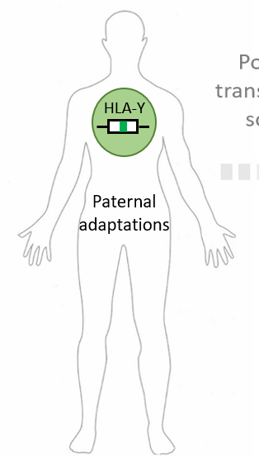
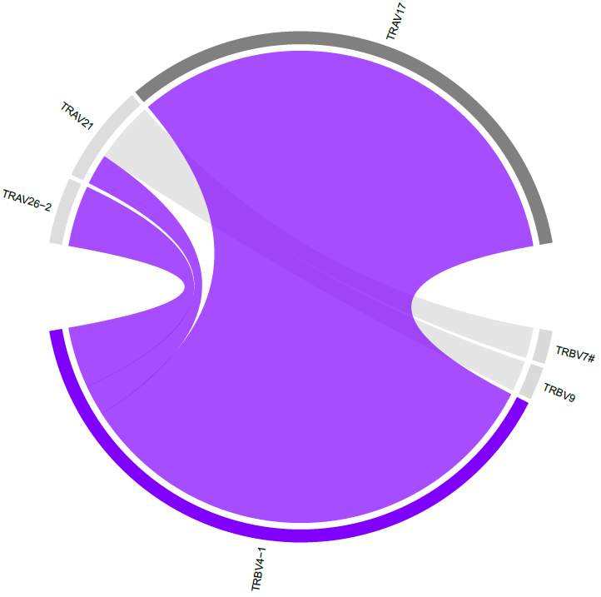
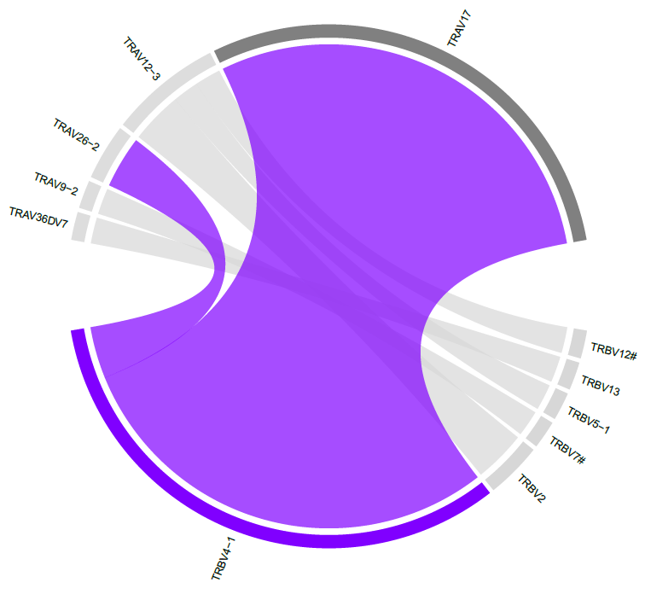
Single cell resolution shows overlap in HIV-specific T cells that respond to non-adapted and adapted forms
TCR α/β repertoire
TPGPGIRYPL
TPGPGVRYPL
“Non-classical” adaptation
NAE
AE
Significant overlap + no difference in TCR diversity
NAE
AE
E
E
H
E
R
Y
H
S
Q
E
E
H
E
K
Y
H
S
W
Leads to T cell dysfunction
Q
HLA
N
W
HLA
N
HLA
HLA
TCR diversity, spectrum of avidities
Select TCRs
Notes:
Results from two 96 well plates of double tetramer positive cells (TCRVB28 and TCRVA12-1)
SLYNTVATL (AE)
SLYNTVVTL (NAE)

Slide 9
Differences in transcriptome for T cells responding to peptides that differ by a single amino acid
Non-adapted profile
Adapted
Up in T cells activated by AE peptide
Activation (NA)
Up in T cells activated by NAE peptide
Act
(A)
TPGPGIRYPL
TPGPGVRYPL
Analysis of single cell T cells – unsupervised
Notes:
TL10 B7
Upregulated in adapted
Understand link between T cell function and TCR specificity

Slide 10
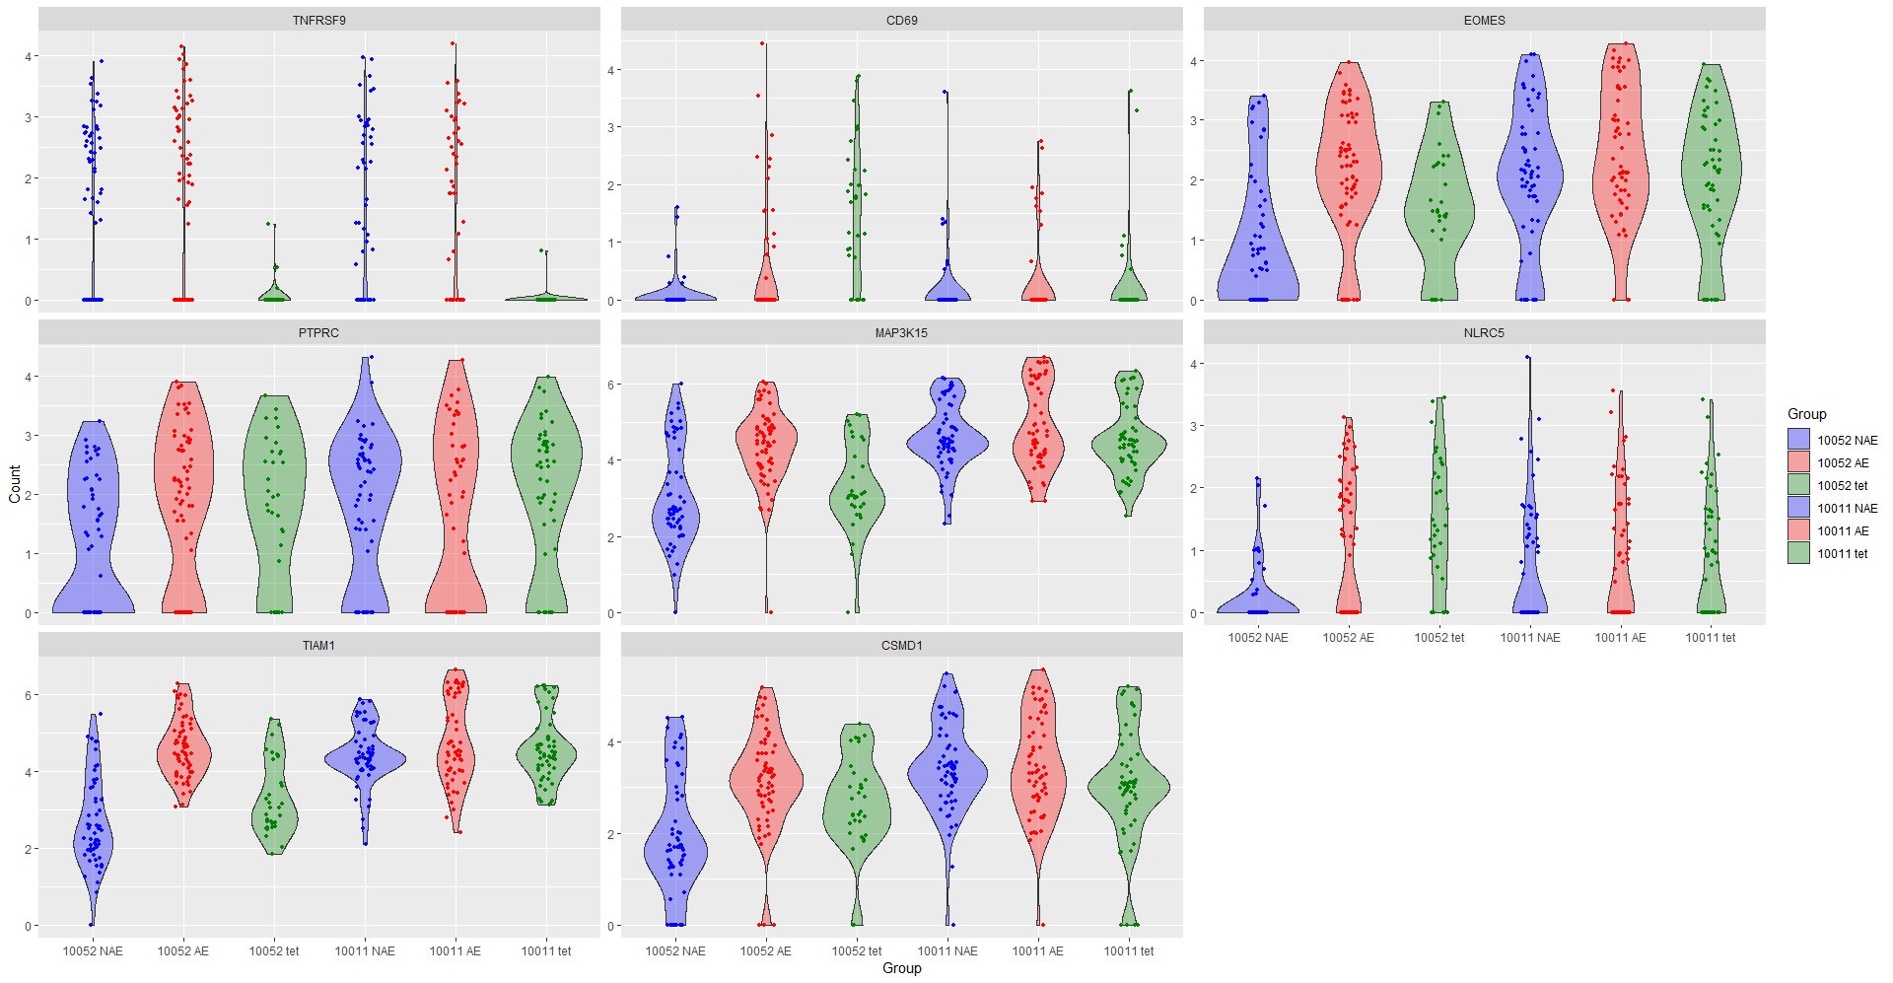
Transcriptome of T cells responding to adapted peptide may reflect less effective phenotype
EOMES
MAP3K15
EOMES – transcription factor associated with T cell exhaustion
MAP3K15 – essential role in apoptotic cell death triggered by cellular stresses.
TIAM1 – role in cell invasion, metastasis and carcinogenesis
CSMD1 – reduction increases the ability to divide, migrate and invade
TIAM1
CSMD1

Slide 11
Summary and Implications for Immunogen Design
Evidence for different mechanisms of viral adaptation based on single amino acid change – beyond loss of antigen recognition
  But no evidence to date to suggest restricted TCR repertoire
Common dominant TCRs reactive to non-adapted and adapted form
  TCR-peptide-HLA affinity differences
  Differences in transcriptome of reactive T cells to the different forms
    Dependent on autologous virus
Epitopes that illicit ineffective responses may need to be proactively excluded
  Particularly need to identify those epitopes in which adaptation is part of circulating virus and elicit ineffective responses
HIV is a really sneaky virus – different mechanisms of adaptation make it difficult to destroy with our immune system

Slide 12
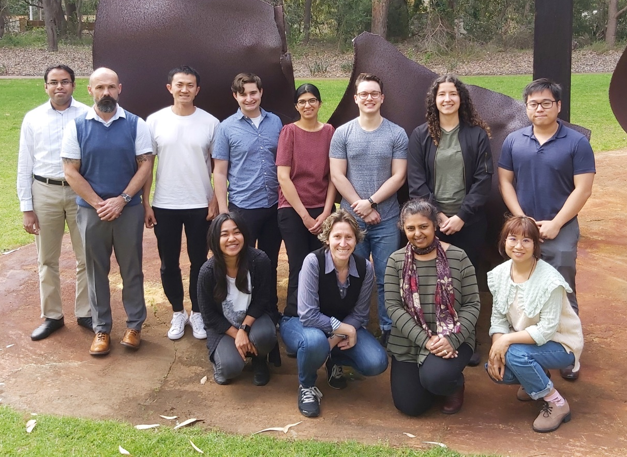



Acknowledgements
IIID Murdoch, Western Australia
Simon Mallal Mina John
Jennifer Currenti* Abha Chopra
Ian James Shay Leary
Linda Choo Bethy McKinnon
Eric Alves* Pooja Deshpande*
Michaela Lucas* Ramesh Ram
Becker Law*
VUMC, USA
Spyros Kalams Mark Pilkinton
Louise Barrett Rama Gangula
Wyatt McDonnell Cindy Hager
Rita Smith Joseph Conrad
GHESKIO Centre, Port-au-prince, Haiti
Francine Noel
* UWA
Patients and support staff

