Slide 1
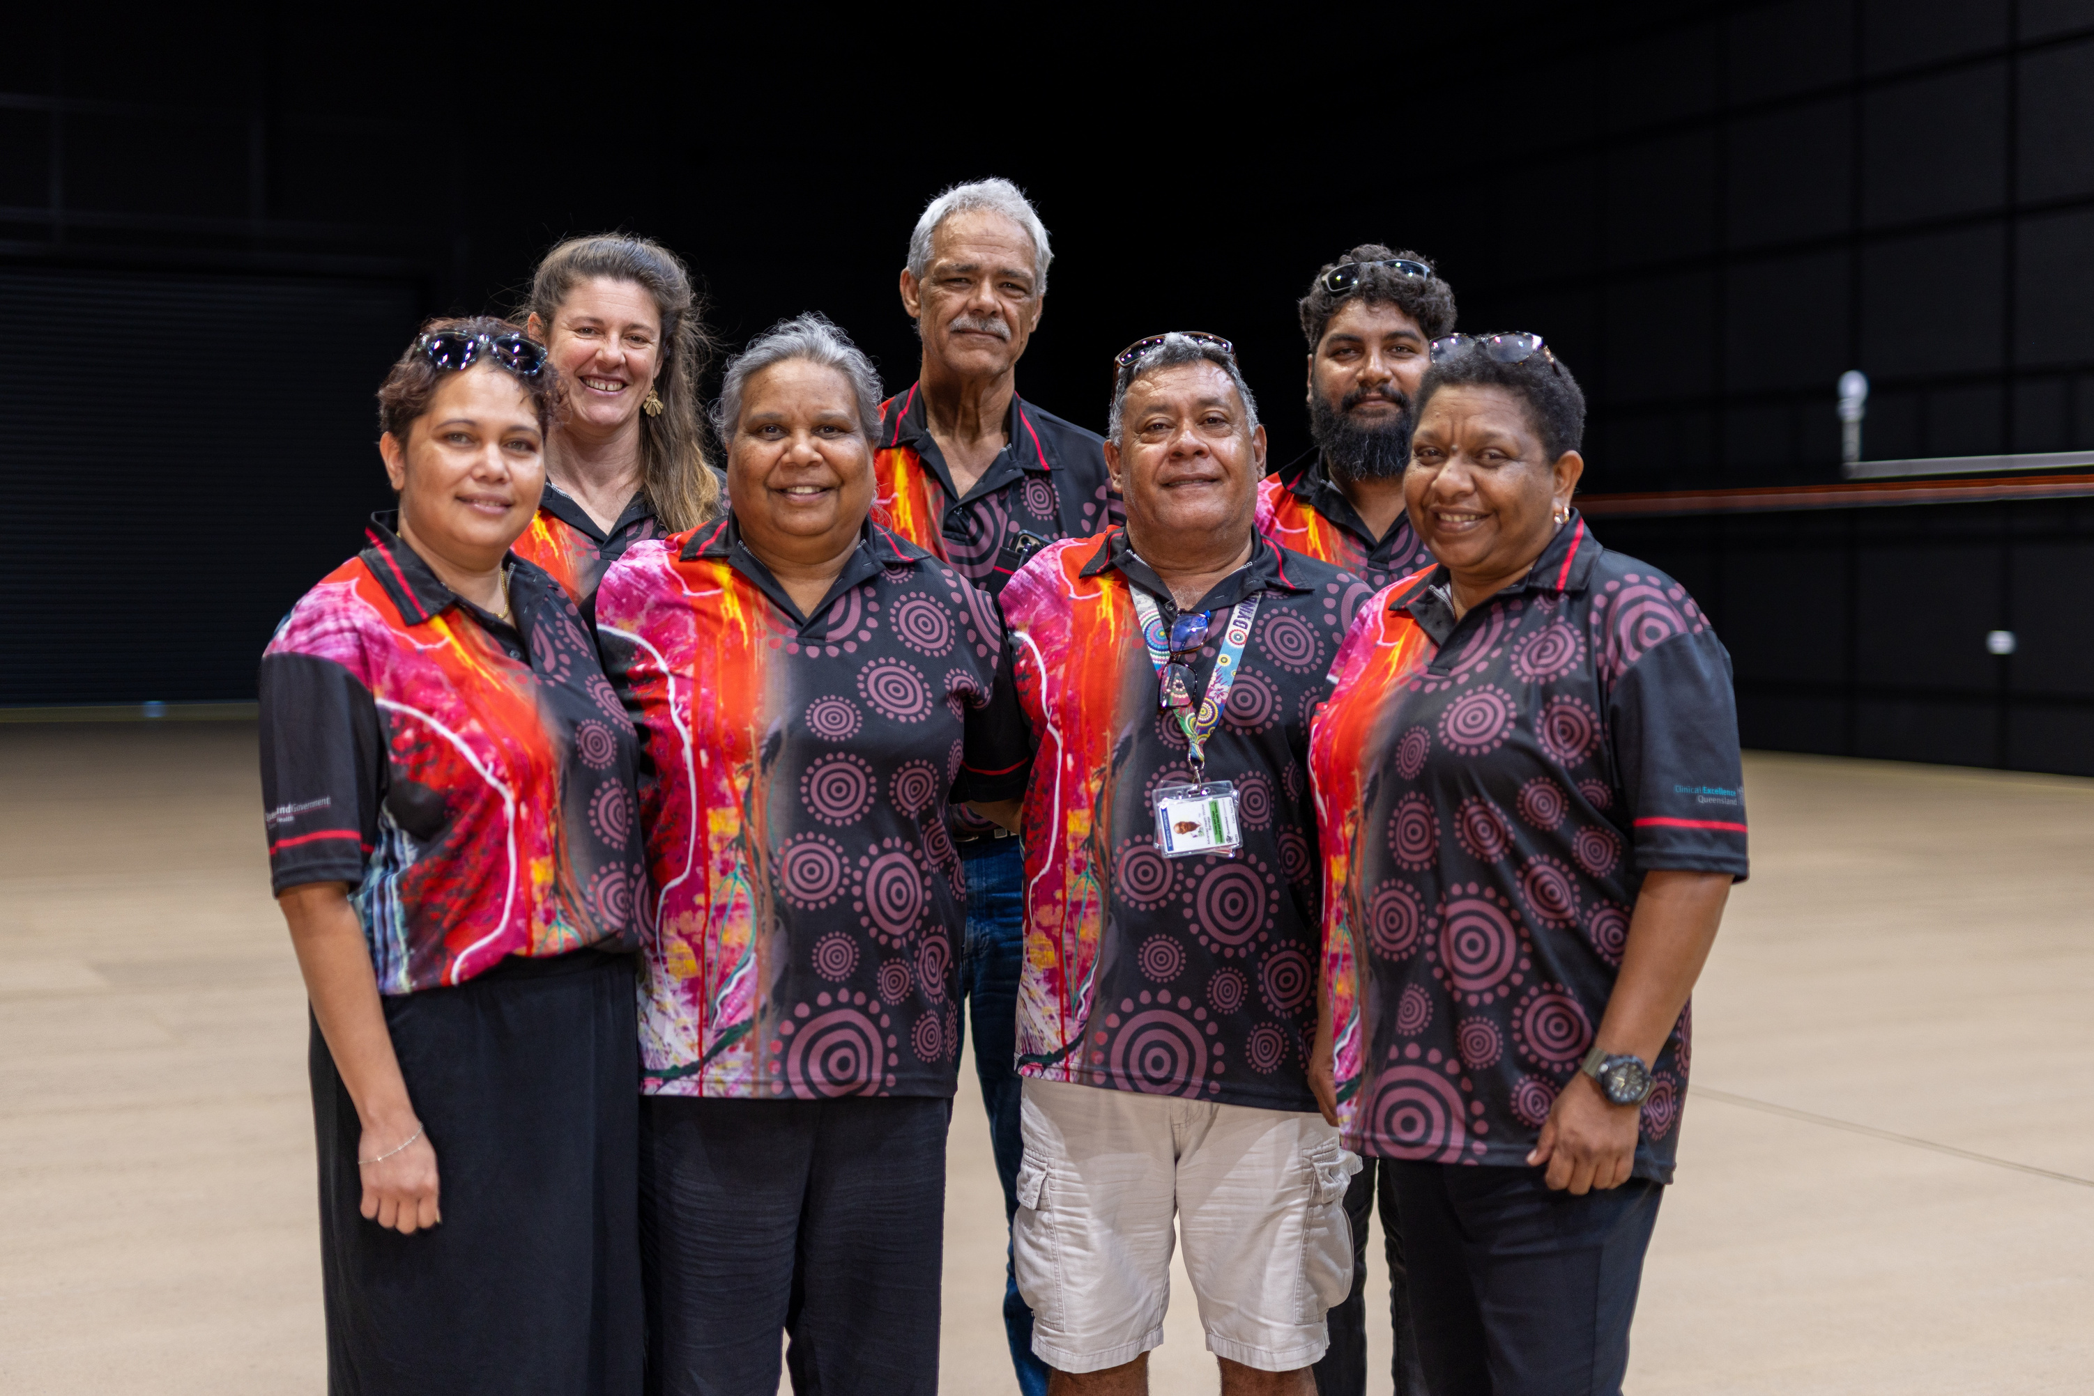
Pregnancy Options & Culture
What does it mean to be a safe person in rural and remote Queensland?
Natasha Chong, Mogan Dempsey & Erin McBride
Funded by Women and Girls’ Health Strategy

Slide 2
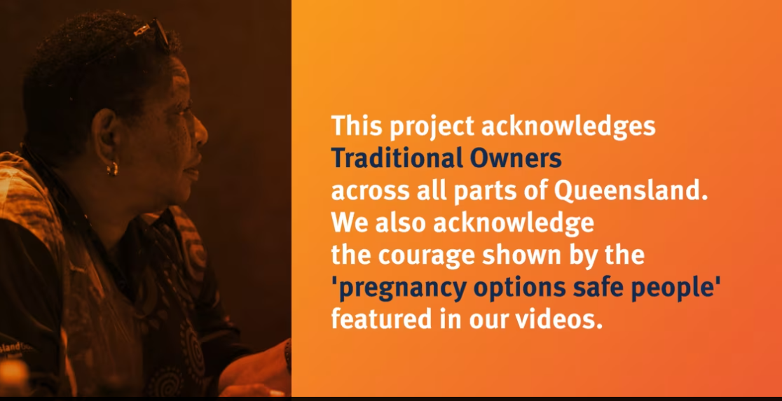

Slide 3

Education for First Nations Workforce
Increasing cultural capability of the Non-Indigenous workforce
Listening, learning & applying lived experience

Slide 4
Education for the First Nations Workforce
Turning cultural taboos, shame and silence into routine health care.
Increasing knowledge of reproductive rights & justice.
Identifying, engaging and supporting safe people across Queensland.

Slide 5
Cultural Capability of the Non-Indigenous Workforce
Growing knowledge and cultural safety.
Building awareness of the role of the Aboriginal and Torres Strait Islander Health Workforce
Improving access, experience and healing

Slide 6
Listening, Learning, Translating & Applying
Lived Experience
Connecting with First Nations abortion consumers to understand pathways to healing.
Co-designed resources to improve health literacy
Translating consumer experience into excellence in care.

Slide 7
Where to Next?
Safe Person Support Systems
First Nations Pregnancy Options Model of Care
Train the Trainer
Continue Starting Difficult Conversations across Queensland

Slide 8
Meet Queensland’s Safe People
https://vimeo.com/1038791699/e51607df41

Slide 9
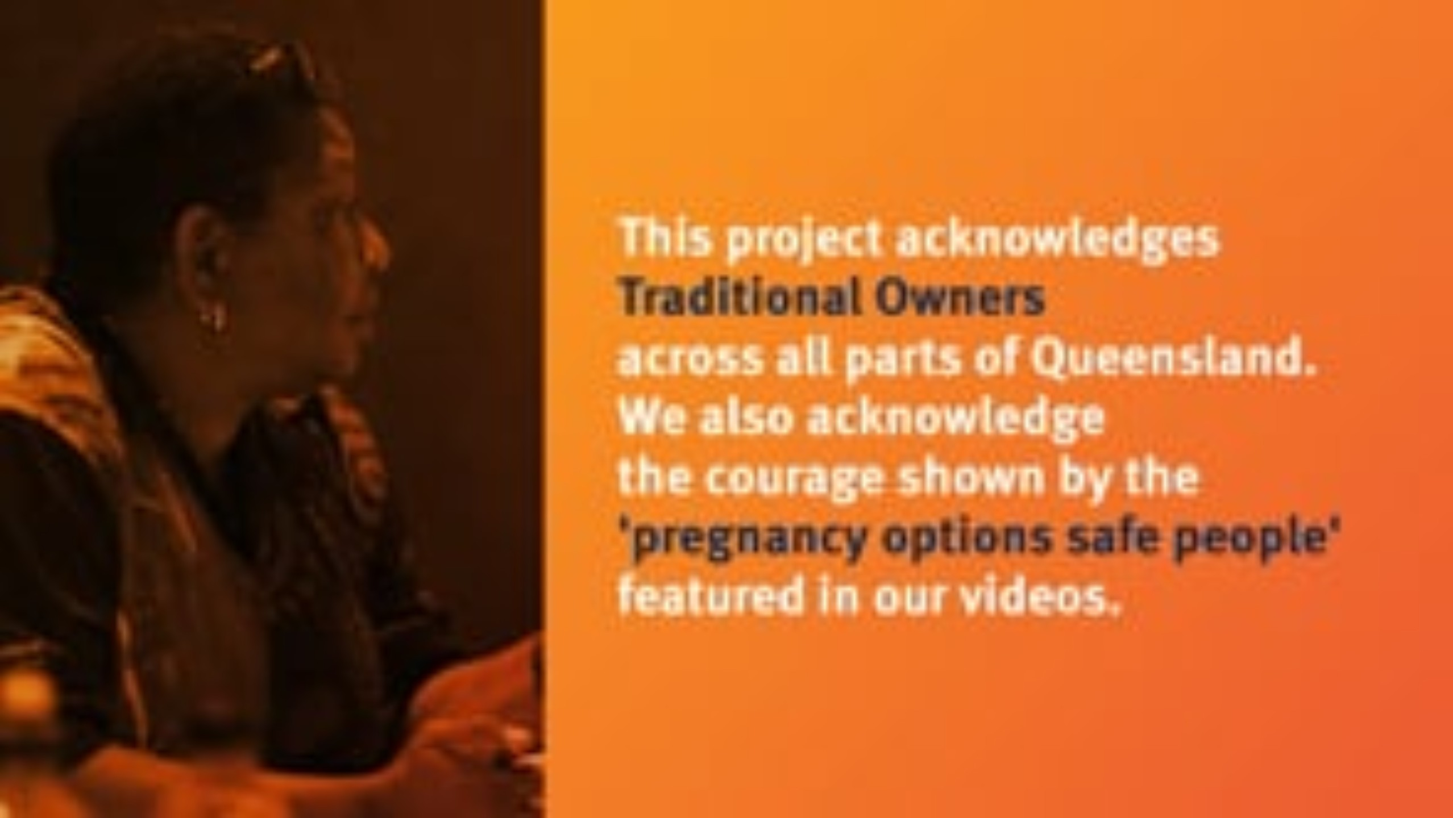

Slide 10
Questions & Contact Information
Natasha.chong@health.qld.gov.au
Morgan.dempsey@health.qld.gov.au
Erin.mcbride@health.qld.gov.au

Slide 11
