Slide 1
Triple Elimination Workshop
Australasian HIV & AIDS Conference
Adelaide, Western Australia
Date: 15-17th September 2025
Nano Gideon
National STI-HIV Program Manager
Public Health Division
National Department of Health

Slide 2
Background
HIV in PNG in 1987
Care and Treatment Program in 2003
Care and Treatment more centralized
Only in One City – Port Moresby
Consistent Increase to 22 provinces with 165 ARV Facilities
Backed up by 400 HIV Counselling and Testing sites
In 2023, 6700 people were diagnosed (18 cases per day)
In 2024, 11000 were diagnosed (30 cases per day)
Across both years and more so in 2024 , babies were born with HIV
Currently 60000 People diagnosed with are registered into HIV Care and treatment across PNG

Slide 3

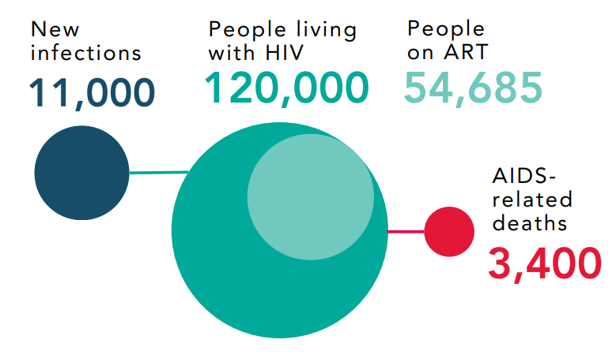
HIV Prevalence in PNG is 1.5%
Approximately 30 new infections per day
60 % are women in the Child bearing age
7 more babies are born with HIV every day

Slide 4
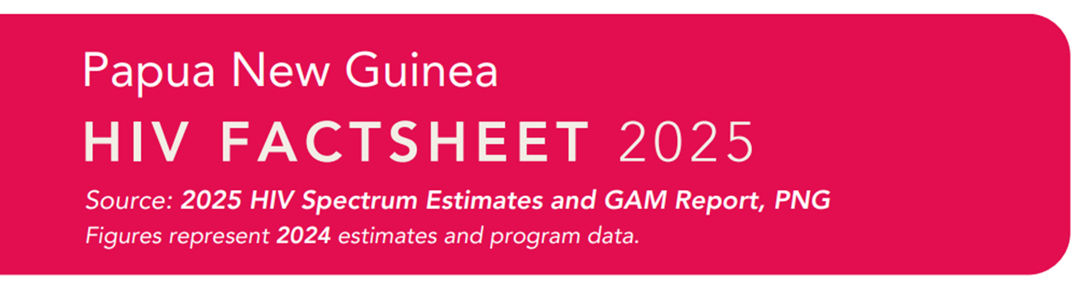
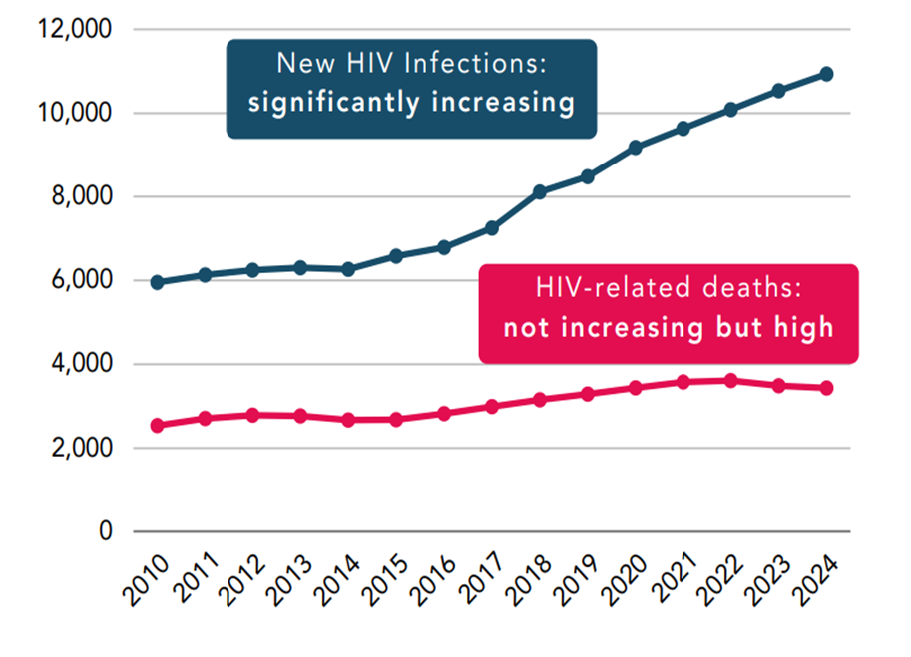
Globally, new infections have declined by 39%
In PNG HIV Infections have increased significantly
Increased coverage of ART
HIV Related deaths have remained stable but high in last 5 years

Slide 5
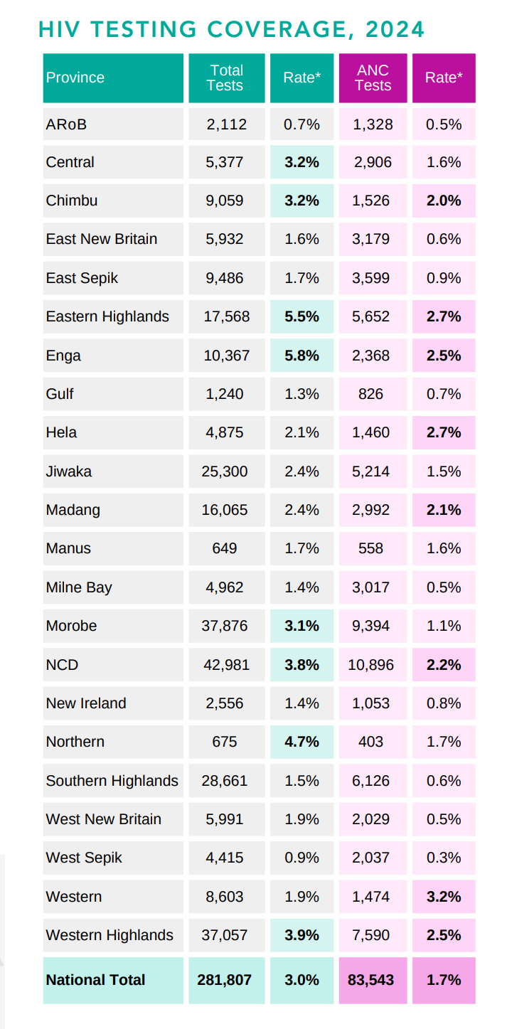
Effective Testing in ‘high risk groups’ increased across 22 Provinces in 2024
70% of data produced by 8 Provinces – under reporting from 14 provinces
HIV testing in ANC clinics improved across the country

Slide 6
ANC and PPTCT
Almost Non-Existent PPTCT Program across country – no tracking and prevention program in existent since 2017
Estimated 260 000 pregnant women in PNG
Only 160 000 attend at least 1 ANC care visit
80 000 receive at least 1 HIV test
1200 pregnant women tested positive for HIV (1.6% of those tested)
Estimated 7400 women living with HIV with only 2039 (27%0 receiving ART
Estimated 2675 new pediatric infections in 2024 (36% MTCT)
Only 755 infants tested for HIV within 2 months of birth

Slide 7
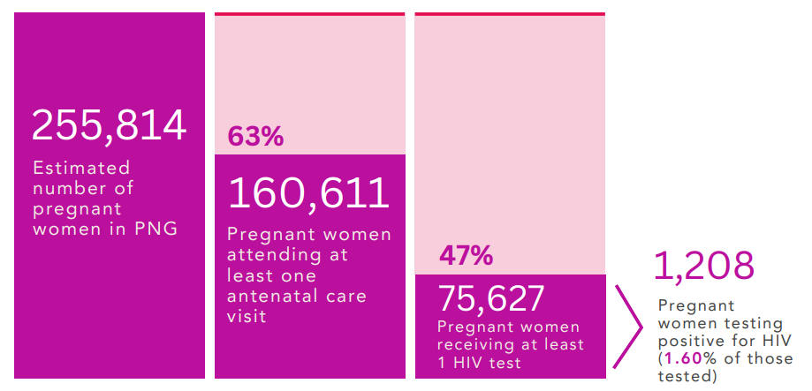
Preventing Mother to Child Transmission of HIV
HIV Testing during pregnancy can help women access ARV treatment
Treatment can prevent transmission of the virus to the babies

Slide 8
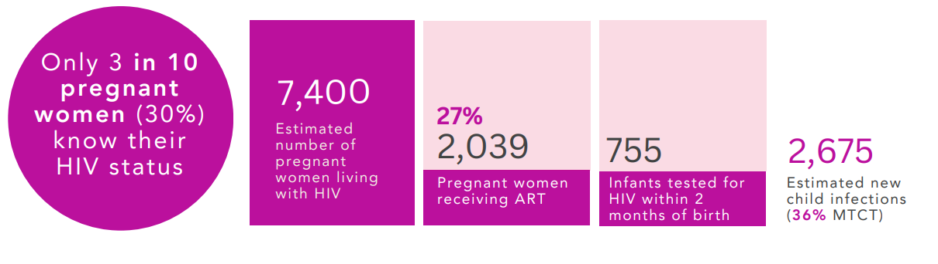
Preventing Mother to Child Transmission of HIV
Every year KPMs are coming in Pregnant and recorded at ANCs
Newly Diagnosed pregnant women are also seen at ANCs
Tracking these women continue to a challenge

Slide 9
# | #Province | Female Tested | Positive | Seropositivity (%)
1 | ARoB | 1,328 | 7 | 0.53
2 | Central | 2,906 | 46 | 1.58
3 | Chimbu | 1,526 | 30 | 1.97
4 | East New Britain | 3,179 | 20 | 0.63
5 | East Sepik | 3,599 | 34 | 0.94
6 | Eastern Highlands | 5,652 | 152 | 2.69
7 | Enga | 2,368 | 60 | 2.53
8 | Gulf | 826 | 6 | 0.73
9 | Hela | 1,460 | 40 | 2.74
10 | Jiwaka | 5,214 | 78 | 1.50
11 | Madang | 2,992 | 63 | 2.11
12 | Manus | 558 | 9 | 1.61
13 | Milne Bay | 3,017 | 16 | 0.53
14 | Morobe | 9,394 | 101 | 1.08
15 | NCD | 10,896 | 241 | 2.21
16 | New Ireland | 1,053 | 8 | 0.76
17 | Northern | 403 | 7 | 1.74
18 | Southern Highlands | 6,126 | 38 | 0.62
19 | West New Britain | 2,029 | 10 | 0.49
20 | West Sepik | 2,037 | 7 | 0.34
21 | Western | 1,474 | 47 | 3.19
22 | Western Highlands | 7,590 | 188 | 2.48
 | Total | 75,627 | 1,208 | 1.60
2025 ANC Testing summary Jan – June 2025
# | Province | Total Tested | HIV + Pregnant women
1 | EHP | 1550 | 24
2 | WHP | 4277 | 65
3 | SHP | 2491 | 19
4 | Jiwaka | 2132 | 27
5 | Hela | 251 | 30
6 | Morobe | 1550 | 24
7 | Simbu | 475 | 9
 | Total | 12726 | 198
2024 ANC Testing summary

Slide 10
Current Challenges in National PPTCT Program
Provincial Data entry decentralization
  National and provincial coordination of Dx, reporting and follow-up tracking of ANC cases
Improved linkage
  from ANC Clinics to HIV care and treatment facilities
Community Involvement
  Mentor Mothers training, capacity building
  Engagement to provincial coordination team for follow-up of ANC HIV + Pregnant women
Structured Sustained Follow-up
  from ANC - Birthing
  Post Natal – Breast Feeding period
  NAT at 6/52 and at 2 months post Cessation of Breast feeding at 9 months
Complete Weaning
  Exposed infants at 6 months advised as early and followed through
Exposed infants with negative NAT result
  are further supported to stay off breast milk
  Continue mothers clinical care support through adult HIV Care + Treatment program

