Slide 1


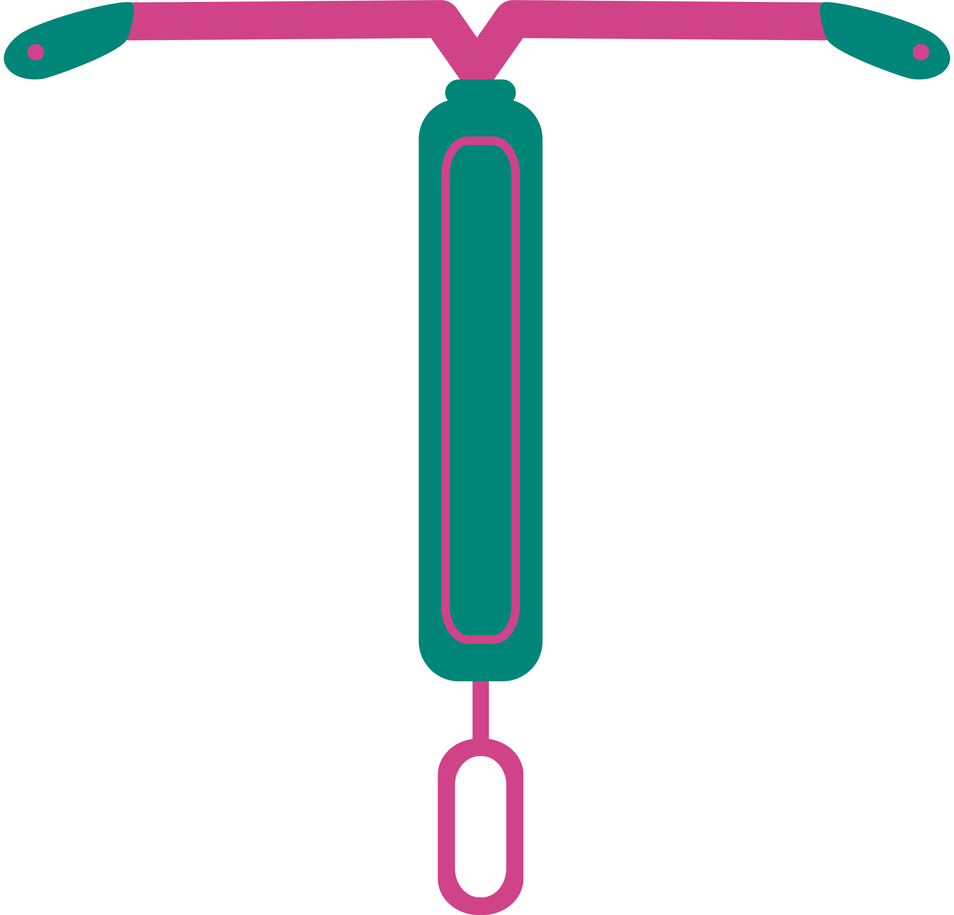

Contraception & Reproductive Coercion and Abuse online screening tool & information portal
Presented By : Léné Ritter
Notes:
Before we begin, I would like to acknowledge the Traditional Owners of the land on which we meet today, the Kaurna people, and pay my respects to Elders past, present, and emerging.
In our work, we also acknowledge the historical use of contraception and reproductive health care as a tool of harm against Aboriginal and Torres Strait Islander people. We are committed to reducing barriers and fighting for reproductive justice.
Thank you so much for joining me today, I’m Lene and I’m CbyC Community training and engagement coordinator.
I’m here to talk to you all about our contraception and RCA online screening tool and information portal.

Slide 2
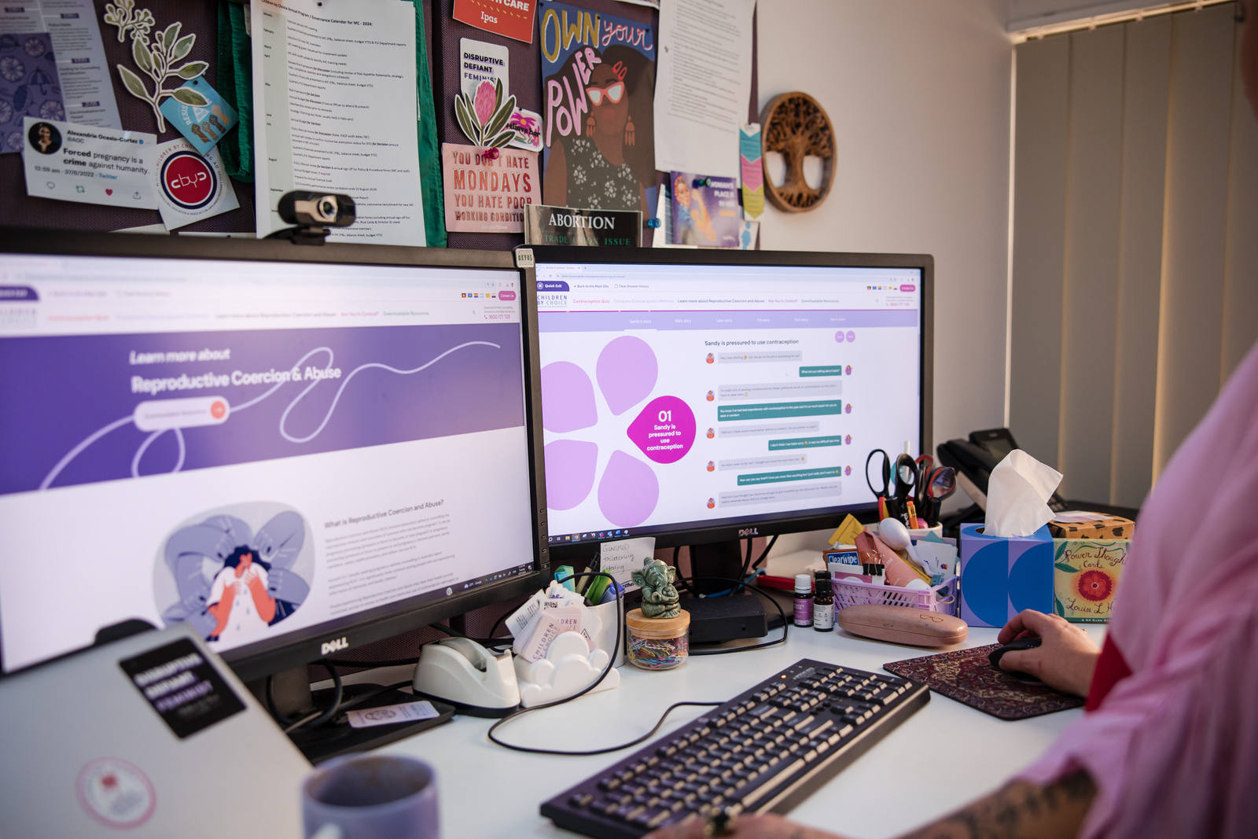
Reproductive Coercion and Abuse
  A behaviour aimed at establishing power and control by interfering with a person’s reproductive autonomy.
  Intent is key
Children by Choice | 2025
Notes:
Just to start off with, who's heard of RCA before?
It's completely ok if you haven't heard this terminology before.
RCA: Intentional manipulation or control where one person exerts pressure or force over another's reproductive choices.
Goal: control the other person's ability to make decisions about their reproductive health including whether to have children, use contraception or decide when and how to become pregnant.
Doesn't need to be perpetrated by intimate partners, but also can be family members, carers, and CbyC believe it can be perpetrated by systemic structures.

Slide 3

Background
Prevalence
Screening
15% of our clients report experiencing RCA
>30% of clients with disabilities
Existing screening tools shown to be largely ineffective in detecting RCA
Children by Choice | 2025
Awareness
Ongoing limited awareness of RCA
Variable definitions
Notes:
As many of you will know, we have been working on research and developing resources about Reproductive Coercion and Abuse for some time.
Prevalence - 15% CbyC clients RCA, 1 in 7 expereince RCA, intersectional - >30% reported having a disability also reported experiencing RCA
Screening – gap in information – 2017 1st resource on contraception and RCA (many may have seen – need for update, inclusive language and information has changed)
Awareness – limited awareness and limited awareness in wider society, plenty research (important) DFV.
WE noticed, however, a gap in practical information and resources for both community members and professionals.
While awareness about RCA is slowly increasing, what then? What do people do with this information? How do they learn more, screen or respond to RCA in practice?

Slide 4
Contraception & RCA project
Funded by Keeping Women Safe Grant, Queensland Government
Increase consumer & professional understandings of RCA
Improve consumer awareness of contraceptive methods other than 'the pill', & give guidance re. discussing with professionals
Provide a 'soft' introduction to RCA through contraceptive resources
Create an RCA information portal/ 'one stop shop'
Children by Choice | 2025
Notes:
So with these issues and needs in mind, we sought and won a grant from the Queensland government to digitise our much loved fold out resource. This project aimed to...
READ SLIDE – also:
Came out of experiences of just being prescribed the pill, advocate for self, more information
1 in 5 SM
75% unhappy with their current choice but scared to change
GP times - empower clients to take info into shorter appointments
Focus groups to ensure evidence based -> downloadable PDF for allow for further questions w/ healthcare professional

Slide 5

Process
1
Research
2
Consultation
Update content in much-loved foldout resource
8 focus groups over 7 months
  Medical & DFVSA professionals
  Consumers
4
3
Web development
Incl. scoring of quiz responses
Notes:
Update content 2017 guide – outdated language,
new evidence
8 focus groups 7 months
Web development – scoring
Back to consultation – approx. 4 rounds of consultation

Slide 6
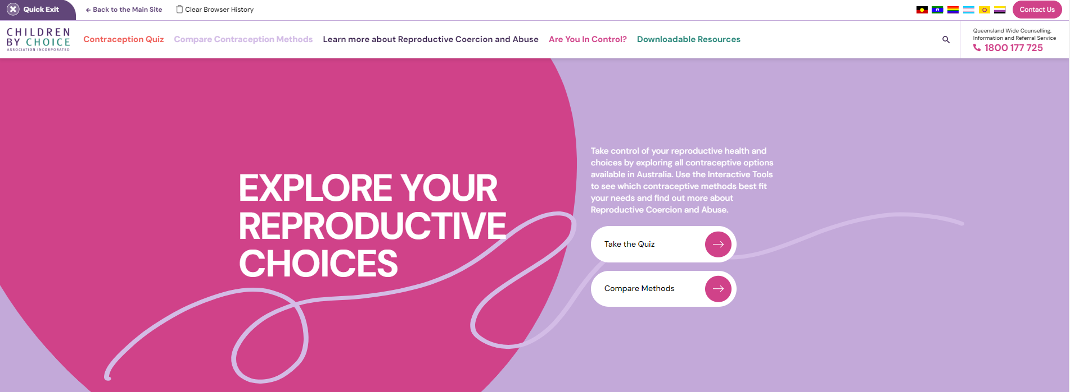
The website
Children by Choice | 2025
Notes:
Result: The website and new updated foldouts - if you use these or want to use them in your practice, we have printed many copies for free!
walk you through the 5 sections of the website, what they contain and how you can best use them.

Slide 7

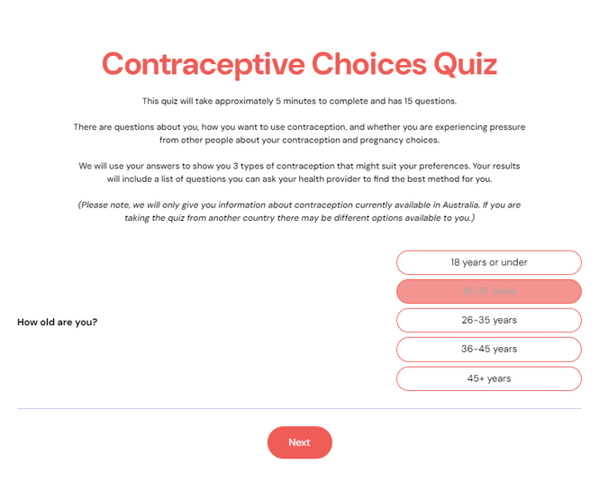
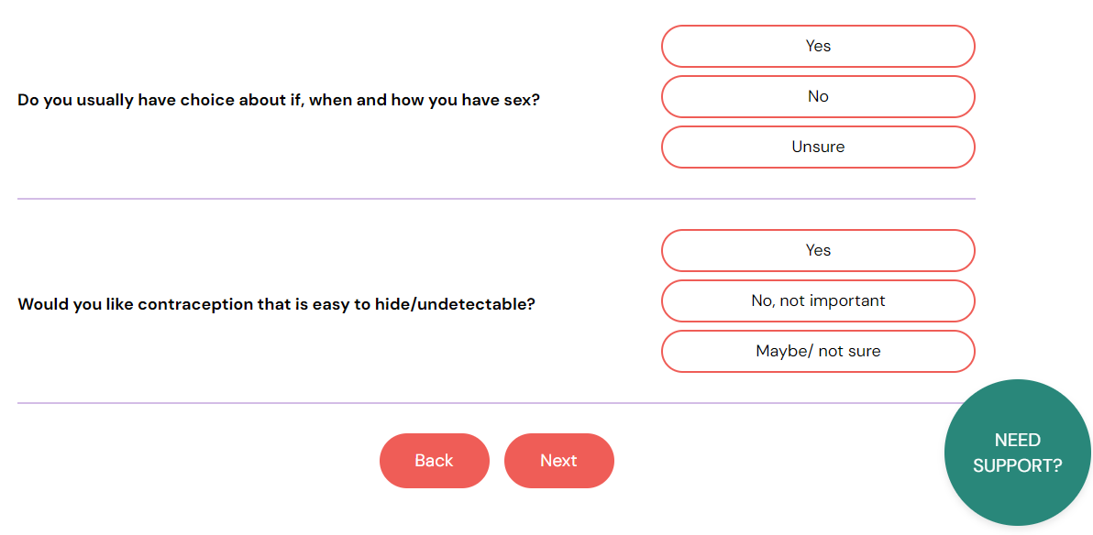
The Quiz
Children by Choice | 2025
Notes:
-Originally designed with consumers in mind, we wanted to expand understandings of contraceptive methods other than the pill.
-Most people in this room will have a good awareness of the many methods of contraception available
-We wanted provide consumers with options, language, and questions to ask their GP in particular to ensure they can find methods that suit them and work with their GP.
-Divided up into contraception and the other half is screening for RCA.
-These questions have been adapted by work done by Laura Tarzia and colleagues, and we'd like to acknowledge her ongoing feedback regarding this website too - thank you Laura!
-Introduce RCA at the same time.
- For each answer about contraception, the user receives a score, and the 3 methods with the highest score are then described in detail in a downloadable document. The document also contains a list of questions people can ask their providers - around things like side effects, pain, follow up, and so on.
-The RCA Q’s – no score but automatic pop up referring to national DFV helpline

Slide 8
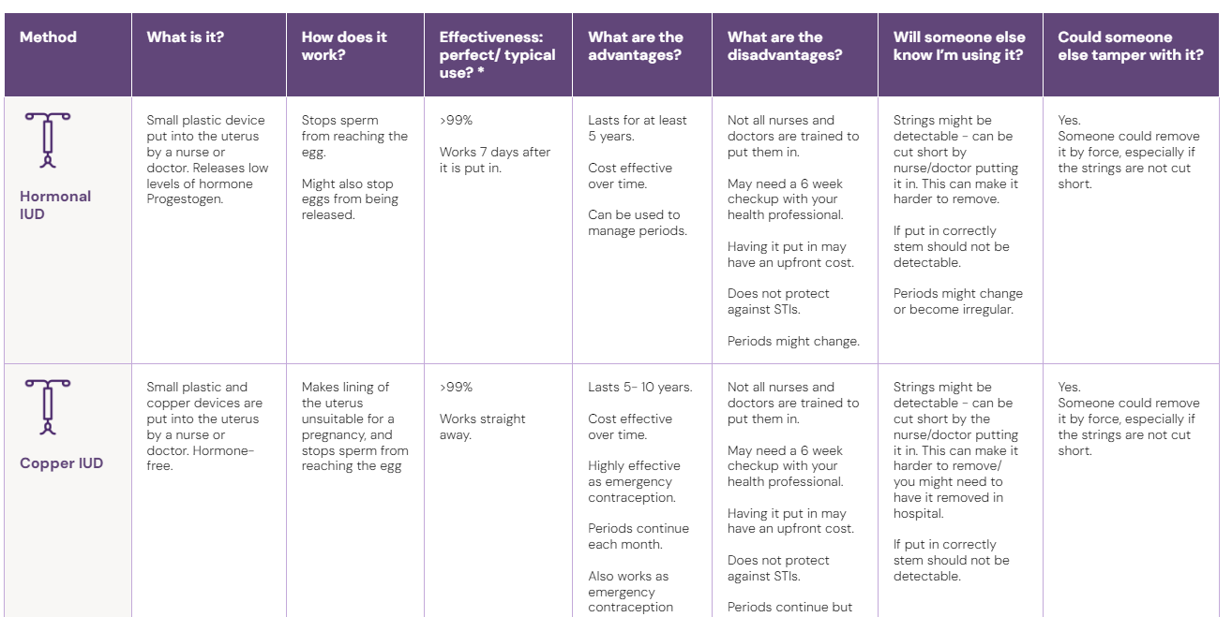
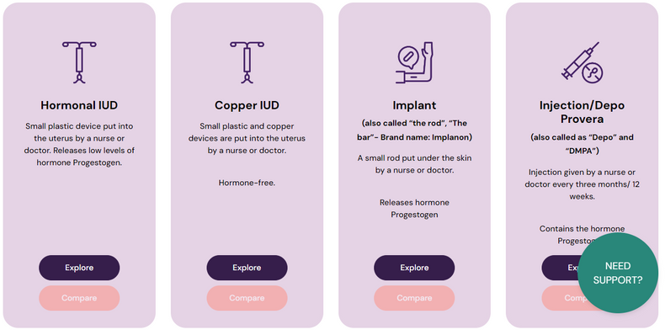
Compare Methods
Children by Choice | 2025
Notes:
-This page is essentially our fold out resource made digital. Users can click on multiple methods,
-Compare – selecting number of them
-Downloadable table with information (Detectable, length, use)

Slide 9

Learn about RCA
Definitions & examples of RCA and...
For professionals:
  Numbers & services to call/ refer to
  How to identify RCA - questions to ask
  Safety & practical considerations
For support people:
  Signs someone might be experiencing RCA
  How to talk about RCA with a loved one
  Information & support services
Children by Choice | 2025
Notes:
Information page...
Explain page – general info on RCA, professionals and support people

Slide 10

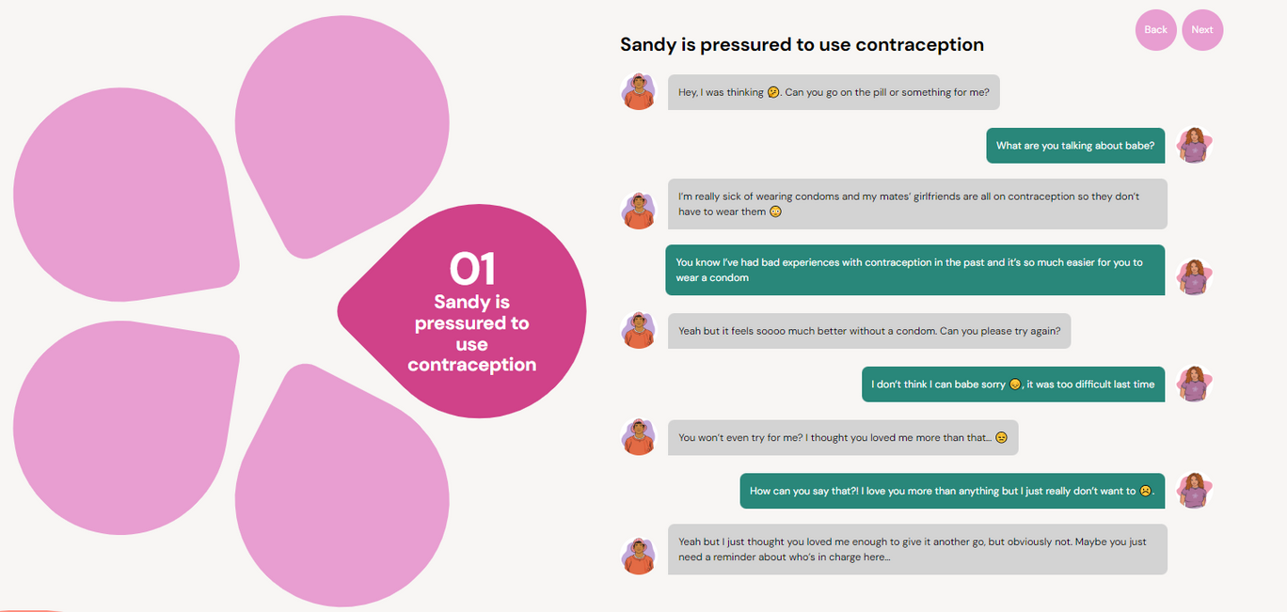
Textversations
Children by Choice | 2025
Notes:
-Not just intimate partners – variety of examples of family, partners and healthcare from all different demographics in order to provide case studies of how RCA can present itself and sound.
-Taking RCA out of the conceptual to reality
They are examples of RCA, including some subtle forms of coercion, which we know many people don't recognize as coercion or violence.

Slide 11

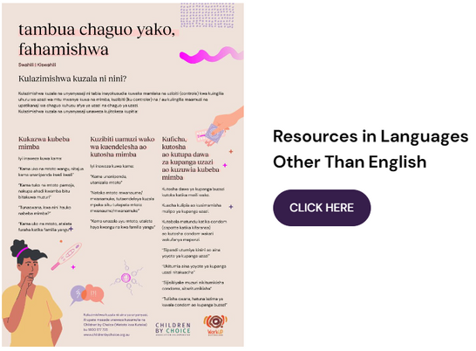
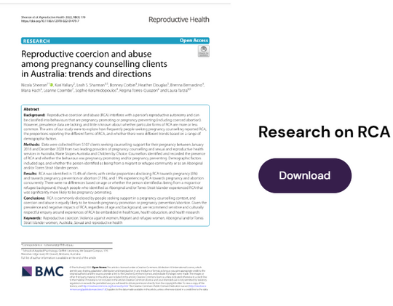
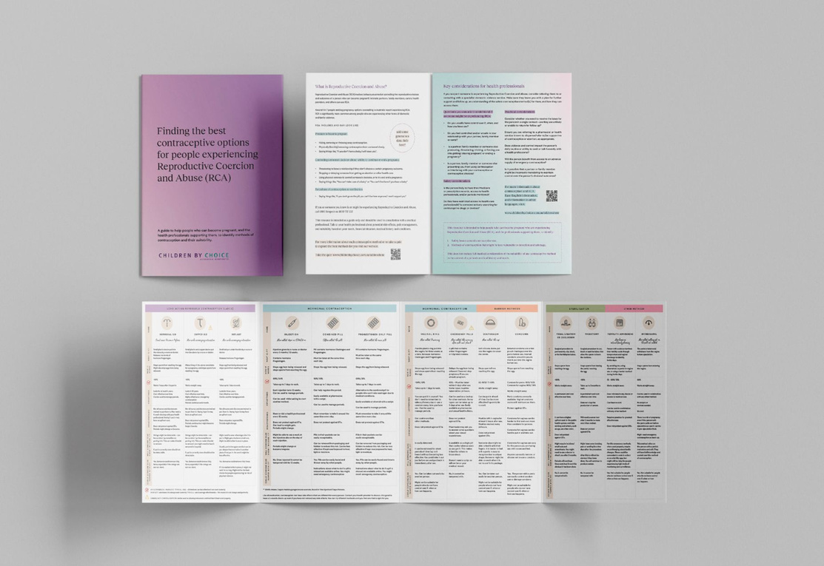
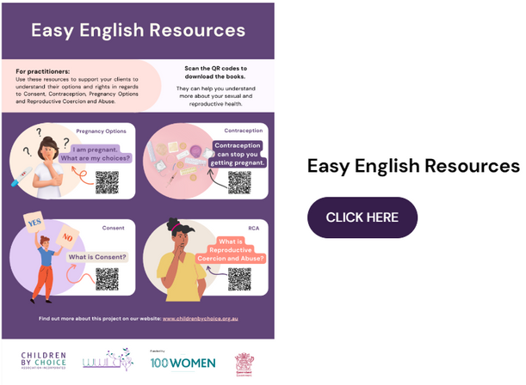
Downloadable resources
Notes:
The final page is a one-stop shop for all of our RCA resources, including
- the foldout resource
- RCA information in 4 languages (Spanish, Arabic, English and Swahili)
- Co-designed RCA information in Easy English
- Research

Slide 12

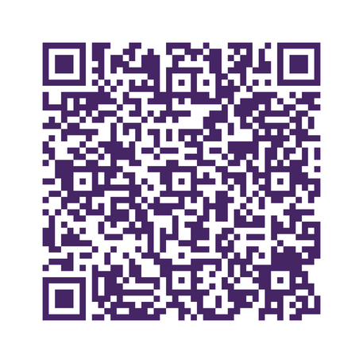


Contraception & RCA Quiz Resources
Take an online quiz to find contraceptive options based on your needs and preferences.
Get downloadable results, questions to ask your health provider, and compare methods.
Learn about Reproductive Coercion and Abuse (RCA).
TAKE QUIZ NOW
Children by Choice | 2025
Notes:
Evaluation input - pop up embedded. Working on the timing.
Last but not least, lets have a look at our new contraception quiz that helps identify RCA.
I'll get you to scan the QR code and we can run through it together.
(Open contraception quiz)
As you can see, it's a fairly intuitive tool that both clients and professionals can use, it's a 2 birds 1 stone system, gives consumers great options on contraception options and also identifies if they are at risk of RCA.
ON TABLE TOO
Evaluation - pop up from project

Slide 13

Thank you
Presented by: Léné Ritter
lener@childrenbychoice.org.au

