Slide 1
2019 JOINT AUSTRALASIAN SEXUAL HEALTH AND HIV&AIDS CONFERENCE
INTEGRATED CASE MANAGEMENT PROGRAM (ICMP)
The Rocky Road to Success
Ines Bruss, Bernadette Gillespie, Lisa Bastian and Byron Minas Department of health western Australia
Acknowledgements :
Manager Lisa Bastian and Epidemiologist Byron Minas
Regional Public Health Units and HIV specialist treating teams:
s100 GP prescribers
Royal Perth, Fiona Stanley & Sir Charles Gardiner Hospital.
WA AIDS Council
Disclosures:
There are no disclosures of interest to be made.
Join the Conversation @ASHMMEDIA #HIVAUS19 #SH19
Notes:
Hello, my name is Ines Bruss and this is my colleague Bernadette Gillespie and together we are the Integrated Case Management program, part of Public and Aboriginal Health Division at Dept of Health WA.
Our journey has been a Rocky Road to Success.

Slide 2
2019 JOINT AUSTRALASIAN SEXUAL HEALTH AND HIV&AIDS CONFERENCE
BACKGROUND:
Since mid-2016, ICMP incorporated Treatment as Prevention (TasP), as core of element of preventative work, engaging PLWHIV who are:
difficult to locate and disengaged from HIV treatment, and
have complex psychosocial needs, and
through their sexual or injecting behaviours are likely placing others at risk of HIV transmission.
Two Case Management Officers provide intensive outreach across Perth metropolitan to engage this largely transient population with HIV clinical specialist teams; and provide counselling, referrals and psychosocial interventions.
Join the Conversation @ASHMMEDIA #HIVAUS19 #SH19
Notes:
Since mid-2016, we at the ICMP have incorporated Treatment as Prevention (TasP), as core of element of our work, engaging PLWHIV who are:
difficult to locate and disengaged from HIV treatment, and
have complex psychosocial needs, and
through their sexual or injecting behaviours are likely placing others at risk of HIV transmission.
The two of us provide intensive outreach across Perth metro area to engage this largely transient and often homeless population with HIV clinical specialist teams; and provide counselling, referrals and psychosocial interventions.

Slide 3
2019 JOINT AUSTRALASIAN SEXUAL HEALTH AND HIV&AIDS CONFERENCE
In the 18 month period 01/07/2016 to 31/12/2018, the viral load results for 30 metropolitan ICMP clients were observed to monitor the impact of integrated case management.
Clients EXCLUDED from the audit (total n=39):
Residing primarily in regional WA with direct service provision by regional public health units (n=10): due to variable practice approaches and resources allocated by regional public health unit teams.
Unable to be found (n=3)
Long term incarcerated (n=3)
Referral too recent to be included in study (n=11)
Other (n=12): unsubstantiated allegations, interstate, refusing to engage, deceased.
Join the Conversation @ASHMMEDIA #HIVAUS19 #SH19
Notes:
We completed an audit of viral load results for 30 metropolitan ICMP clients, to monitor the impact of our new integrated case management approach in the 18 month period 01/07/2016 to 31/12/2018.
From a pool of 69 ICMP clients, 39 clients were excluded from the audit (total n=39):
10 Residing primarily in regional WA with direct service provision by regional public health units (n=10): due to variable practice approaches and resources allocated by regional public health unit teams.
3 Unable to be found (n=3)
3 Long term incarcerated (n=3)
11 Referrals too recent to be included in study

Slide 4
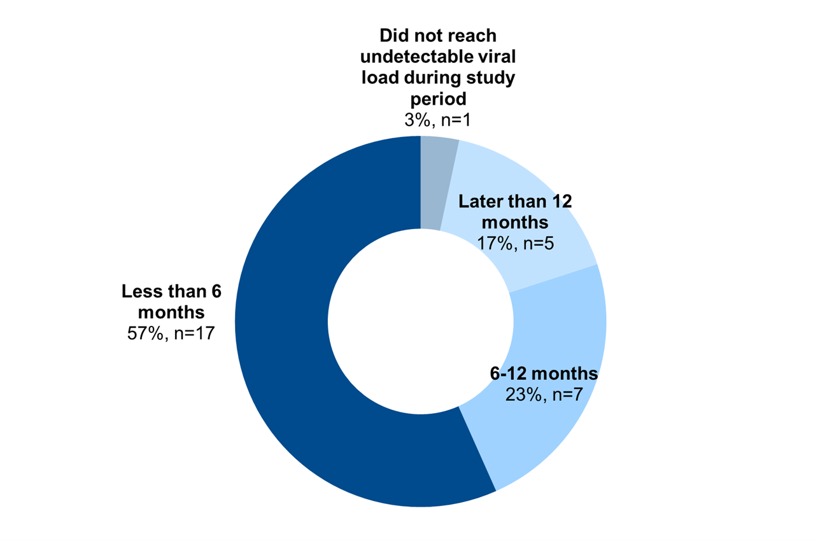
2019 JOINT AUSTRALASIAN SEXUAL HEALTH AND HIV&AIDS CONFERENCE
Time from referral to undetectable viral load (30 clients)
Median time to reach undetectable viral load = 130 days post referral
Join the Conversation @ASHMMEDIA #HIVAUS19 #SH19
Notes:
12 Other (n=12): unsubstantiated allegations, interstate, refusing to engage, deceased.
RESULTS:
All but one client achieved an undetectable viral load after being referred to the Program (n=29; 97%).
57% of ICMP clients reached undetectable status within six months of referral (n=17; 57%);
By 12 months the figure was 80% (n=27) were undetectable.
17% of clients took more than 12 months to achieve UDVL
Overall, the median time to reach an undetectable viral load was 130 days post-referral.

Slide 5
2019 JOINT AUSTRALASIAN SEXUAL HEALTH AND HIV&AIDS CONFERENCE
CONCLUSIONS:
The challenge is to keep our clients at sustained undetectable viral load
Significant success achieved utilising the new approach in assisting this marginalised population to achieve and maintain undetectable viral loads of <200 copies/mL.
Without ICMPs intensive approach, this population would most likely not engage in HIV treatment, hence continuing to place others at risk of HIV.
In future audits we aim to compare results across different time periods.
Join the Conversation @ASHMMEDIA #HIVAUS19 #SH19
Notes:
CONCLUSIONS:
The challenge is to keep our clients at sustained undetectable viral load
Significant success was achieved utilising this new approach in assisting this marginalised population to achieve and maintain undetectable viral loads of <200 copies/mL.
Without our intensive approach, this population would most likely not engage in HIV treatment, hence continuing to place others at risk of HIV.
In future audits we aim to compare results across different time periods.
QUESTIONS:
** 94 new HIV notifications 01/07/2016 to 31/12/2018
** Currently 2024 patients on Treatment in WA
** 1.2% of PLWHIV in WA are being serviced by ICMP
** 2.5% of PLWHIV in WA are being serviced by ICMP, or SHAPE or both

