Slide 1
Fear of Loving: A Therapeutic Group Program to Promote Wellbeing In Pregnancy After Fertility Treatment
Dr Julia Feutrill, Perinatal and Infant Psychiatrist
Ms Michelle Stuckey, Clinical Psychologist and Fertility Counsellor
Marce Conference, Perth, 12/10/2019
Notes:
Thanks Robyn – a background for the patients we see who have had struggles with infertility there is always loss and grief.
Disclaimer – As much as my name is up ther on the screen, M has really done the bulk of the work and I have simply been in the backgeound cheering her on.
Michelle and I have been working in PIMH for many years and have often commented on the prevalence of patients who have experienced infertility and how the experience of infertility can live on in their experience of their pregnancy, their delivery and their parenting. Her more recent foray into fertility counselling has further clarified the specific issues that arise and the need to work towards some sort of continuity of care from infertilty to pregnancy and to parenthood for which there are few avenues as most are discharged from the fertililty services at 7 weeks gestation and then enter mainstream obstetric services which often doesn’t recognise the journey they have endured to get there.
So to set the frame – let me highlight the journey of ART thus far and outline the scope of the issue and some of the evidence which there is relatively limited due to the relatively recent occurrence of ART, the distinct lack of data base and recording of outcomes related to parental mental health.
Then Michelle will provide an outline of her program – for which we have finally submitted ethics approval but can provide some of the feedback from the couples who have been involved already.

Slide 2
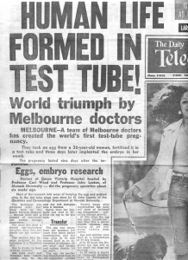
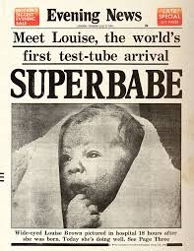
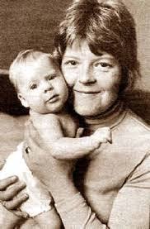
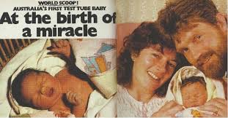
Notes:
The in vitro fertilisation program was formed with an amalgamation of research teams at the melbourne and monash universities and the Queen Victoria and Royal Melbourne hospitals under the guidance of Carl Wood.
In 1973 they succeeded in producing the first ever human IVF pregnancy. The pregnancy lasted 9 days.
They were three years ahead of Steptoe and Edwards who achieved an ectopic pregnancy in 1976.
Louise Brown was born in July 1978 at olham general hosptial – her delivery was shrouded in secrecy as her mother was taken to theatre in darkness for an elective CS. The birth had to be filmed to give documented evidence that she was indeed from her mother. She was kept under police guard and even her father was escorted by police to see her.
At delivery, she was immediately whisked away from her mother - to have a battery of tests to confirm she was normal.
The men who pioneered the treatment gynacologist Patrik Steptoe and Nobel Prize winning physiologist Robert Edwards had over the preceeding 10 years gone through hundreds of embryo transfers prior to the success of this one.
1980 Melbourne – the third IVF baby in the world
Here is baby Candice Reed. In that same year they achieved 15 pregnancies and 9 more live births.
The same Australian team achieved and delivered the worlds first human frozen embryo and in 1984 the first donated egg IVF pregnancy.
Australia led the world and held the first international IVF conference with the americans learning directly from the team at Monash.
As I was reading all these statistics and the idea that for many of these women and men – they were having experimental treatment and surgery with very low chance of success and high trepidation about how the children would turn out. It must have been incredibly anxiety provoking and is perhaps a reflection of their desperation to be parents. I wonder what sort of support or recognition was given to them.
The same desperation can occur today – with many couples subjecting themselves to years of treatment with slim hopes of success.

Slide 3
82 215 treatment cycles
55 368 fresh/thawed embryo cycles
18 860 clinical pregnancies
15 405 live born babies (1:25 children born in 2017)
Assisted Reproductive Technology Report Australia and New Zealand 2017
Notes:
1:6 struggle with infertility with increasing rates of so called social infertility

Slide 4
Infertility
Depression in infertile couples 15-54% (more failed, more risk)
Anxiety in infertile couples 8-28%
F>M except when infertility is related to M
2 fold risk of infertility with depression (PRL, HPA, TFT, LH, immune system) and possibly anxiety
Depressed couples do less cycles with less success
AD Medication DOES NOT↑ miscarriage, BZD?
Fertility medication can impact on MHD
Past trauma can be retriggered in treatment
Notes:
Infertility itself is a risk factor for mental health disorders and symptoms.
Mental health disorders can be a risk for fertility and its treatment
Been thinking about the increased rate of infertility in the context of untreated depression and wondering at how Ron De Kloets work might be relevant. Are we seeing an impact on the reproductive system from the chronic stress of a MHD?
Unfortunately, in many cases, it may not be possible to completely eliminate treatment with benzodiazepines. While this study suggests an association between benzodiazepine exposure and increased risk of spontaneous abortion, the absolute risk does not exceed what we would normally expect in the general population. Further study is needed to better understand the risks associated with benzodiazepines and to better estimate the contribution of other factors, particularly severe of symptoms during pregnancy

Slide 5
So what happens once they are pregnant?
Data is mixed.
Some indication of unchanged risk of anxiety and depression but ? underreporting
Increased levels of pregnancy related anxiety
Increase in anxiety around childbirth and early weeks
Lower sense of self efficacy
Impact on relationship with developing baby
Idealised view of pregnancy
Notes:
Pregnancy related anxiety has been separated out from more general anxiety – Possibly because it doesn’t get detected on our usual screening instruments or perhaps in an attempt to show that the anxiety related to ART is not as bad as other anxiety? Clinically it is a huge problem and often a great source of distress and dysfunction for parents to be. They are painfully anxious – which often impacts on the representations and bonding they have with their child.

Slide 6
So what happens once the baby is here?
More presentations with child related worries
Lower breastfeeding rates
Increased admission to Parenting units
Possible increase in dysregulation of baby
Ongoing dyadic impact
Notes:
When I talk with my paediatric colleagues – one of the most important bits of history is mode of conception – they collect this until children are in their early teens. It is important to them from a biological perspective but also they find it helps them understand the parents better in their reactions to their child being unwell.

Slide 7
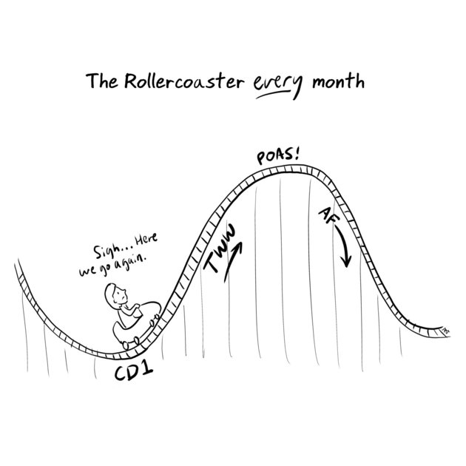
Infertility - A Non-Normative Life Transition
Emotional rollercoaster with a lack of control
Chronically stressful situation
Existential crisis
Grief
Isolating and lonely
Couples Journey
Alison Wong
Notes:
Thanks Julia
Im really pleased to be sharing this work with the people here today - we feel that it has great potential in an area of genuine need
There currently isn’t anything tailored to couples pregnant after fertility treatment and more and more couples are requiring these treatments to fall pregnant
After spending time developing it we now have one group complete and have sought ethics approval to expand the program.
Following on from what Julia has told us, here are some of the real psychological and emotional struggles that people with infertility experience.
It truly is an Emotional rollercoaster for nearly everyone who requires this treatment - the hope and then the disappointments with failed pregnancy tests. It is not something to work hard at and achieve and this lack of control is particularly difficult for some people.
Chronically stressful situation
It can be an Existential crisis. Some people will question the purpose and meaning of their life particularly if they are faced with the decision to use donor sperm or eggs or embryos.
Grief - A large part of the counselling as a Fertility Counsellor has to do with grief and the loss of how one thought they would be pregnant and it is often a silent grief as even for those couples who tell some people they are using fertility treatment they don't tend to tell a very wide circle.
Can be isolating and lonely - as it impacts on social relationships - particularly with family or friends who either don’t know about the couples treatment or who are pregnant.
Couples Journey Because its a chronic stressor, relationship stress may have been heightened during fertility treatment i.e. individual coping strategy can negatively impact the partner

Slide 8
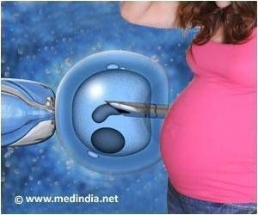
Pregnancy Conceived with Fertility Treatment
-happiness but anxiety
-fear losing baby
(Evans et al., 2017, Hammarberg et al., 2018)
‘Waiting to Lose’, denial, avoidance, hyper-vigilance and physiological stress
Sense of body as unreliable
Can disrupt identity formation (motherhood/fatherhood)
Shame at sense of ambivalence after so wanted and strived for
Notes:
A mix of emotions -happiness but anxiety, -fear losing baby (Evans et al., 2017, Hammarberg et al., 2018)
When pregnant via ART, weekly blood tests from 2 to 7 weeks are the norm. This high degree of monitoring can be highly triggering for those with anxious personalities – Each time they go for a blood test – their anxiety escalates, then they are briefly reassured before they are triggered again by the next blood test /US.
‘Waiting to Lose’, denial, avoidance, hyper-vigilance and physiological stress
(i.e. some mothers can’t imagine their own baby; some mothers can think of nothing else)
Sense of body as unreliable
Can disrupt identity formation (motherhood/fatherhood)
Shame at sense of ambivalence after so wanted and strived for
If these can be recognised, acknowledged opening and worked on – then their impact stays confined to pregnancy and wont ‘spill over into the postnatal period

Slide 9
HEART AND HOPE
Pregnancy after Infertility
An antenatal program, specifically designed for women, couples or groups who have a history of infertility or who have utilised assisted reproductive technologies to achieve their current pregnancy.
Notes:
We have called this program Heart and Hope to recognise the courage and optimism that can help couples get through an uncertain and high stakes pregnancy.

Slide 10
Heart and Hope
Three sessions of 2 hours
For couples pregnant after ART
EPDS, GTQ, BARE, DASS (pre and post measures)
Qualitative pre and post questionnaire
Adapted for individuals
Manualised program informed by:
- Cognitive Behavioural Therapy
- Acceptance and Commitment Therapy
- Emotion Focussed Couple Therapy
i

Slide 11
Aims
To explore the experience of being pregnant after a history of infertility and conception utilising ART.
Normalise and accept feelings
Promote reflective capacity
Provide psycho-education to minimise the risks of antenatal and postnatal anxiety and depression
Prevent experience of fertility treatment disrupting the normative psychological processes that take place in pregnancy
Notes:
To explore the experience of being pregnant after a history of infertility and conception utilising ART.
Normalise and accept feelings, such as disbelief and ambivalence about pregnancy, about the baby and about future ability to parent.
To promote reflective capacity to guide the re-definition of the self and how the past may be influencing the present
Providing psycho-education and practical suggestions to minimise the risks of antenatal and postnatal anxiety and depression, such as practising mindfulness, importance of social support and self-care activities.
Overall our aim is to Prevent experience of fertility treatment disrupting the normative psychological processes that take place in pregnancy

Slide 12
Facilitator
Provide a non-judgemental space to enable concerns and ambivalence about being pregnant (and impending parenthood) as well as their excitement and joys to be discussed
Develop a relationship that encourages capacity to think about their parenting transition, keeping their baby in mind
Provide a warm and supportive environment where the focus is on enhancing each person’s sense of them self as a parent-to-be and part of a parenting-couple.
Use emotionally charged events that may arise during the group as an opportunity in the here and now for individual and group development.
Notes:
Reflective and relational approach
Provide a non-judgemental space to enable concerns and ambivalence about being pregnant (and impending parenthood) as well as their excitement and joys to be discussed -
Develop a relationship that encourages capacity to think about their parenting transition, keeping their baby in mind -We structured the group so that the focus is not just on learning but more primarily on reflecting on the couples internal and external experiences as they are preparing for parenthood. Thinking of the the baby as a person, with a mind of his her/ own was something we really wanted to foster in the pregnancy.
Provide a warm and supportive environment where the focus is on enhancing each person’s sense of them self as a parent-to-be and part of a parenting-couple. So we hope to enhance resilience by having the individuals see how they can gain some control and acceptance of their experience of being anxious for example.
Use emotionally charged events that may arise during the group as an opportunity in the here and now for individual and group development.

Slide 13
Participant Expectations For The Group
Husband: I want to learn more about how fertility effects people without being uncomfortable. I want to learn how to talk about issues without it becoming a sob story
Wife: Meet other couples with similar experiences and see how they dealt with fertility treatment. To build a stronger relationship/emotional connection with my husband
Wife: Discussion about anxiety in pregnancy
Husband: To support my wife
Wife: Further acceptance that this can be a normal pregnancy and that it is ok that we used ART to conceive. To not feel so hard on myself that we had to use ART. To not feel so alone. To enjoy this pregnancy
Husband: How to support your partner when she is anxious. To know we are not the only ones
Wife: To meet others in similar situation. Learn coping strategies.
Notes:
Here are some comments from the group that we have run with personal expectations for they wanted from the group
Participants were 12-21 weeks gestation
You can see that there is a yearning to not feel alone, to talk about their experiences and wanting to know that others feel the same

Slide 14
Qualitative Experiences Collected Post Group
Hearing others journeys but how the emotions are all the same
Meeting other couples - especially hearing the men’s perspectives
Talking about my fertility journey and early pregnancy eased my anxiety
It was a relief seeing similar people in our situation and learning from each other
Finding it ok not to know/ ask dumb questions
Mindfulness was very helpful
Made me realise I am not alone and my feelings are normal
It really helped my wife with her anxiety but she also heard some of my feelings as I don’t really share that sort of stuff
Notes:
Apart from some really glowing feedback about the tim tams,
Here are some comments from the evaluation questionnaire about how the participants found the group

Slide 15
Pre- Post Measures
Normal range EPDS, DASS for all people
How concerned are you about your baby’s health in this pregnancy?
1= Not at all, 2 = A little, 3 = Somewhat, 4 = Quite a bit, 5= Very much
 | Woman A | Woman B | Woman C | Woman D
PRE | 4 / 5 | 1 / 5 | 5 / 5 | 4 / 5
POST | 2 / 5 | 2 / 5 | 3 / 5 | 4 / 5
Notes:
No mental health disorders in any of the people in this group
But the women (bar one) all held quite a lot of fear that something might happen to their baby. Interestingly, the one that didn’t was the only one who had a complication in her pregnancy - and she did present with an avoidant coping style
So we know this group is beneficial for couples pregnant after infertility but of course we need to quantify the benefit with the running of many more groups which we will do soon.

Slide 16
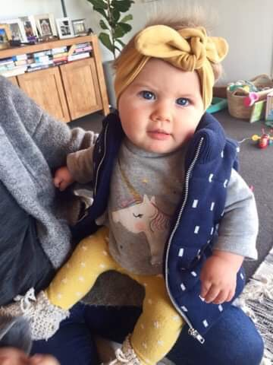
Infertility
Repeated single test lines
All encompassing
Two little blue lines
The shadows start to lift
Joy descends upon us
Notes:
One of the components of the program was for each person to write some Haikus about their experiences with fertility treatment and with pregnancy.

