Slide 1
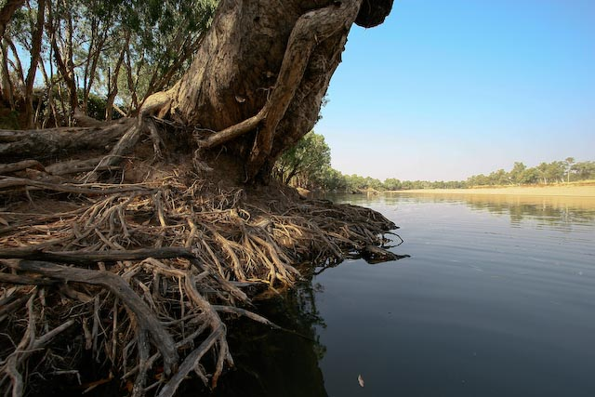

The “Sensible Centre”
Sustainability and northern development
Michael Douglas, Ian Baker, Graham Tupper

Slide 2
Northern development
Old idea, hasn’t really taken off
Legacies in the north
  Big dreams
  Past failures
  Skepticism
Legacies of past: Murray-Darling Basin
  Billion $$ environmental repair bill
  Social upheaval with water claw-back
  Indigenous interests not considered
Polarised debates, conflict, uncertainty

Slide 3
Northern development
Old idea, hasn’t really taken off
Legacies in the north
  Big dreams
  Past failures
  Skepticism
Legacies of past: Murray-Darling Basin
  Billion $$ environmental repair bill
  Social upheaval with water claw-back
  Indigenous interests not considered
Polarised debates, conflict, uncertainty

Slide 4
Common ground: Sustainability
Agriculture: interested in development and economic sustainability
  But what will that look like? What won’t it look like?
The conservation sector: interested in environmental sustainability and economies
Indigenous sector has interests in social/cultural sustainability and economies

Slide 5
The Sensible Centre
What’s needed to reduce the risks and barriers for development while strengthening environmental protection and creating social benefits?

Slide 6
What’s needed
Evidence based planning
  For land and water use
Sound economic analysis
  Markets, supply chains. Start small-grow large.
Genuine Indigenous engagement

Slide 7
What’s needed
Adequate time
  (and capacity) for planning and decision making, testing, learning and refining
Reform government processes
  to break down silos and foster consistent approach in planning and approvals
Improved evidence base
  (and case studies) to make informed decisions
  Resources, biodiversity, water requirements

Slide 8
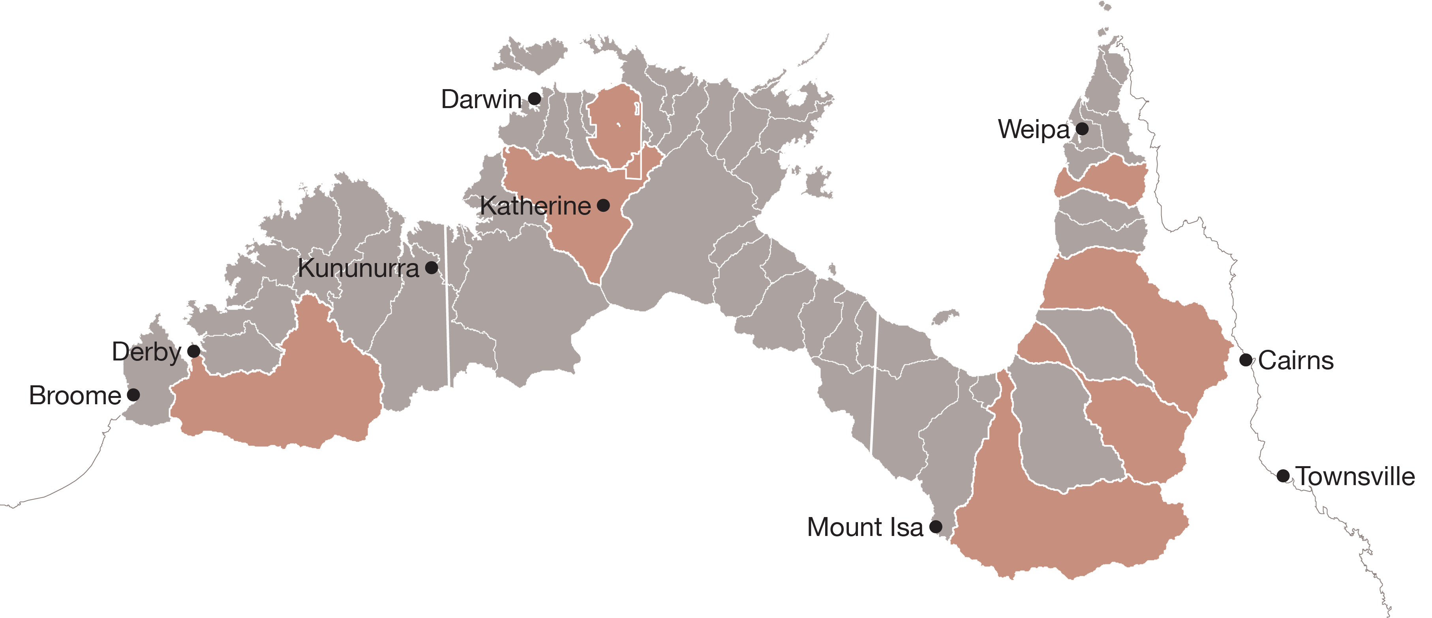
What is the NESP Northern Hub doing?
Integrated planning (WA)
Indigenous engagement (WA)
Environmental water requirements (NT, WA, QLD)

Slide 9
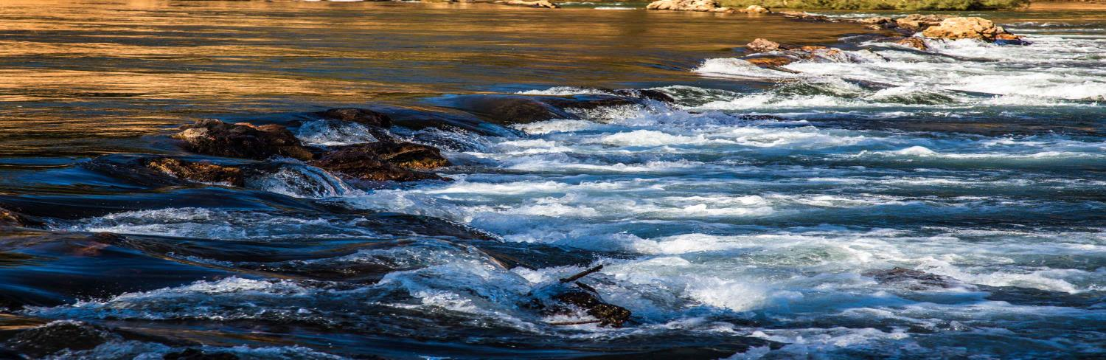




Establishing the environmental water requirements for the Daly River, NT
Alison King, David Crook, Simon Townsend, Peter Dostine, Julia Schult, Doug Ward, Thor Saunders & Kyle Tyler

Slide 10
New research in the NT
When does water get onto the floodplain?
Where are the dry season habitats?
Which fish and bugs live in the shallow areas?
How do black bream and pig-nosed turtle use and move through shallow areas?
What are the fish feeding on in the dry?
Which fish breed in the dry season?
How does water use affect all of this?

Slide 11
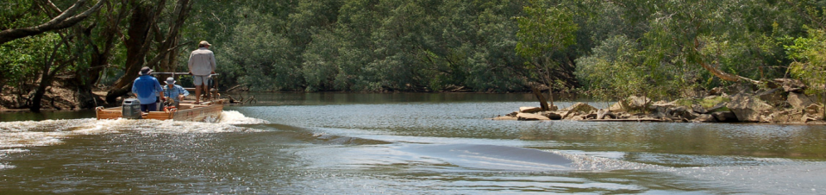

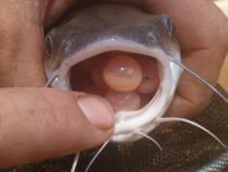
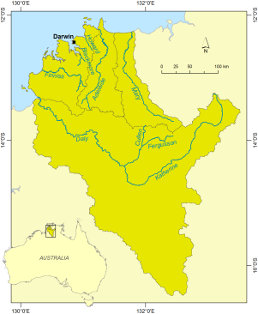
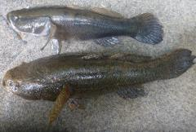
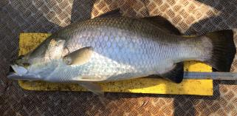





Forecasting fish resilience to environmental change in northern Australia
Resilience: “capacity to resist or quickly recover from degradation”
Project aims to:
  Collect life history & biological traits information of key fish freshwater species
  Predict responses to changing environmental conditions, e.g. water resource development, climate change
Contact: Alison King, Charles Darwin University
Notes:
Traits include morphological, reproduction, movement and food preferences)

Slide 12

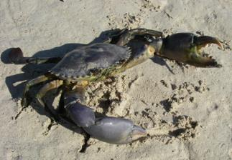
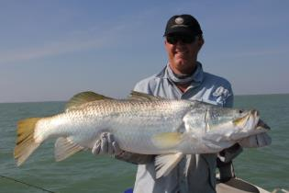
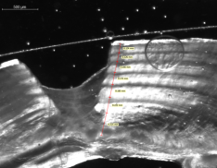

Influence of freshwater flows on growth and abundance of Barramundi and Mud Crab in the Northern Territory
Contact: David Crook, Charles Darwin University
Predicted growth
Wet
Dry
Notes:
Project aims:
Use advanced bio-chronology techniques to characterise relationships between freshwater flow and growth and recruitment in barramundi and mud crab
Employ statistical modelling frameworks to predict the effect of changes in water regimes (management and climate) on barramundi and mud crab fisheries

Slide 13
Michael Douglas
0408467000
michael.douglas@uwa.edu.au

