Slide 1
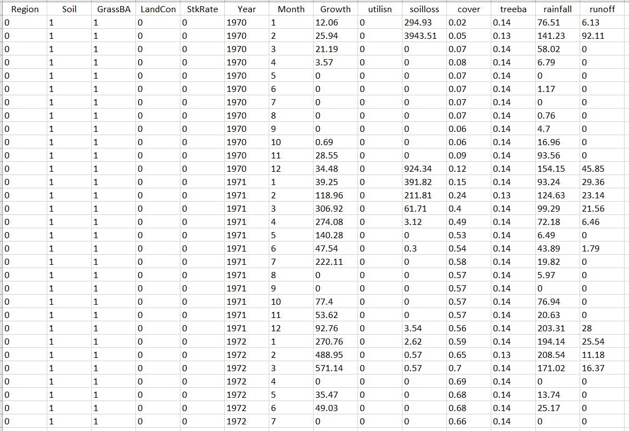
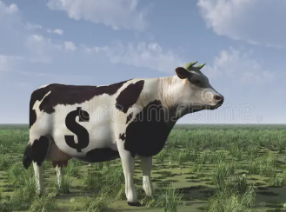
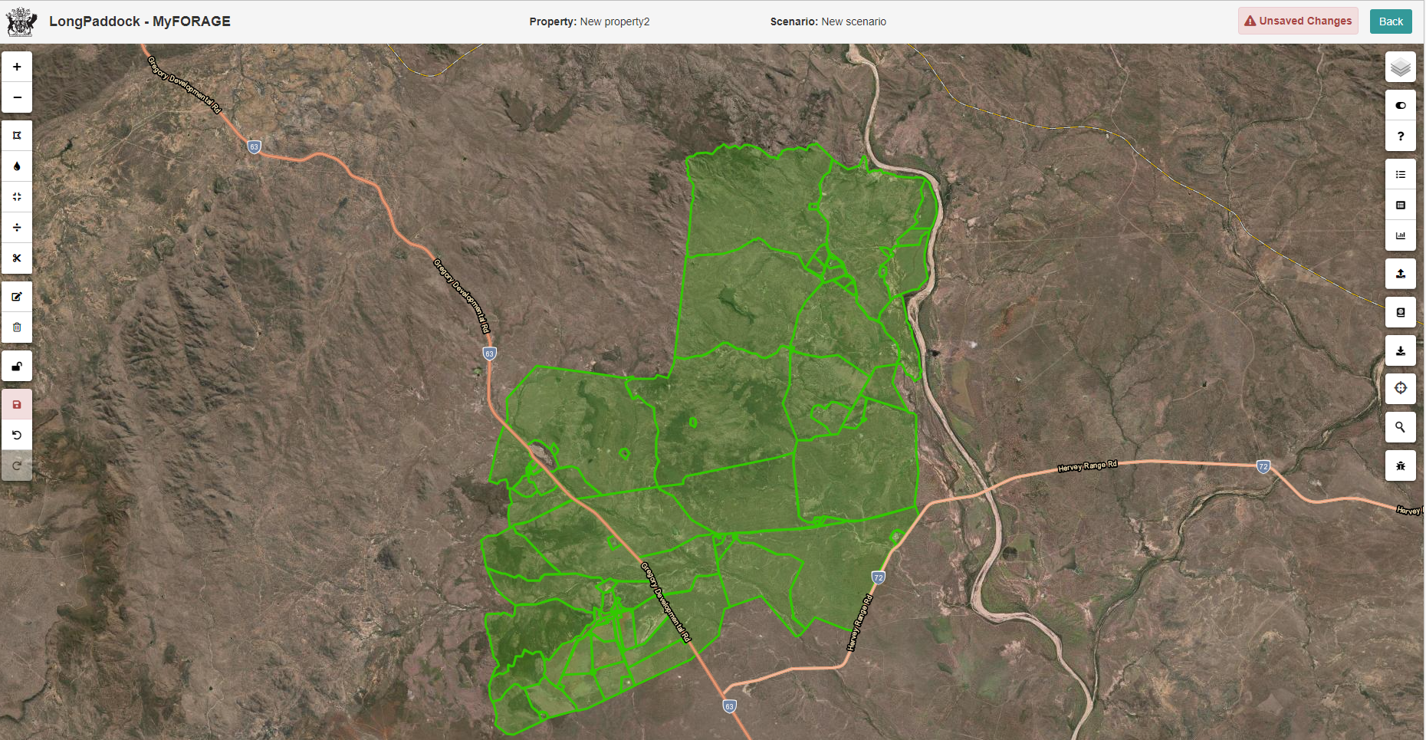
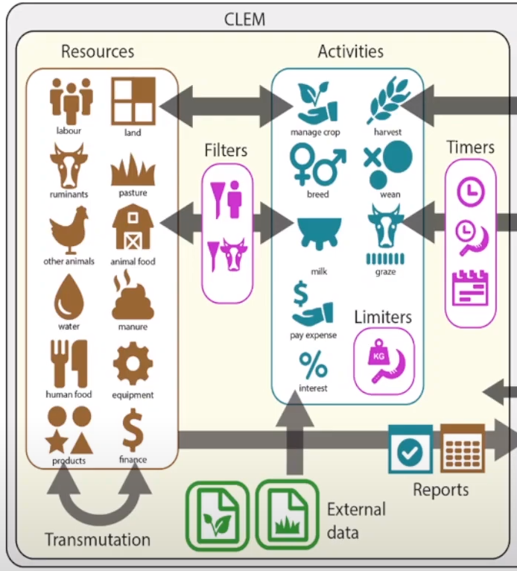
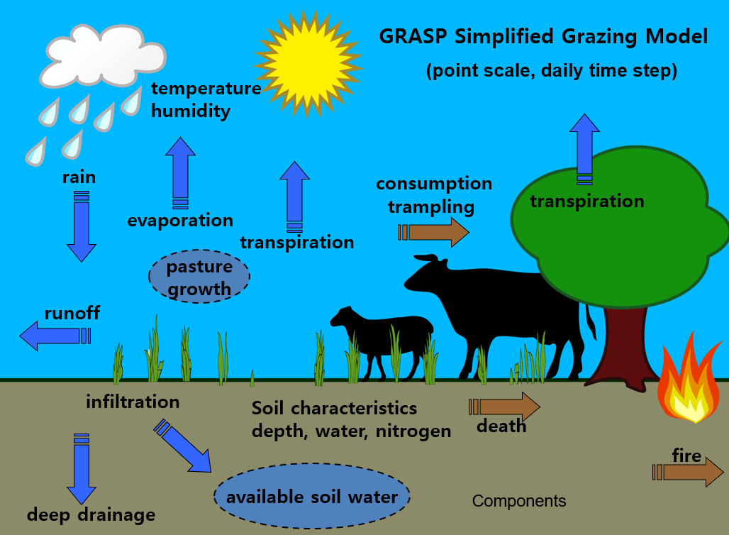


A new method of generating pasture input data for CLEM modelling
X. Zhang, J. Carter, G. Stone, B. Zhang, G. Fraser
QLD Department of Environment and Science
6. Farm economic analysis
process phase
1. Select property in MyFORAGE
5. User inputs data cube into CLEM
2. Set up GRASP pasture model
(Accounts for land types and woody vegetation)
Automated online system to run GRASP Pasture Model
Generates input data for CLEM Crop Livestock Enterprise Model (CSIRO)
Analyses property economics for
grazing enterprises
in Queensland
4. Large data cube generated for
input into CLEM
(Variables i.e. pasture growth (kg/ha) averaged for property FPC levels and land types/soils - converted to SQLite database cube)
3. Run GRASP model on High
Performance Computer
(Simulation outputs include-: 6 levels of grass basal area, 10 levels of land condition, and 23 levels of stocking rate)
4
This work is supported by: Drought and Climate Adaptation Program
Queensland Reef Water Quality Program

