Slide 1

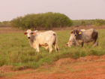

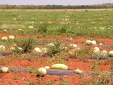
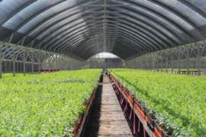
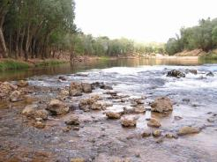

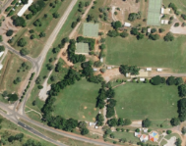
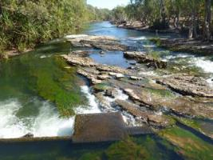

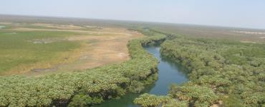

Water Resources Division, DENR
www.nt.gov.au

Slide 2
WRD – what we do
  Science for decision making
    Water Resource Monitoring
    Aquatic Health
    Water Resource Assessment
  Water resource management
    Policy and planning
    Licencing and compliance
www.nt.gov.au
Notes:
Overview of the division

Slide 3
Water Allocation Plans
Declared by the Minister under Section 22B of the Water Act.
Developed for water resources where there is competition for water resources and a need to establish additional water management arrangements to protect values
  Built on current legislation, policy and science
  Developed with advice from stakeholders who represent diverse interests
  Set clear, measurable and achievable objectives
  Identify uncertainty and risk but enable management decisions and provide investment certainty
  Enable continued learning through monitoring, evaluation and review
www.nt.gov.au

Slide 4
Regional Water Allocation Planning Snapshot
3 WAP areas
3 Water Advisory Committees
Declared
Tindall Katherine
In preparation
Oolloo
Tindall Mataranka – Daly Waters
Sept/Oct 2017
Aug 2019
Sept 2018

Slide 5
Key Discussions with Water Advisory Committees
Climate, Hydrogeology and Water Resource Assessment tools
Values of the aquifer – Environmental, Cultural, Economic
Current and future water uses
Sustainable Yield and Consumptive Pool
Promoting best use of water – trading water entitlements and ‘use it or lose it’
Enabling Aboriginal economic development – strategic water reserves
Monitoring and Evaluation
www.nt.gov.au

Slide 6
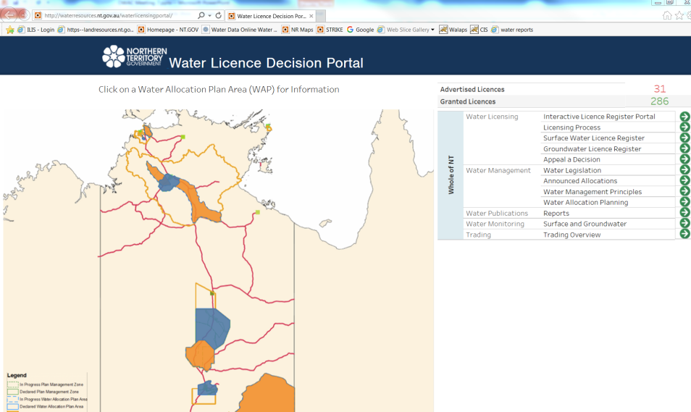
What else is new?
www.nt.gov.au

